Slide 1
Plymouth Ski & Snowboard Club
2025

Slide 2
Contact Information
Paul Pearson
Recreation Supervisor
763-509-5228
ppearson@plymouthmn.gov
Zach Swenson
Program Coordinator
763-509-5226
zswenson@plymouthmn.gov
Parks and Recreation General Line: 763-509-5200
Parks and Recreation Office hours: Mon – Fri 8:00am to 4:30pm

Slide 3
Trip Dates
Wayzata Middle Schools
1/10/25 – Wild Mountain – Central/West
1/17/25 – Trollhaugen – East/Central/West
1/31/25 – Powder Ridge – East/Central
2/7/25 – Wild Mountain – East/Central/West
2/13/25 – Trollhaugen – East/Central/West
2/21/25 – Wild Mountain – East/West
Wayzata High School
1/10/25 – Trollhaugen
1/17/25 – Wild Mountain
2/7/25 – Trollhaugen
2/13/25 – Afton Alps

Slide 4
Registration Information
Pre-Registration is required for all trips
Registration will open Wednesday, December 4th, 2024, at 6:00 a.m. online and 10:00 a.m. over the phone
  Lift ticket and transportation is $99 per participant.
  Registration must be received at the Parks & Recreation office by 4:30 pm on the Tuesday prior to that Friday’s trip.
  If a trip is full, you will be notified and placed on a waitlist.
*Please note any special needs (ex. ADHD, asthma, hearing impaired, medication, etc.) when registering and inclusion needs.

Slide 5
Equipment Rental
The cost for Ski or Snowboard rentals is an additional $28 fee added to your registration
Helmets are strongly recommended
Helmets are included with rentals
  $10 for the helmet only rental

Slide 6
Personal Ski and Snowboard Equipment
Ski or snowboard bags are required to protect your equipment during transit
Boldly Label & ID your bag (you want the bag to stand out)
  Colored tape or ribbon can be very helpful
Students are responsible for own equipment
We will have reserved tables for students to leave things by, there are also cubbies around the chalet
Students may leave school stuff or anything they do not need, on the bus. The bus will be locked
Notes:
We will help students locate lost items, but Plymouth Ski and Snowboard club is not responsible for lost, damaged, or stolen items

Slide 7
Equipment Storage at School
Each school will have a locked storage area to store equipment during the school day
Equipment must be dropped off before the start of the school day on that Friday
Below is the storage location for each school (office staff will assist students)
  WEMS – 107B (unused classroom)
  WCMS – Lower-Level C next to room C25
  WWMS – Lower-Level by Industrial Tech (ETD Storage)
  WHS – Athletic Entrance Storage (near greeter window)

Slide 8
Busing
Departure
Students meet at the school storage area following school dismissal to grab equipment
Each school has different pickup areas (next slides will show maps of each)
The busses will load at 4:15pm and will try to depart by 4:30pm
Return
Students must ride the bus home
The bus will return at the designated pick-up locations
Buses load at 9:15pm and will try to leave the ski area by 9:30pm
The building will be locked when we return, so transportation must be pre-arranged
Students are not allowed to walk home after trips

Slide 9
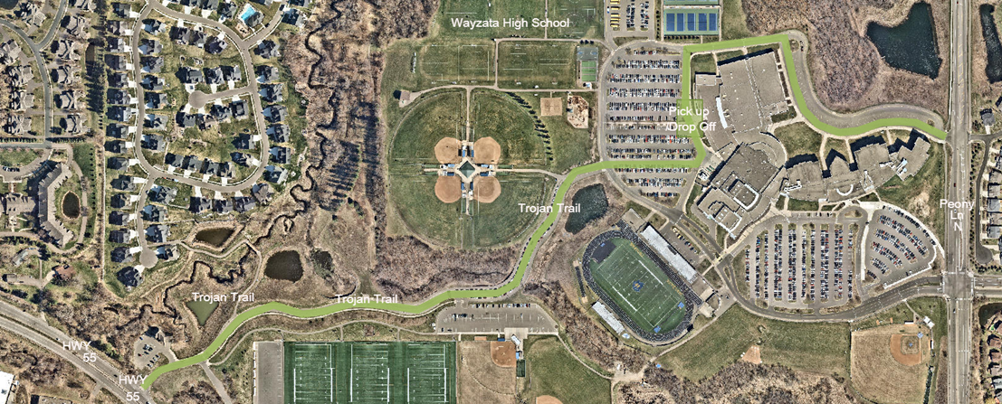
Wayzata High School Bus Route
Notes:
Are maps necessary

Slide 10
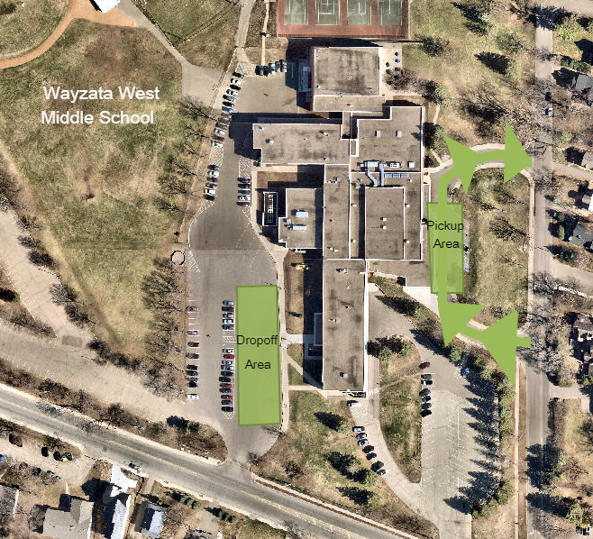
Wayzata West Middle School Bus Route

Slide 11
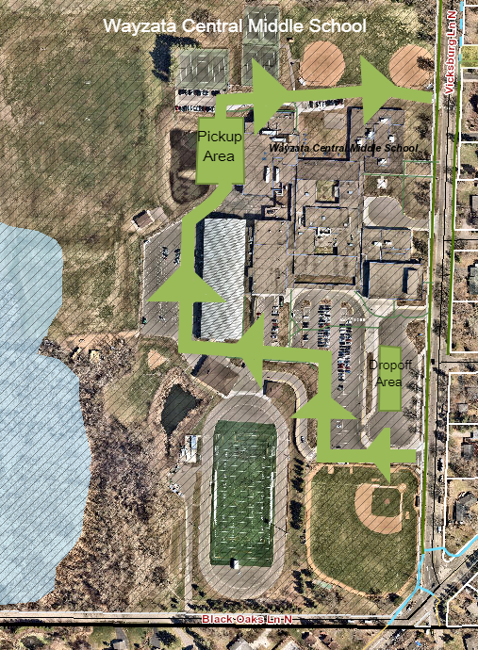
Wayzata Central Middle School Bus Route

Slide 12
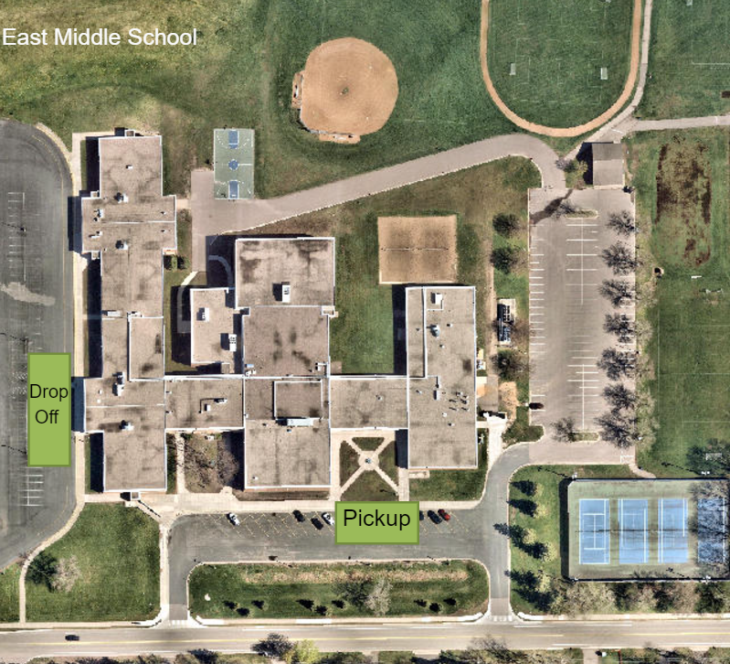
Wayzata East Middle School Bus Route

Slide 13
Emergency Procedures
In the event of an injury, the area ski patrol will provide immediate first aid and the ski area’s emergency procedures will be followed
Staff will be present with student and will notify parents
Guardians are responsible for student once transported by emergency management
If injury is not severe – guardians may come pick student up or they can ride back on the bus

Slide 14
Withdrawal Policy
Withdrawal requests must be made at least one full week prior to the trip
Withdrawals are accepted by calling 763-509-5200 or emailing recreation@plymouthmn.gov
A $10 service fee is retained on each withdrawal/refund request
There are no refunds for missed trips or for withdrawals after the stated full week policy

Slide 15
Cancellation/Weather Policy
A trip may be cancelled due to insufficient enrollment or if the wind-chill is 15 degrees below zero (based on the National Weather Service wind-chill formula)
Weather decisions are made on Friday based upon the forecast for the trip location and on transportation considerations
If a trip is cancelled, a notice will be posted on the Parks & Recreation weather line 763-509-5205 and an email will be sent out to participants
Full refunds will be issued if the trip is cancelled by Parks & Recreation

Slide 16
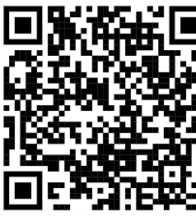
Volunteer Chaperones
Adult volunteer chaperones are wanted
Chaperones receive free lift ticket and rental.
Volunteer application can be found on Ski Club website or use the QR Code above

Slide 17
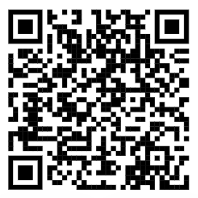
Waiver Information
Completion of the waiver needs to occur once per season
The waiver is valid for the season at all ski hills
Students will not be able to participate until the waiver is completed

Slide 18
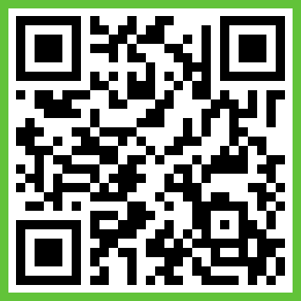
Band App
Communicate bus departures
When we are returning to the schools/when you should be ready to pick your child up
Can be used to ask your questions
Often post any found items that were lost

Slide 19

Questions

