Slide 1
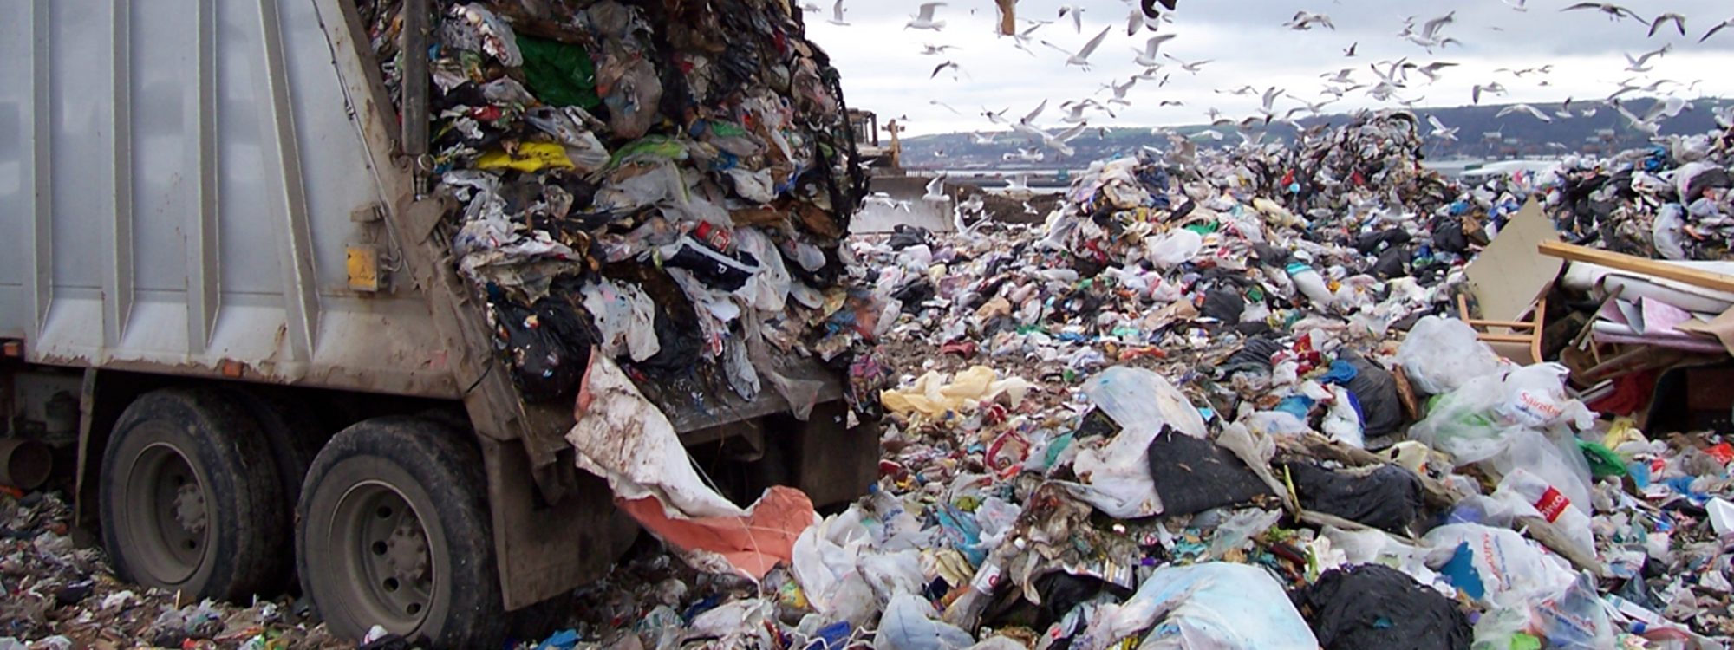
Solid Waste Management Overview
Carolyn Collopy, Waste Reduction and Recycling Unit

Slide 2
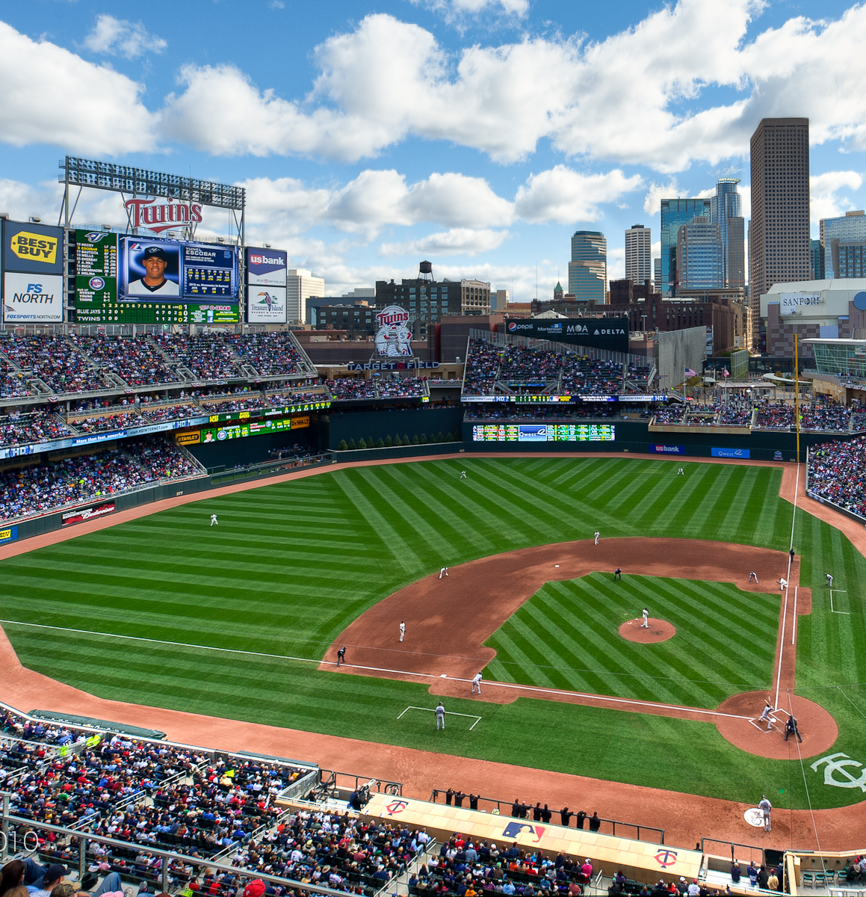
Hennepin County waste generation
About 1.3 million tons of municipal solid waste were generated in 2021.
Add up all the waste created in the county in a year and it’s enough to fill Target Field more than 11 times.
Residents and businesses recycled and composted 39% of the total waste generated

Slide 3
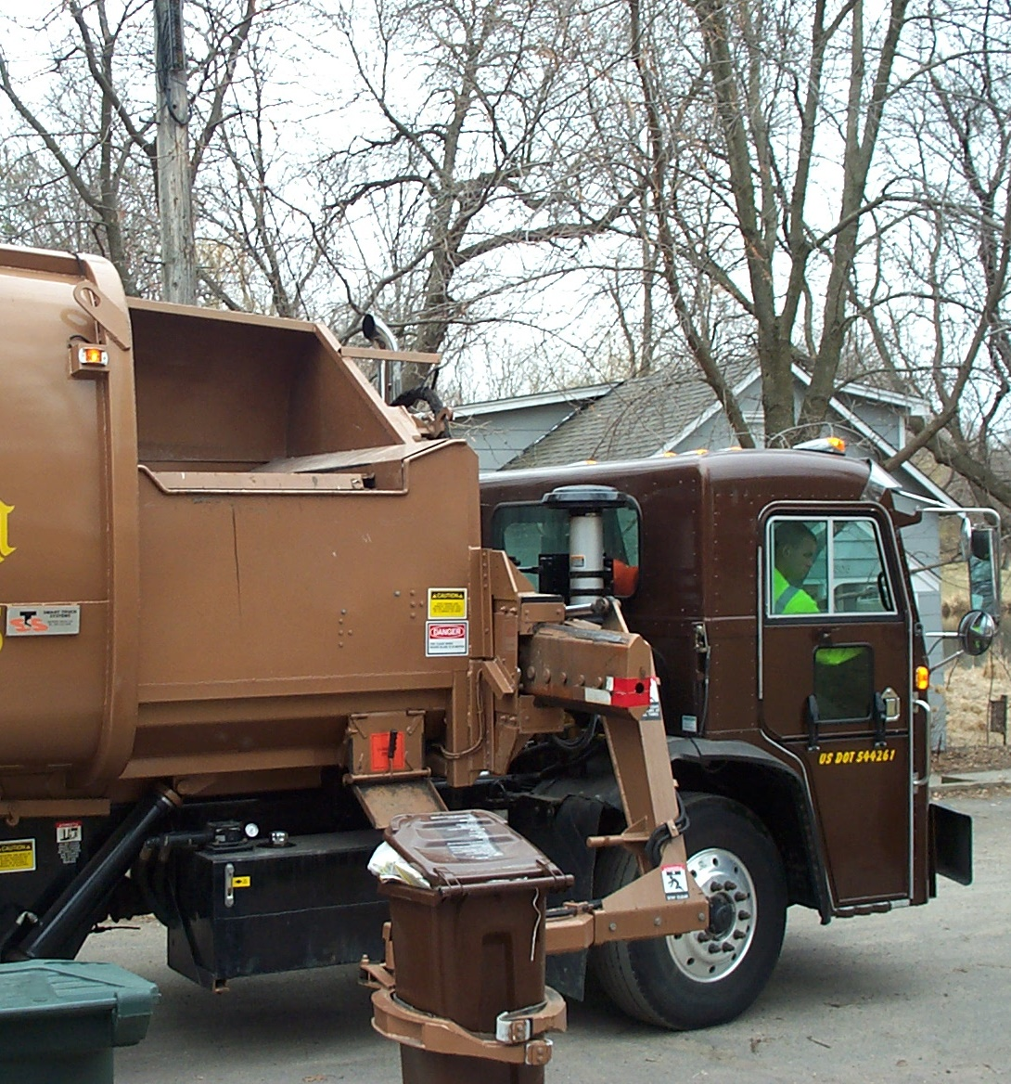
How is waste collected?
Open hauling collection
  Customer chooses hauler
  Many haulers compete in geographic area
  Includes all commercial (recycling, trash, organics), most multifamily (trash, recycling, organics) , and some residential collection (trash, recycling, organics)
Organized collection
  City contracts with hauler on customer’s behalf
  Only one hauler in geographic area
  Mostly limited to residential collection programs (trash, recycling, organics)

Slide 4
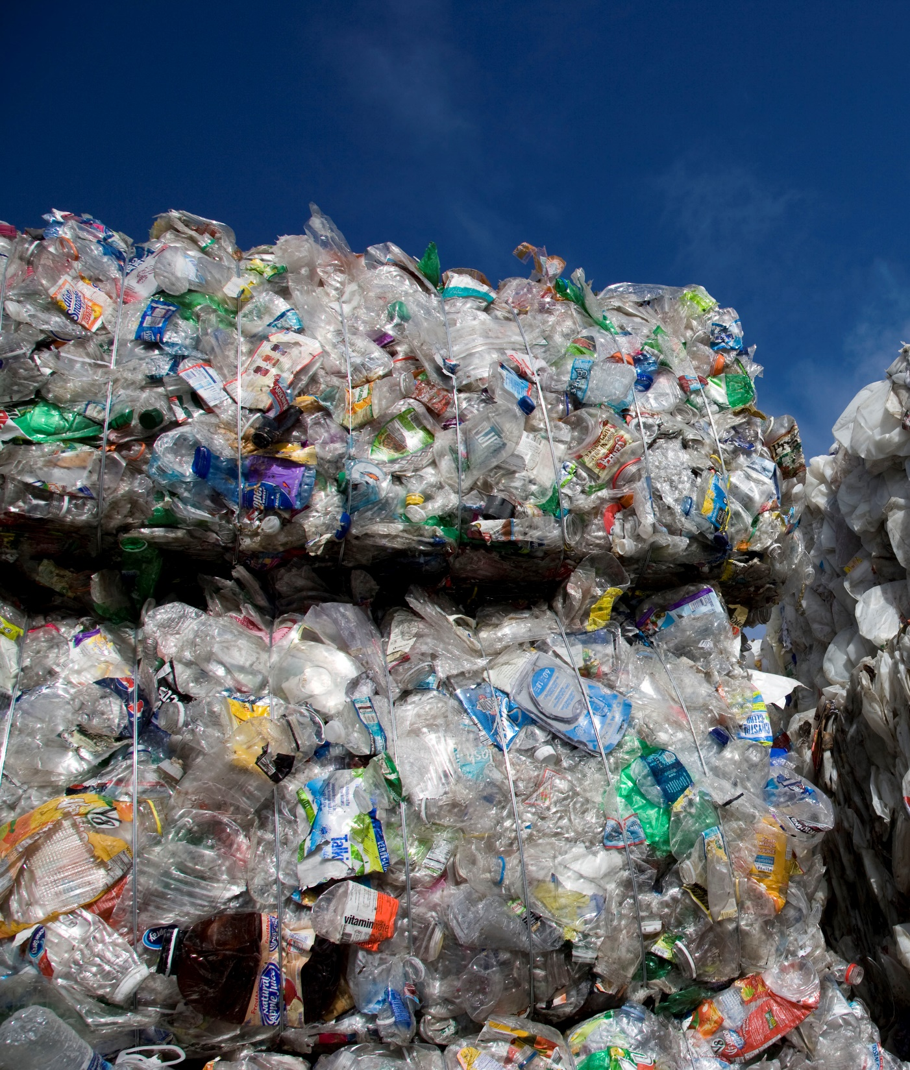
Where does it go - Recycling
8 material recovery facilities (MRFS) in metro, all privately owned
About 80% of the materials are processed in the region
MN recycling markets include West Rock and Pioneer (paper and cardboard), Master Mark and Choice Plastics (#2 HDPE plastic) and Anchor Glass
Most of the cost associated with recycling is collection
Cost to process recyclables (sorting into material streams) is $70-110/ton

Slide 5
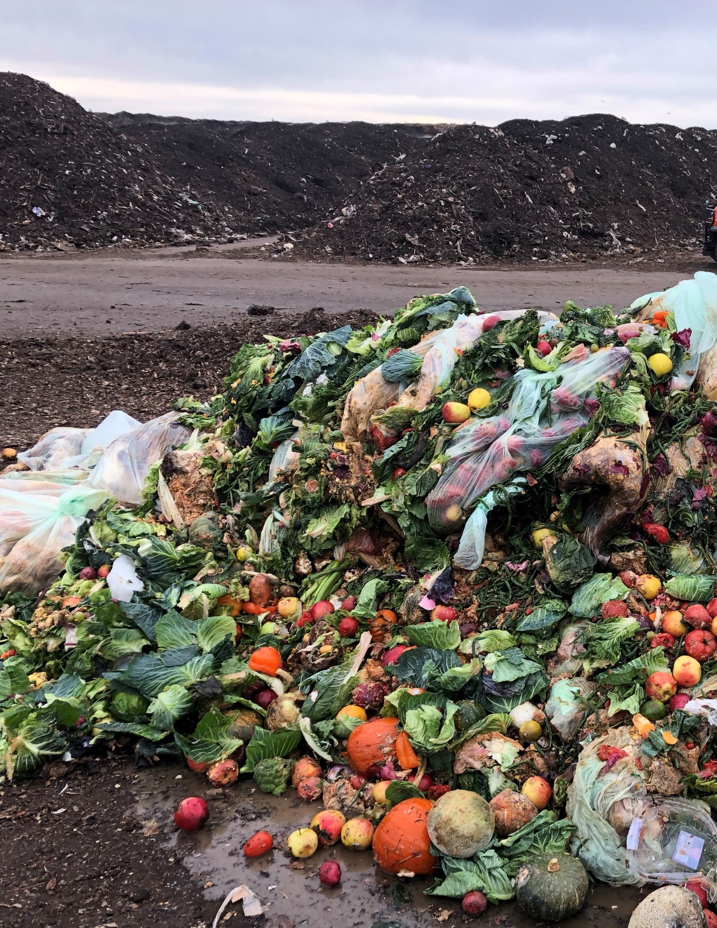
Where does it go – Organics
Food rescue organizations collect for redistribution to people
Commercial programs send material to farms and processors for animal feed or to compost facilities
Residential programs send to compost facilities
2 compost facilities in metro
Brooklyn Park Transfer Station (BPTS) subsidized rate $35/ton
Cost to process organics into compost $40-60/ton

Slide 6
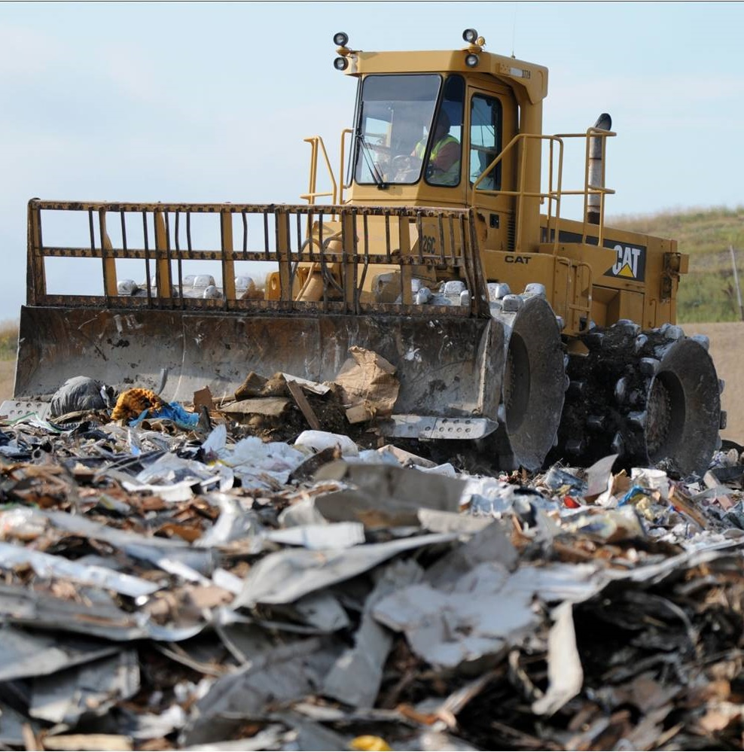
Where does it go – Trash
Hauled direct or to transfer stations which haul in 20 ton loads to:
  Waste to energy - Hennepin Energy Recovery Center (HERC)
  6 landfills (2 in WI), most goes to 2 sites in Dakota County
Cost of disposal $66/ton

Slide 7
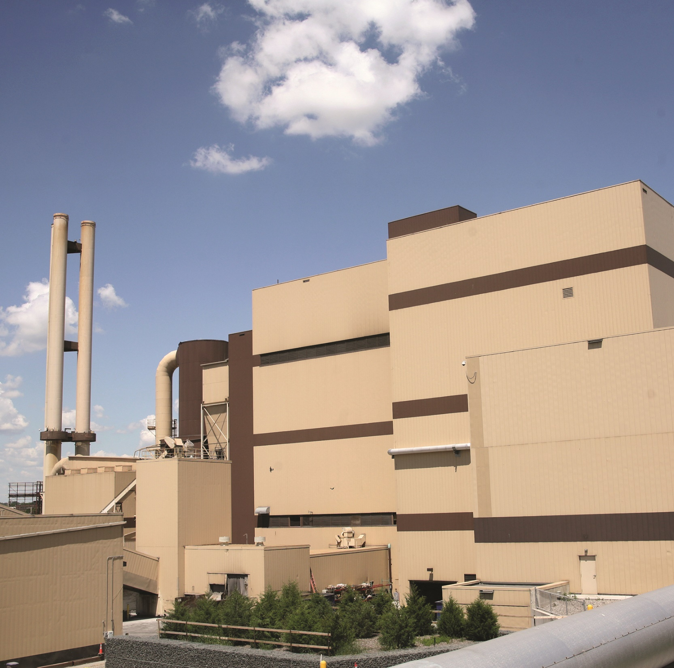
Where does it go – County-owned Facilities
Brooklyn Park Transfer Station
South Hennepin Bloomington
HERC
Anaerobic Digestion (AD) (in the works)

Slide 8
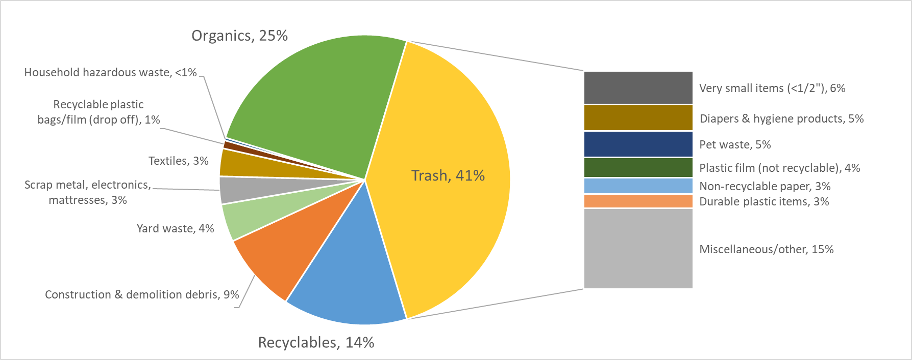
What’s in our trash?

Slide 9
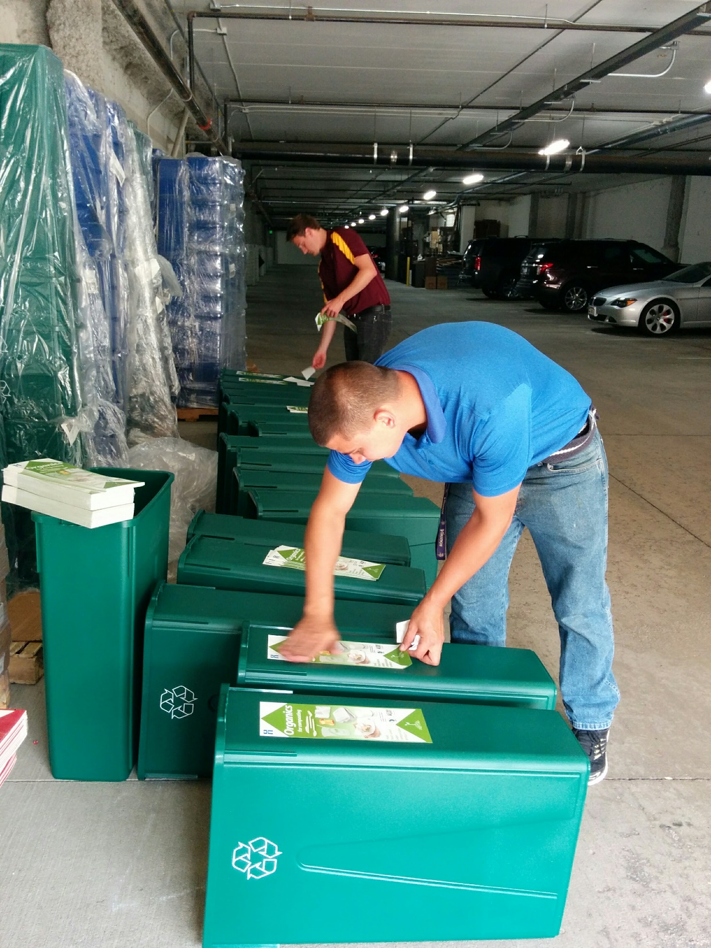
Waste Management Tools - Incentives
Subsidized rate for organics
Taxes and fees on trash
Grants to cities, businesses, multifamily properties, homeowners and schools
  Containers
  Waste prevention projects
  Organics drop-off sites
  Food rescue
  Building deconstruction

Slide 10
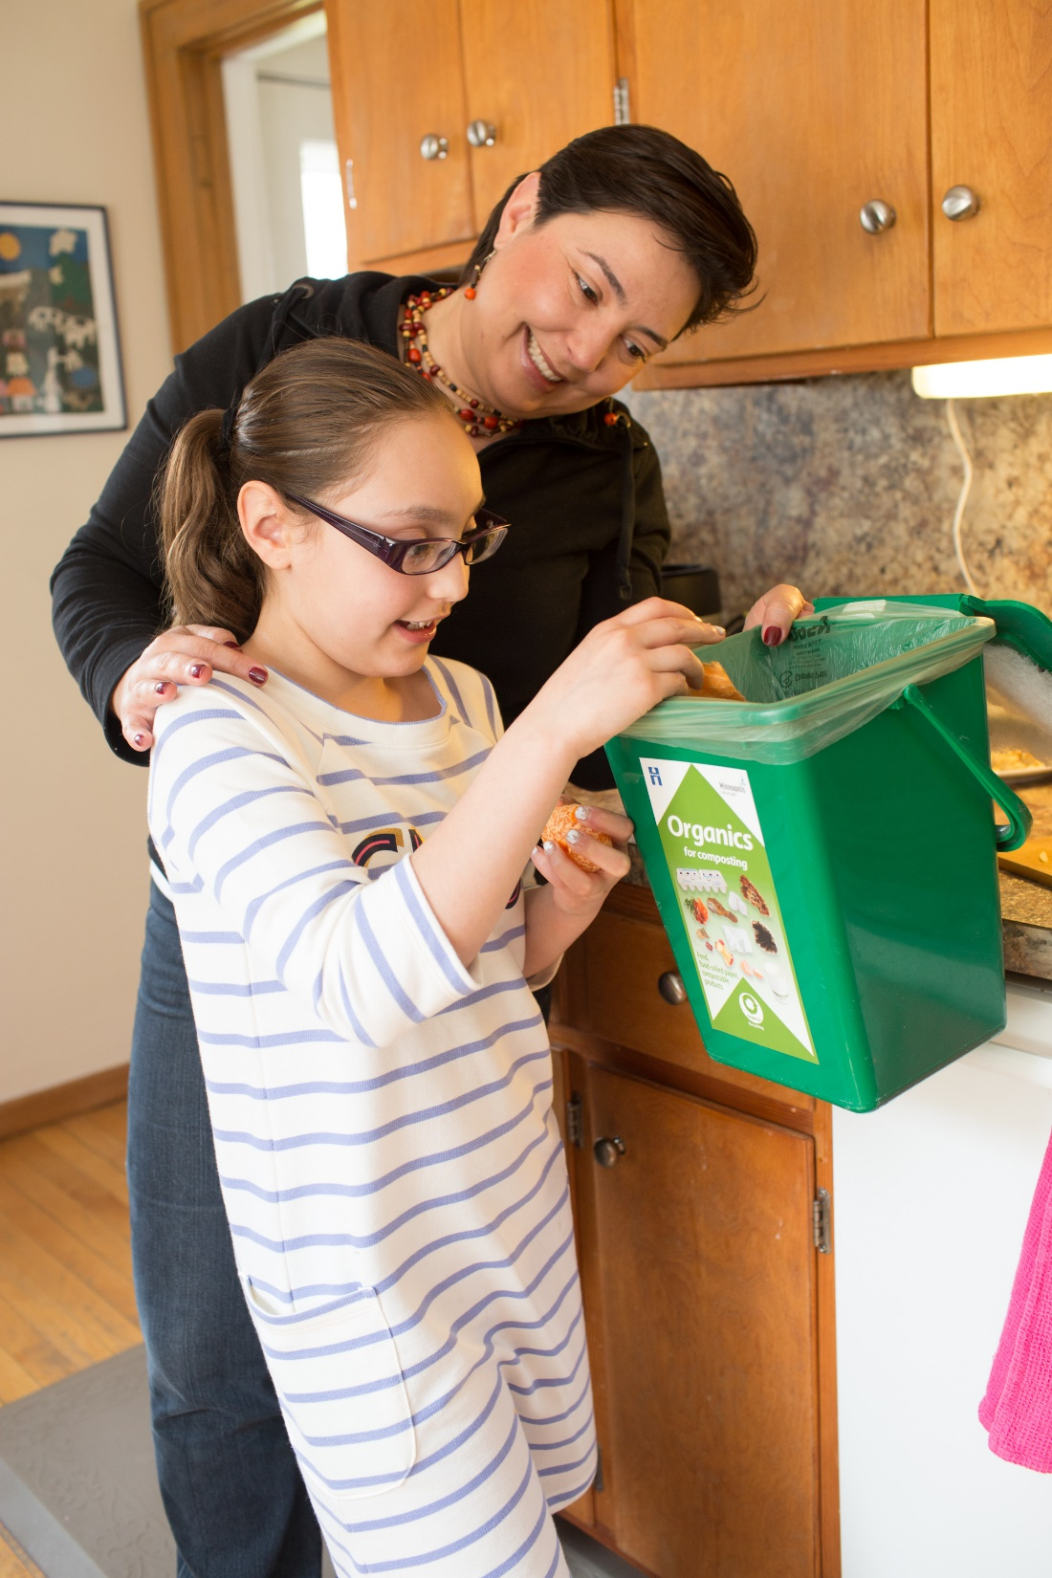
Waste Management Tools - Policy
State requirements – waste hierarchy, management plans and diversion goal for metro counties – 75% by 2030
County requirements – Recycling ordinance 13, licensing
City requirements – multifamily recycling, packaging ordinances, licensing
Product stewardship and extended producer responsibility (EPR) – problem materials like batteries, electronics, & paint, packaging

Slide 11
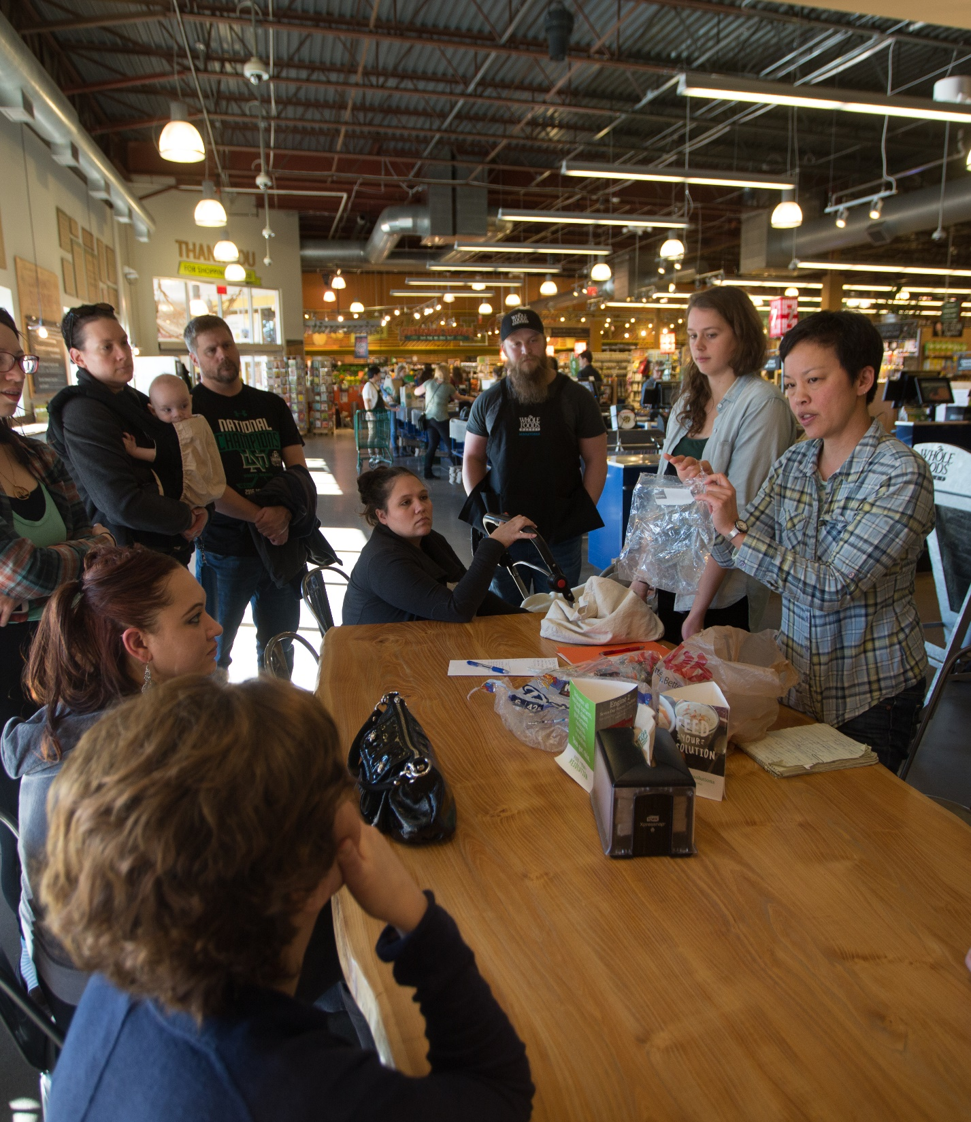
Waste Management Tools - Education
Residential programs – zero waste, plastic-free and food waste challenges, Master Recycler/Composter, Choose to Reuse, Fix-it Clinics
Community partnerships – Green Partners Env. Education Program
School recycling program
Education campaigns and materials

Slide 12
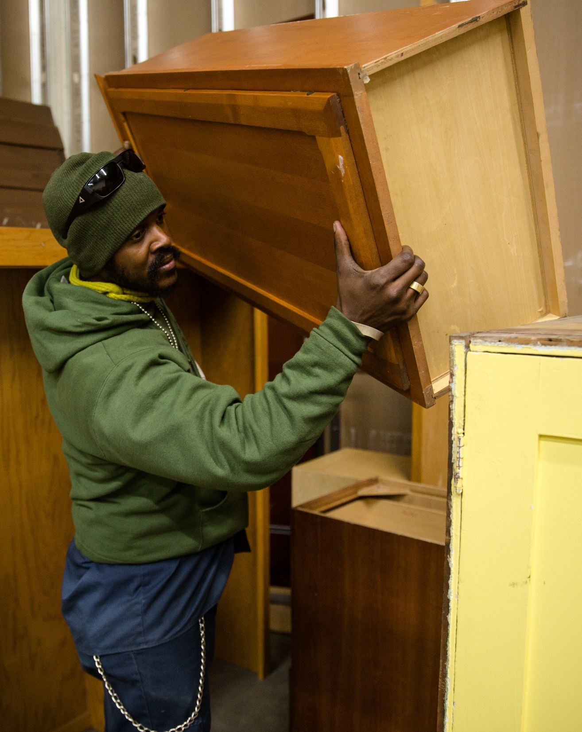
Waste Management Tools - Investments in Market Development & Infrastructure
SCORE funds – residential recycling & organics
Organics recycling – subsidized rate, anerobic digestion (AD) facility
Mattress recycling – workforce and market development
Food waste prevention - research, grants
Reuse & Repair – retailer support, Fix-it Clinics
Deconstruction - workforce development

Slide 13
Develop an operational plan to map
Hennepin County to a zero-waste future
Review of the existing waste management system and the programs and policies that influence it
Robust engagement process of stakeholders and the community
Identification of strategies that will accelerate Hennepin County’s path to zero waste
Draft zero-waste plan presented at board briefing Nov. 2022

Slide 14
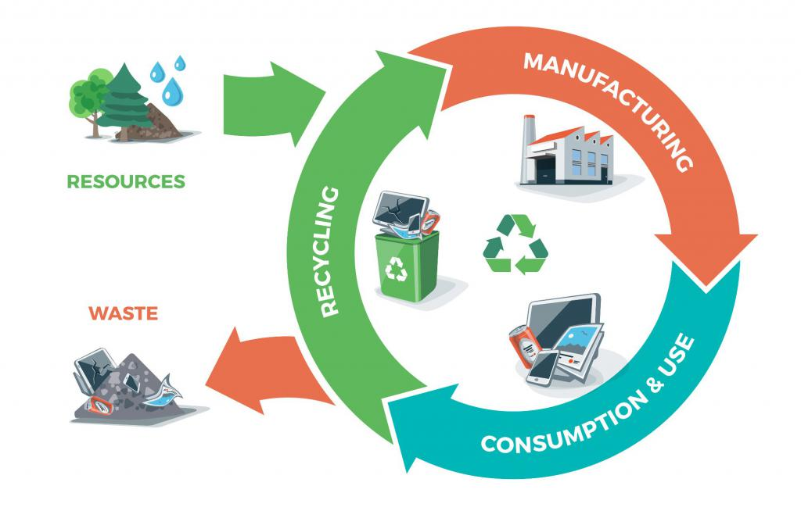
What is zero-waste?
A system where all materials are designed to become resources for others to use, with a key performance measure of diverting 90% or more of all discarded materials from landfills and incinerators.

Slide 15

Using a race equity impact tool to ensure the Zero Waste Plan:
Clearly define the plan’s goals, objectives and measurable outcomes
Engage the community in the decision-making process
Consider who benefits and who is burdened by the plan’s strategies
Examine potential unintended consequences of implementing the plan and develop strategies to advance racial equity and mitigate those unintended negative consequences
Design strategies that are informed by data and driven by the community with maximum impact
Develop mechanisms to track and report on progress/impact for transparency and accountability

Slide 16
Zero-waste plan development approach
Solid waste consultant - national firm with significant solid waste management policy and planning expertise
Facilitation consultant – local consultant with expertise in facilitation and expertise on inclusive engagement techniques and establishing relationships with diverse communities
Cohort of 18 community groups with long-standing relationships with under-represented communities in Hennepin County to conduct engagement

Slide 17
Key steps and timeline to Zero Waste Plan
Phase 1
Listen and Learn
Phase 2
Draft actions
Phase 3
Review
Phase 4
Finalize plan
Jan – May 2022
June - Sept
2022
Oct – Feb
2023
March
2023

Slide 18

We can’t recycle our way out of this, getting to zero waste will require transformative changes in the policies, programs and resources that make up the solid waste system and significant shifts in who benefits from the system.

