Slide 1
Rain Gardens: What, Why, How
By: Trey Albertini

Slide 2
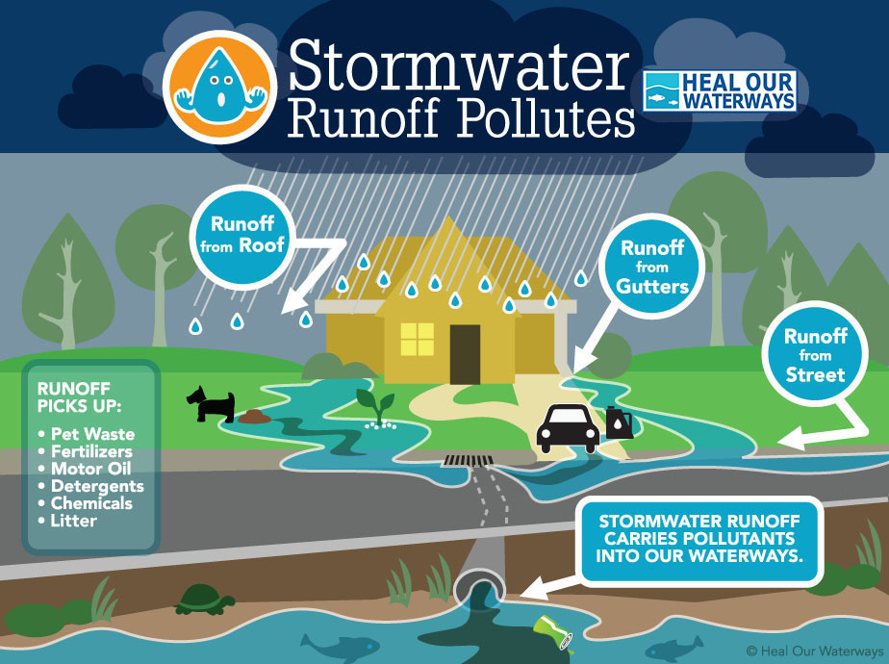
Water Runoff

Slide 3
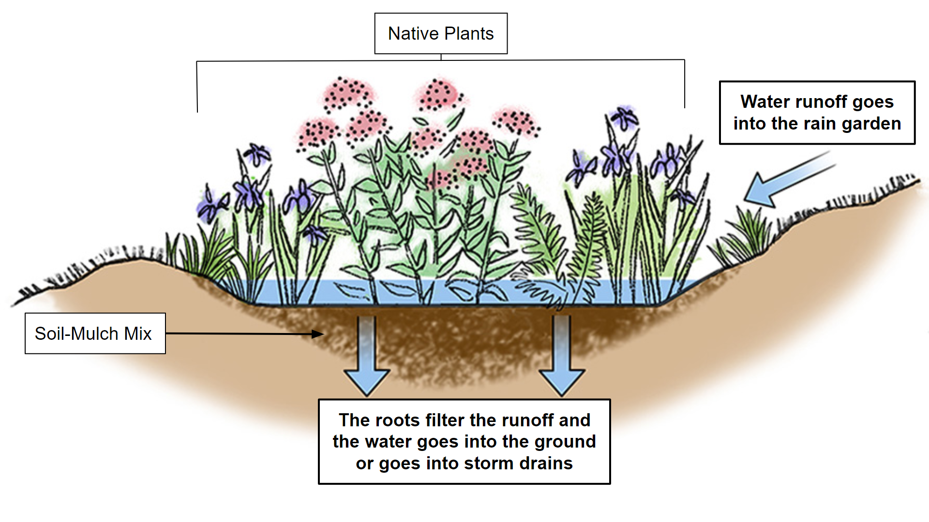
Rain Gardens: How they work

Slide 4

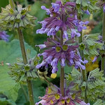
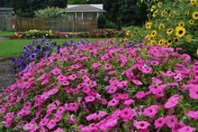
Why Native Plants?
Easier to grow
Promote the pollination of native plants

Slide 5
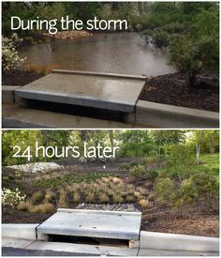
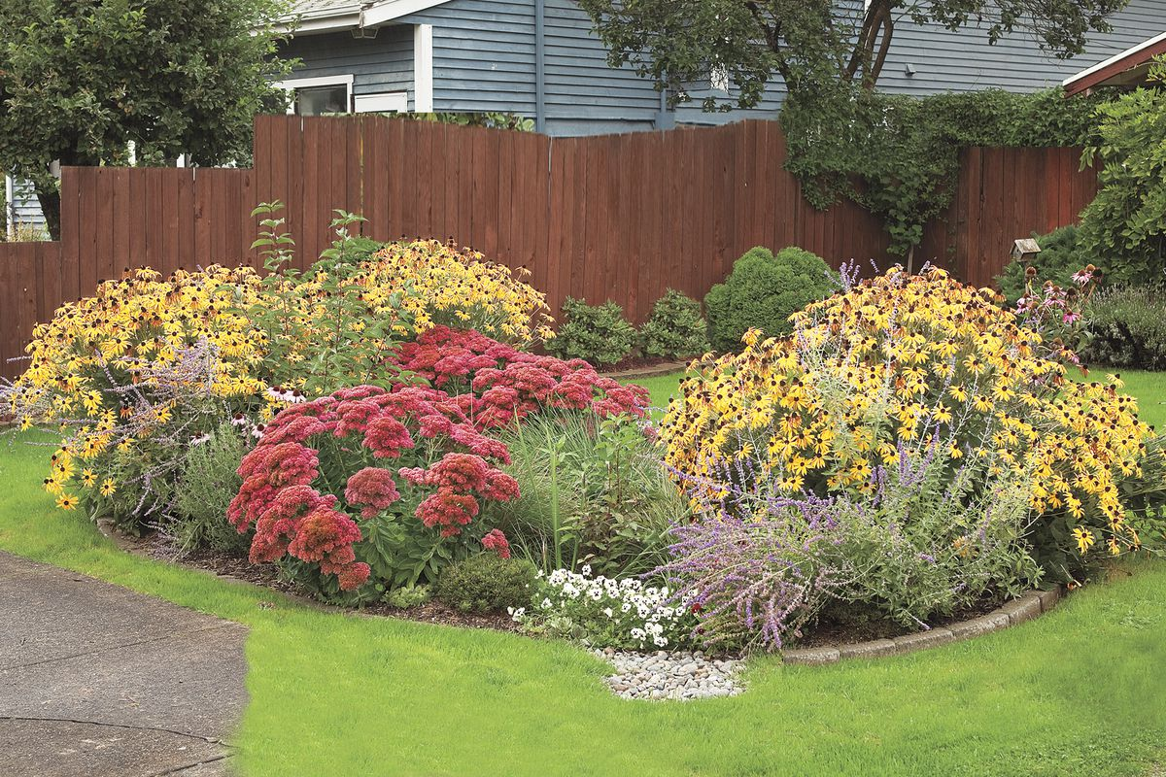
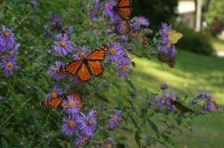
Benefits
Filters water
New habitats
Low maintenance
Looks great

Slide 6
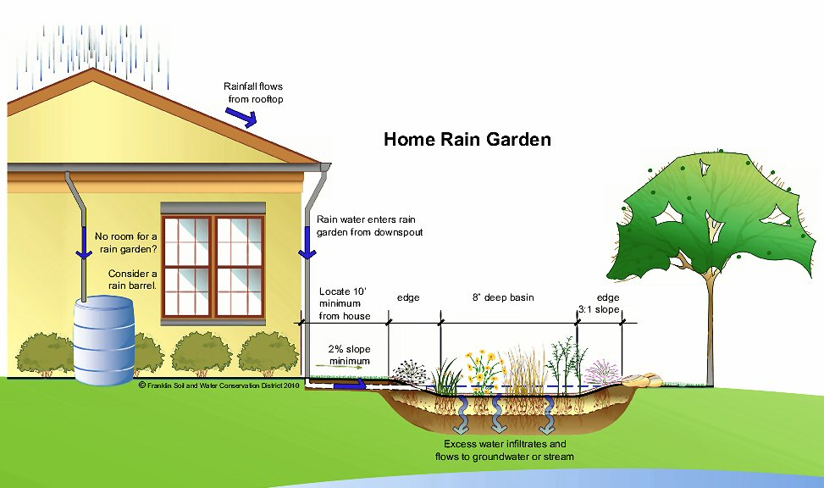
Planning Your Rain Garden

Slide 7
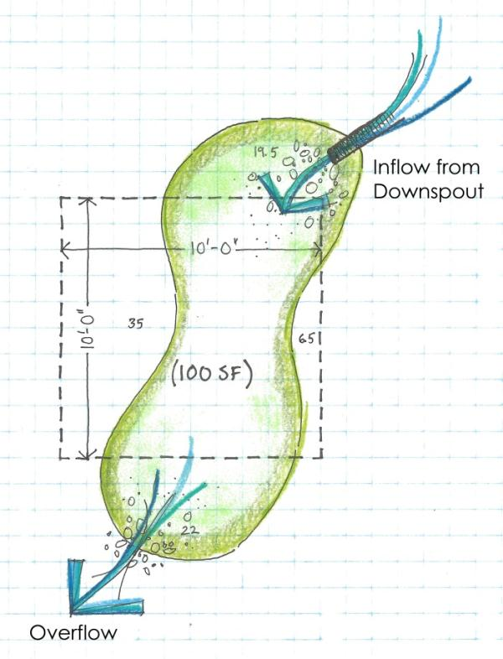
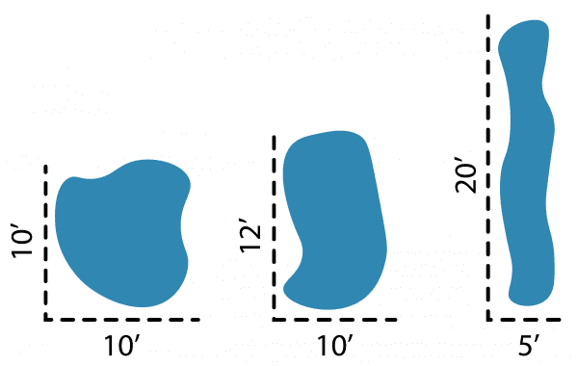
Size and Shape
RULE: Water should be entering in the long side

Slide 8
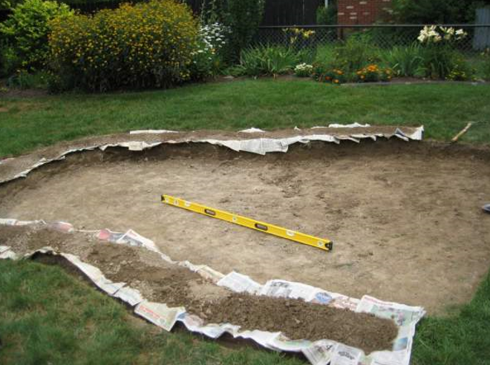
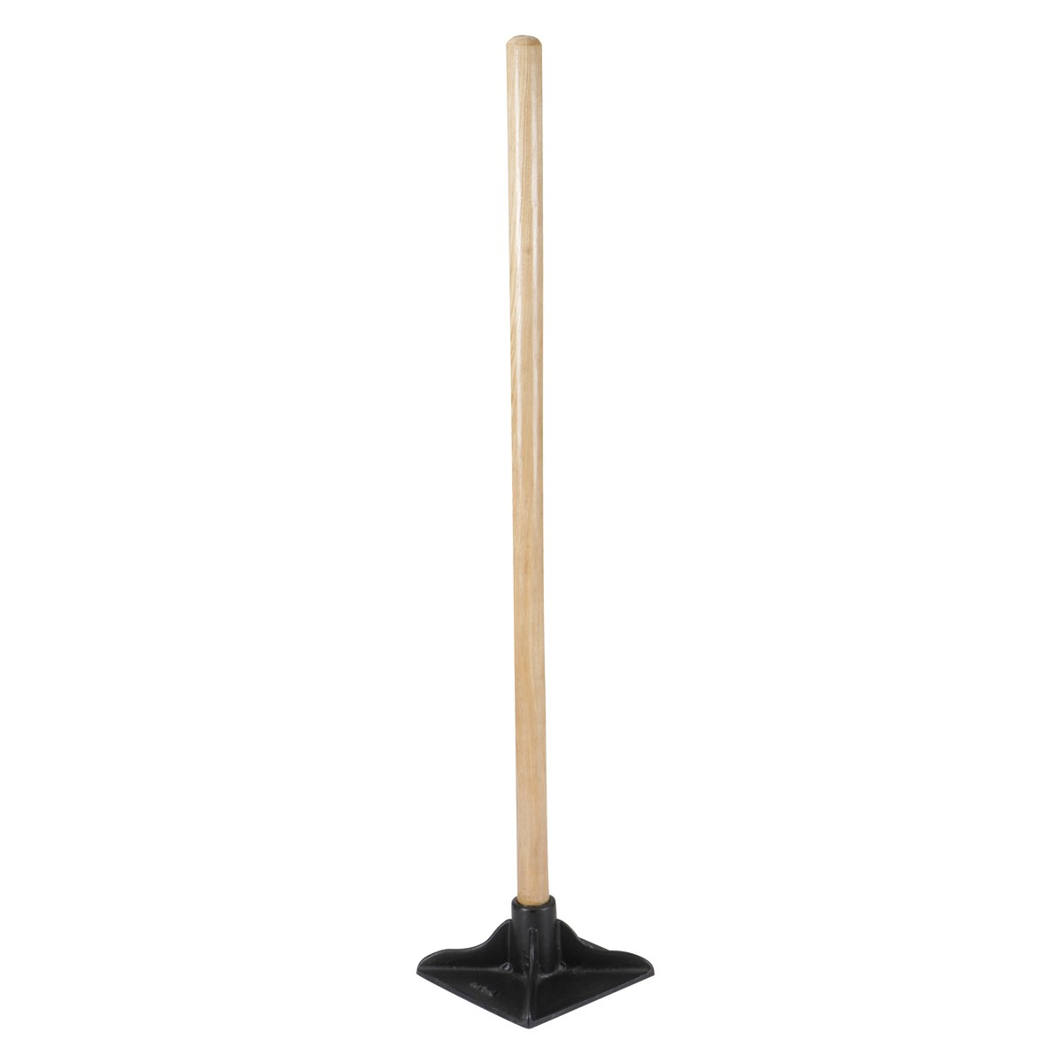
Time to Dig!

Slide 9
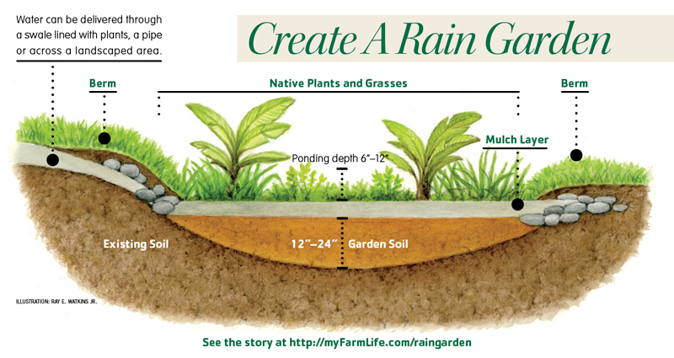
Create a Berm

Slide 10
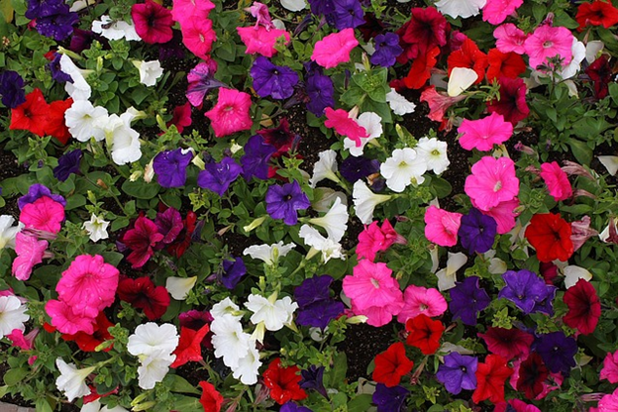
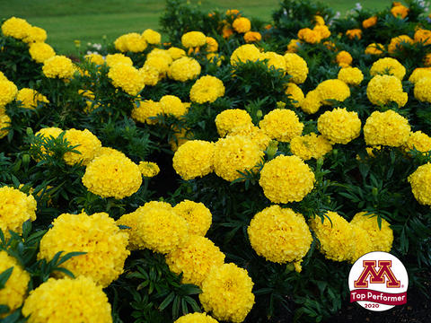
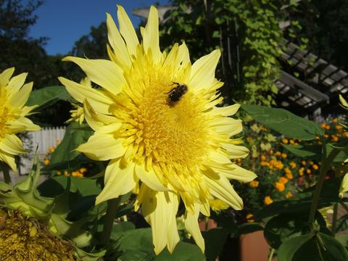
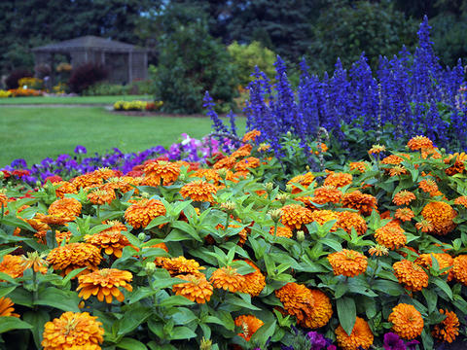
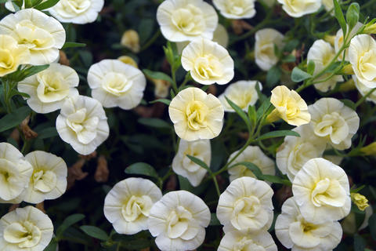
Flowers!

Slide 11
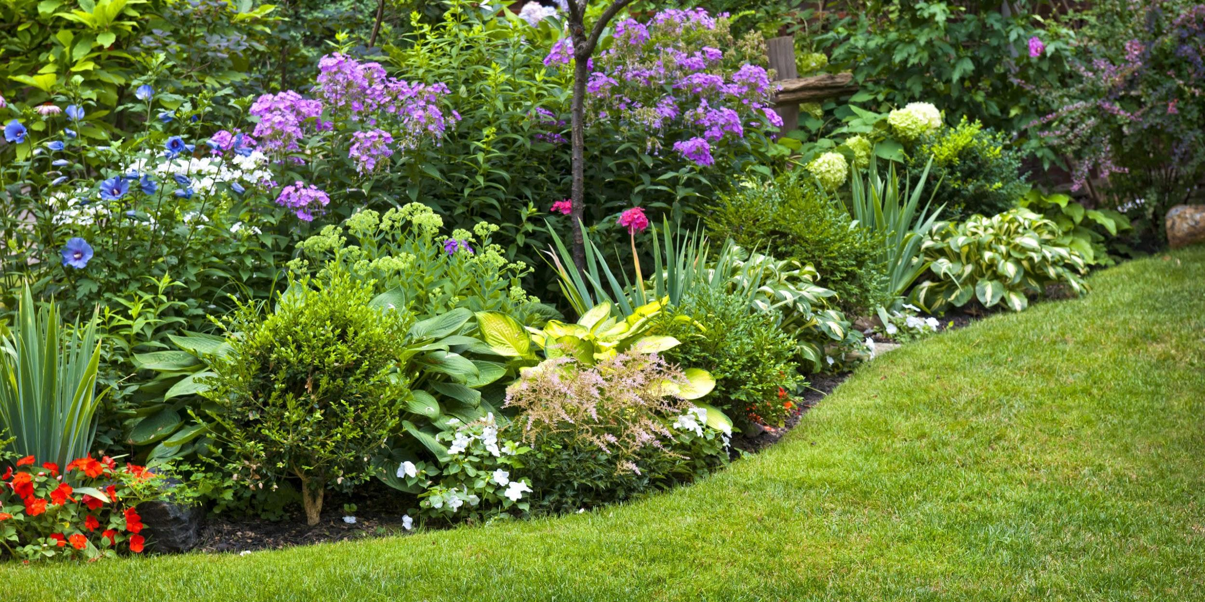
Congratulations!
You now have your very
own rain garden!

Slide 12
Questions?

Slide 13
Thank You for Listening
List of native plants: UMN Native Plants Another How To Guide: Minnehaha Landscaping
https://extension.umn.edu/find-plants/native-plants https://minnehahafallslandscape.com/blog/rain-gardens/
List of trusted native plant vendors: Rain Garden Soil (25% manure, 75% local wood mulch)
South Cedar - https://southcedar.com/ Kernland Landscaping - https://www.kernlandscaping.com/products
Outback Nursery - http://www.outbacknursery.com/
Landscape Alternatives - http://www.landscapealternatives.com/
How to apply for a cost-share funding for up to $350 to plant a pollinator garden (rain garden with native flowering plants)
Lawns to Legumes - https://bluethumb.org/lawns-to-legumes/apply/

