Slide 1

Palmer Creek Drainage
Improvement Project
WR-220001

Slide 2
Project Team
City of Plymouth
  Ben Scharenbroich, Water Resources Supervisor
    bscharenbroich@plymouthmn.gov
Design Consultant, Stantec
  Chris Meehan, PE
  Rena Weis, PE

Slide 3
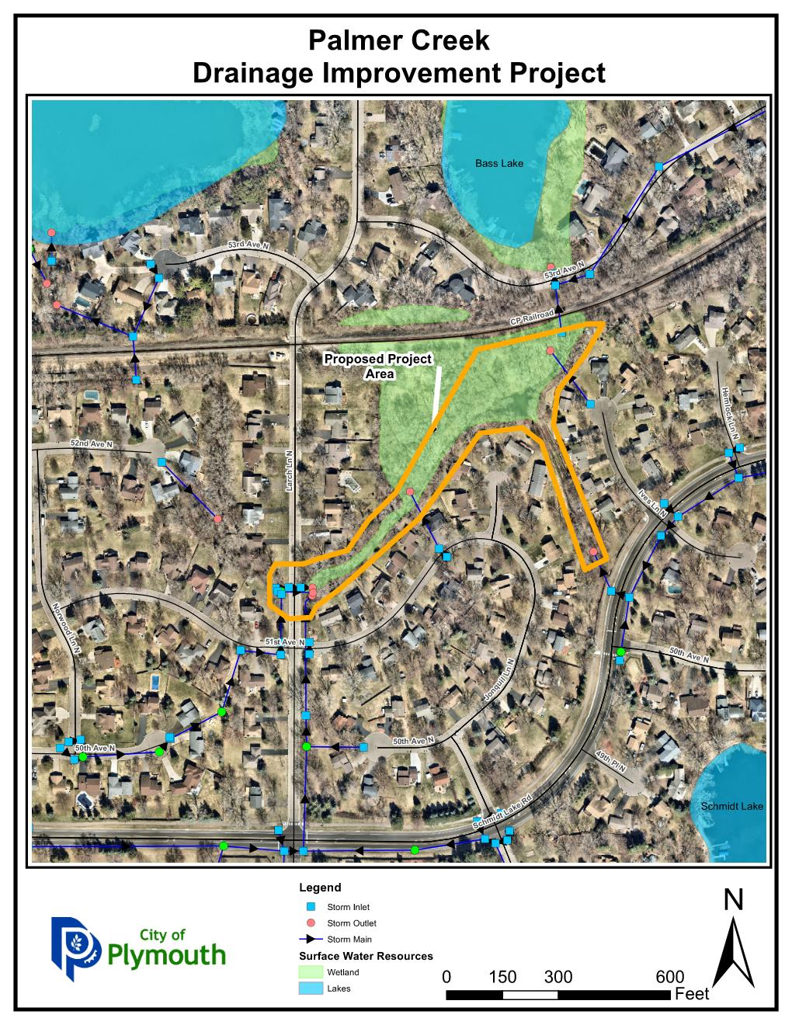
Maple Grove
Plymouth

Slide 4
Project Timeline
Phase | Time
Initial Watershed Presentation | August 2022
Resident Meeting | August 29, 2022
Engineering Final Design | Fall 2022
Contractor Bidding | Fall 2022
Possible Construction | Winter 2022/2023

Slide 5
Identified Potential Improvements
  Repair streambank erosion
    Vegetated rip rap
  Storm Sewer Infrastructure Repair
  Sediment Dredging
    Address Water quality
    Address Bank Erosion
    Removal of sediment and debris
  Rip Rap Check Dam Installation
  Tree Removals
    Evaluated Diseased & Hazardous Trees
    Identify those Impacting flow
    Identify those potentially impacted by bank erosion improvements areas
Notes:
This development was constructed before many of the current storm water management best practices were utilized. Recent stormwater modeling has identified the potential that some properties have higher flood risk than others, but tangible flood risk reduction cannot be had without significantly impacting the nature of the neighborhood.
With the entirty of the design, Barr will model the improvements to ensure no adverse impacts are pushed to properties.

Slide 6
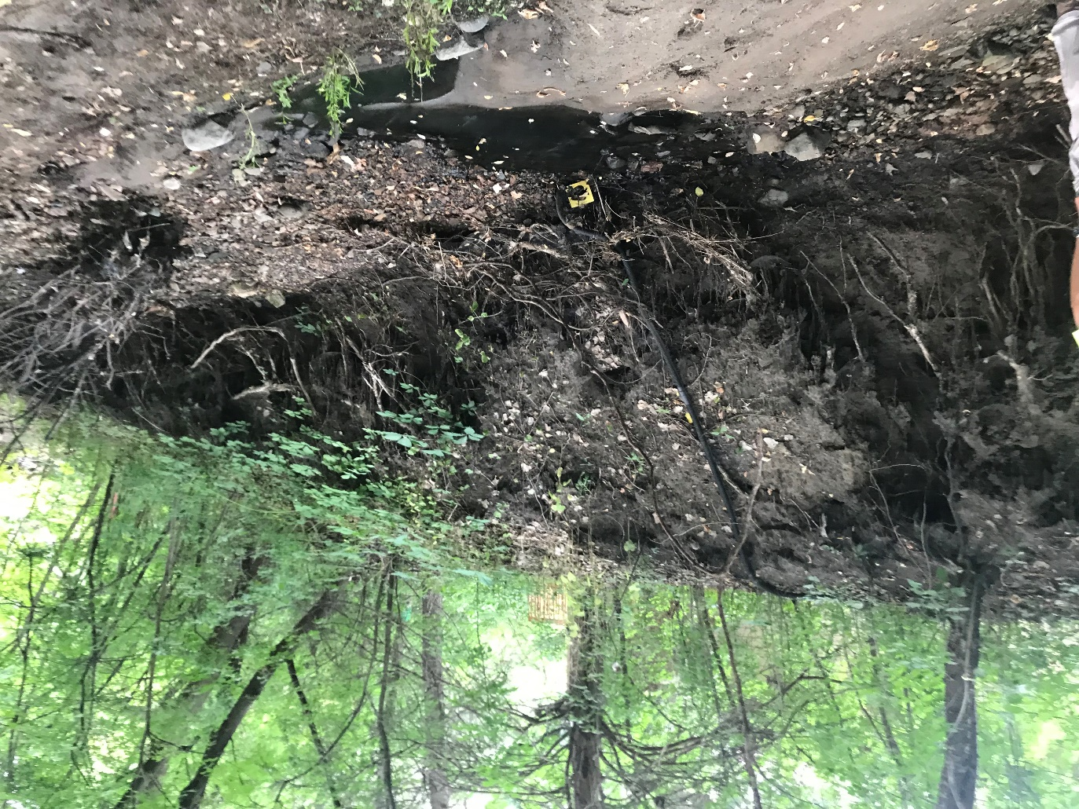
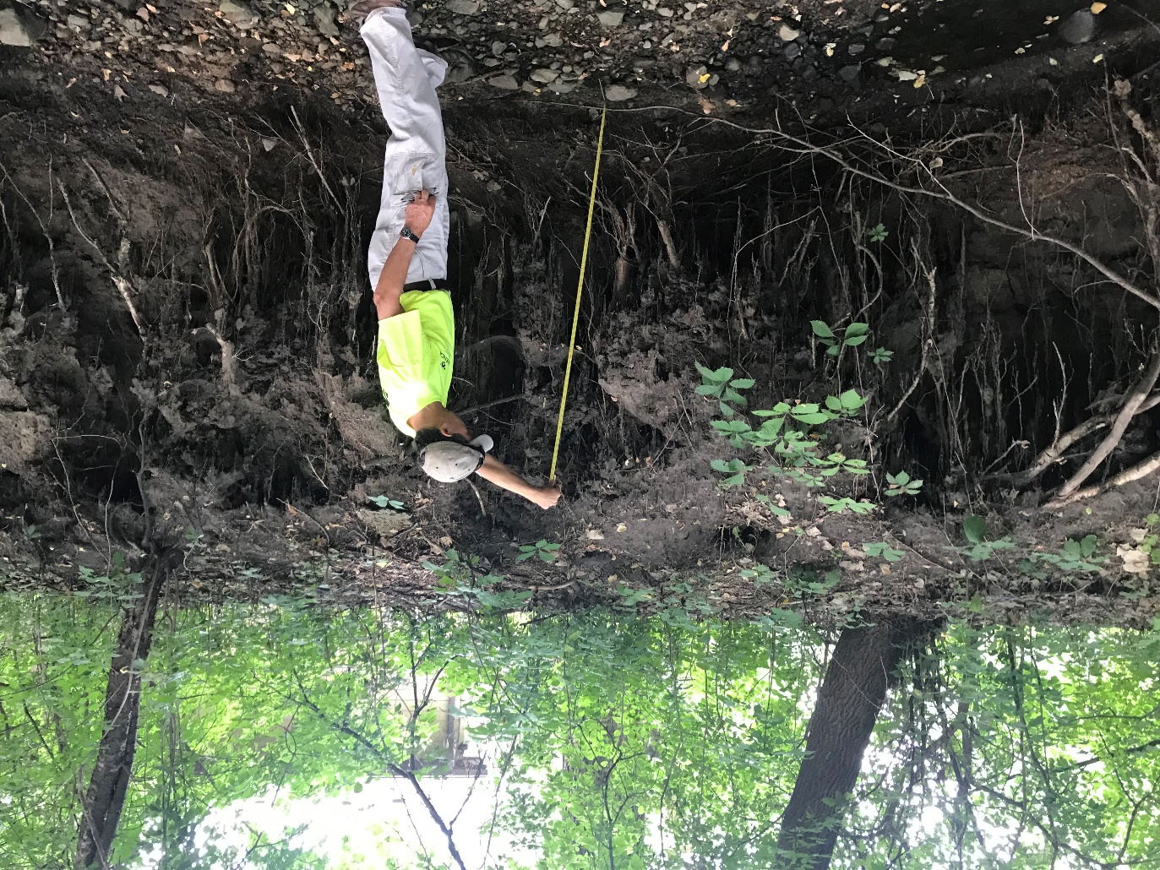
Current Conditions Eroding Banks

Slide 7
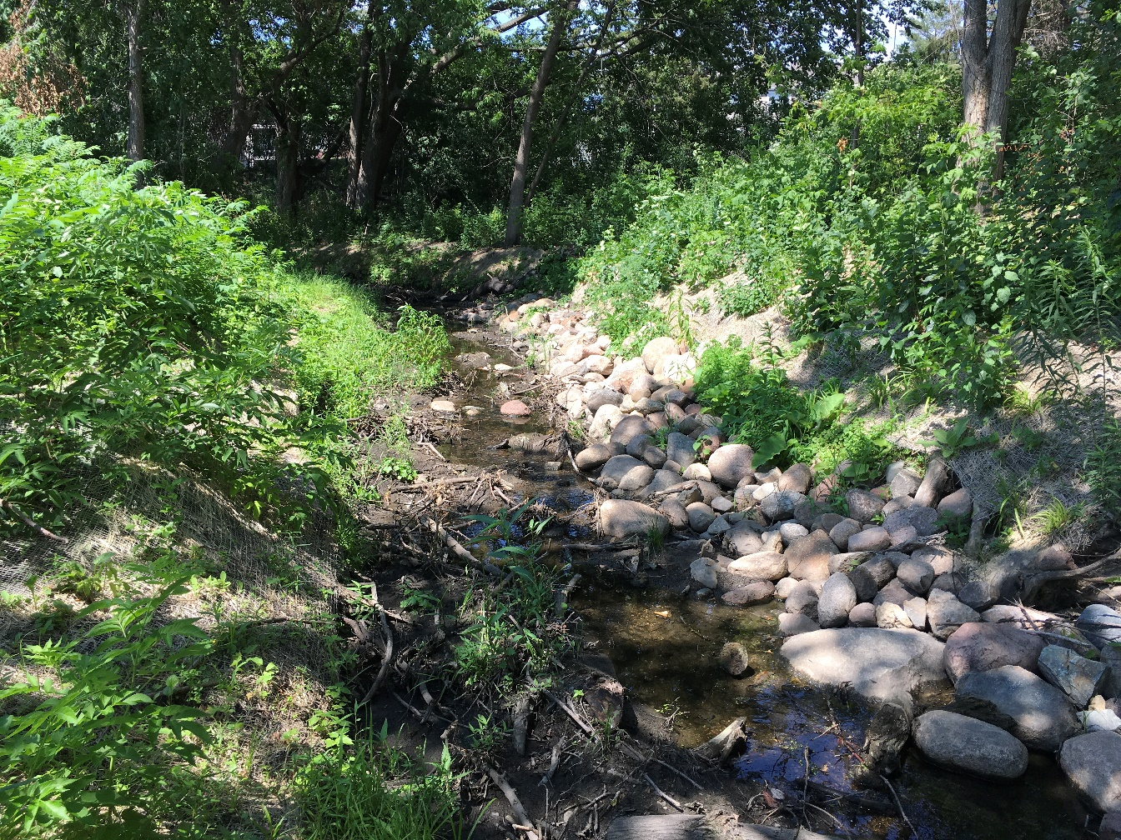
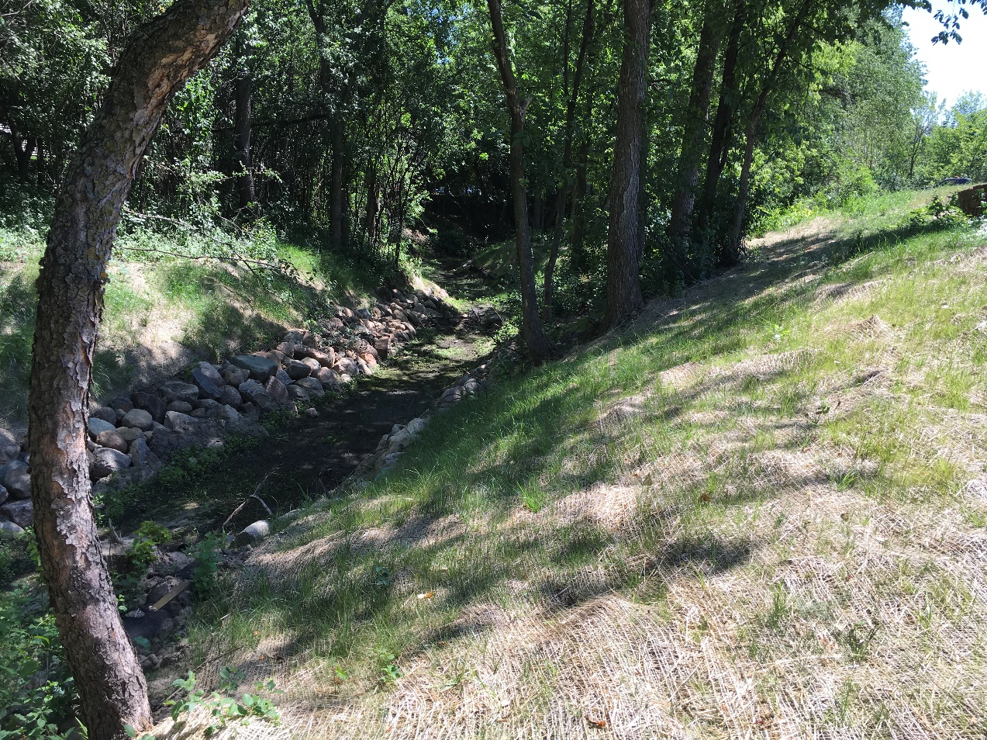
Post Project Channel Erosion Repair

Slide 8
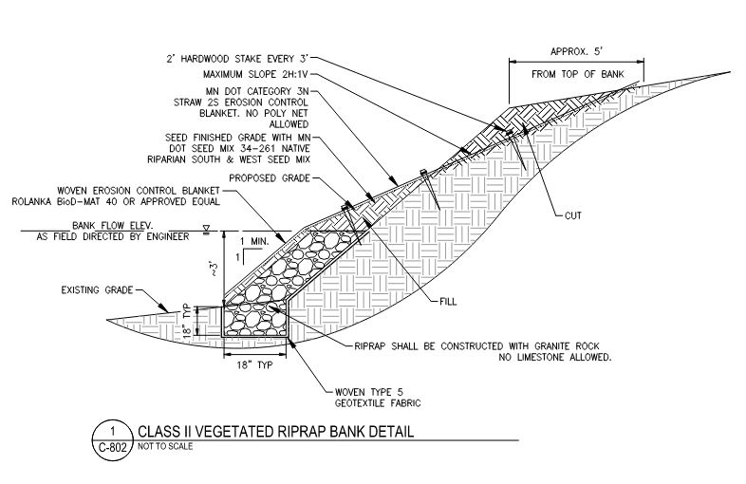
Vegetated Rip Rap Detail

Slide 9
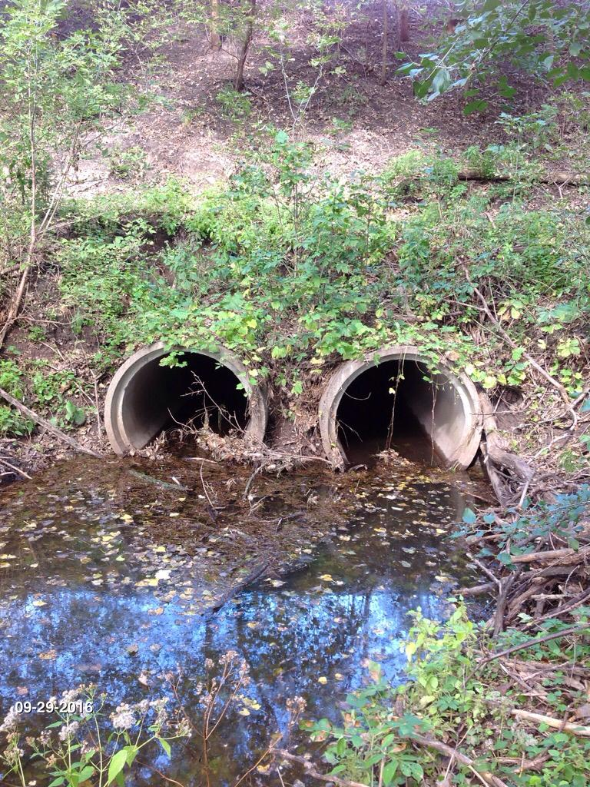
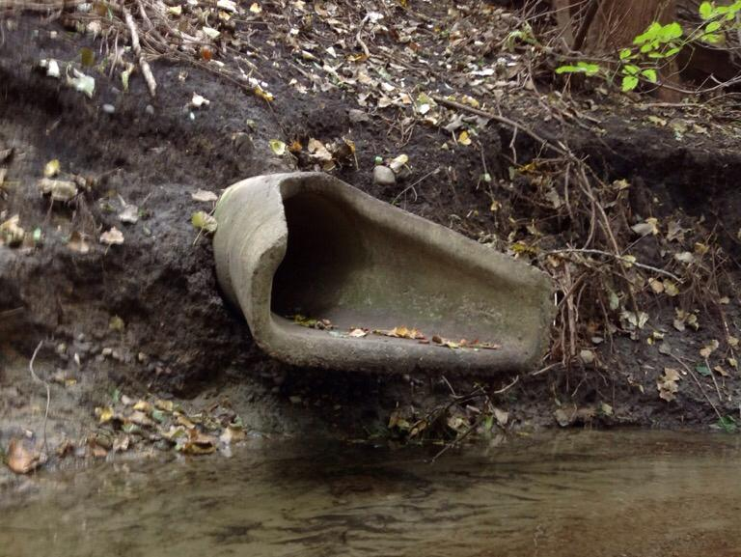
Storm Sewer Infrastructure Repair

Slide 10
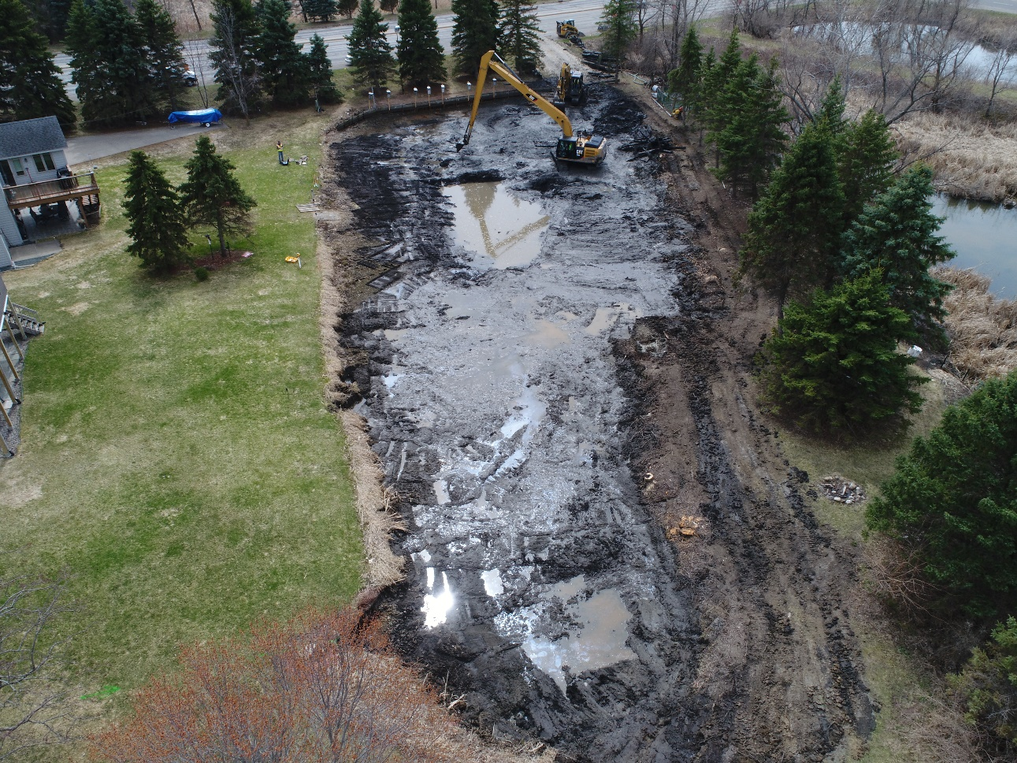
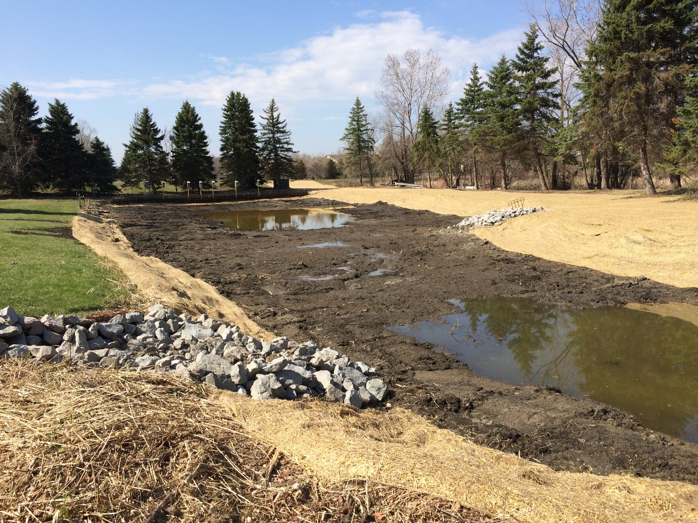
Pond Dredging & Maintenance

Slide 11
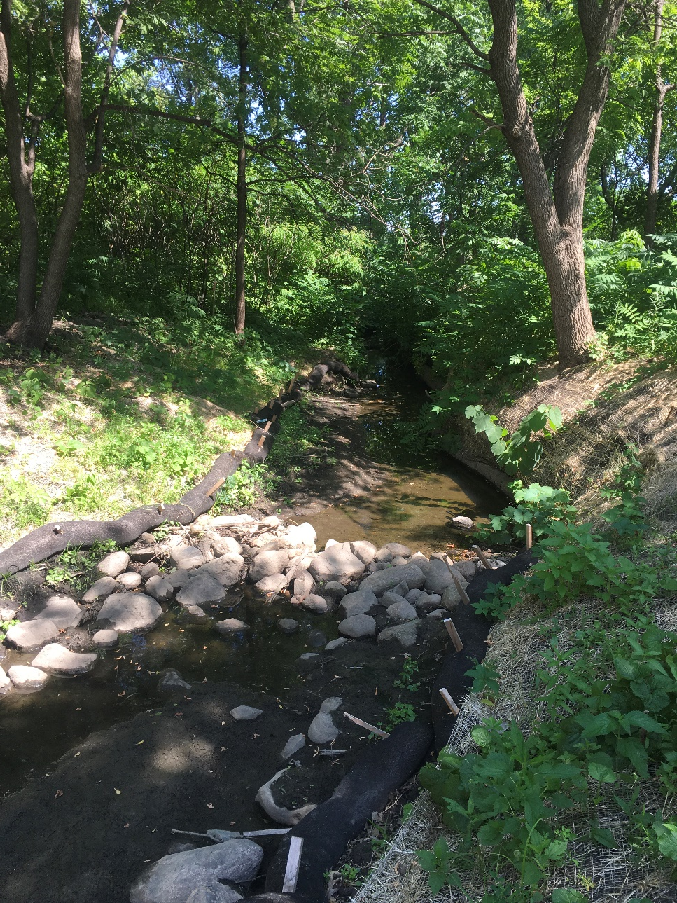
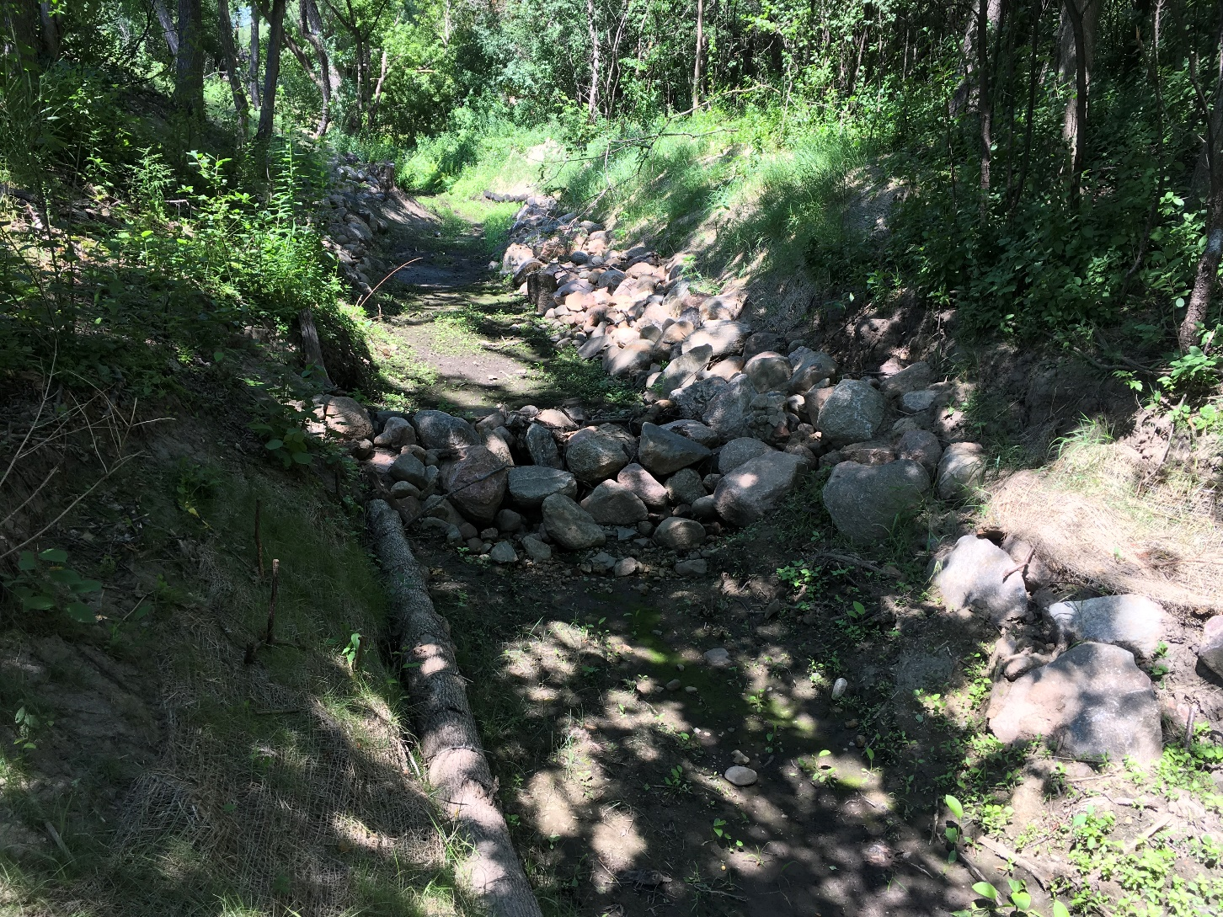
Rock Check Dam

Slide 12
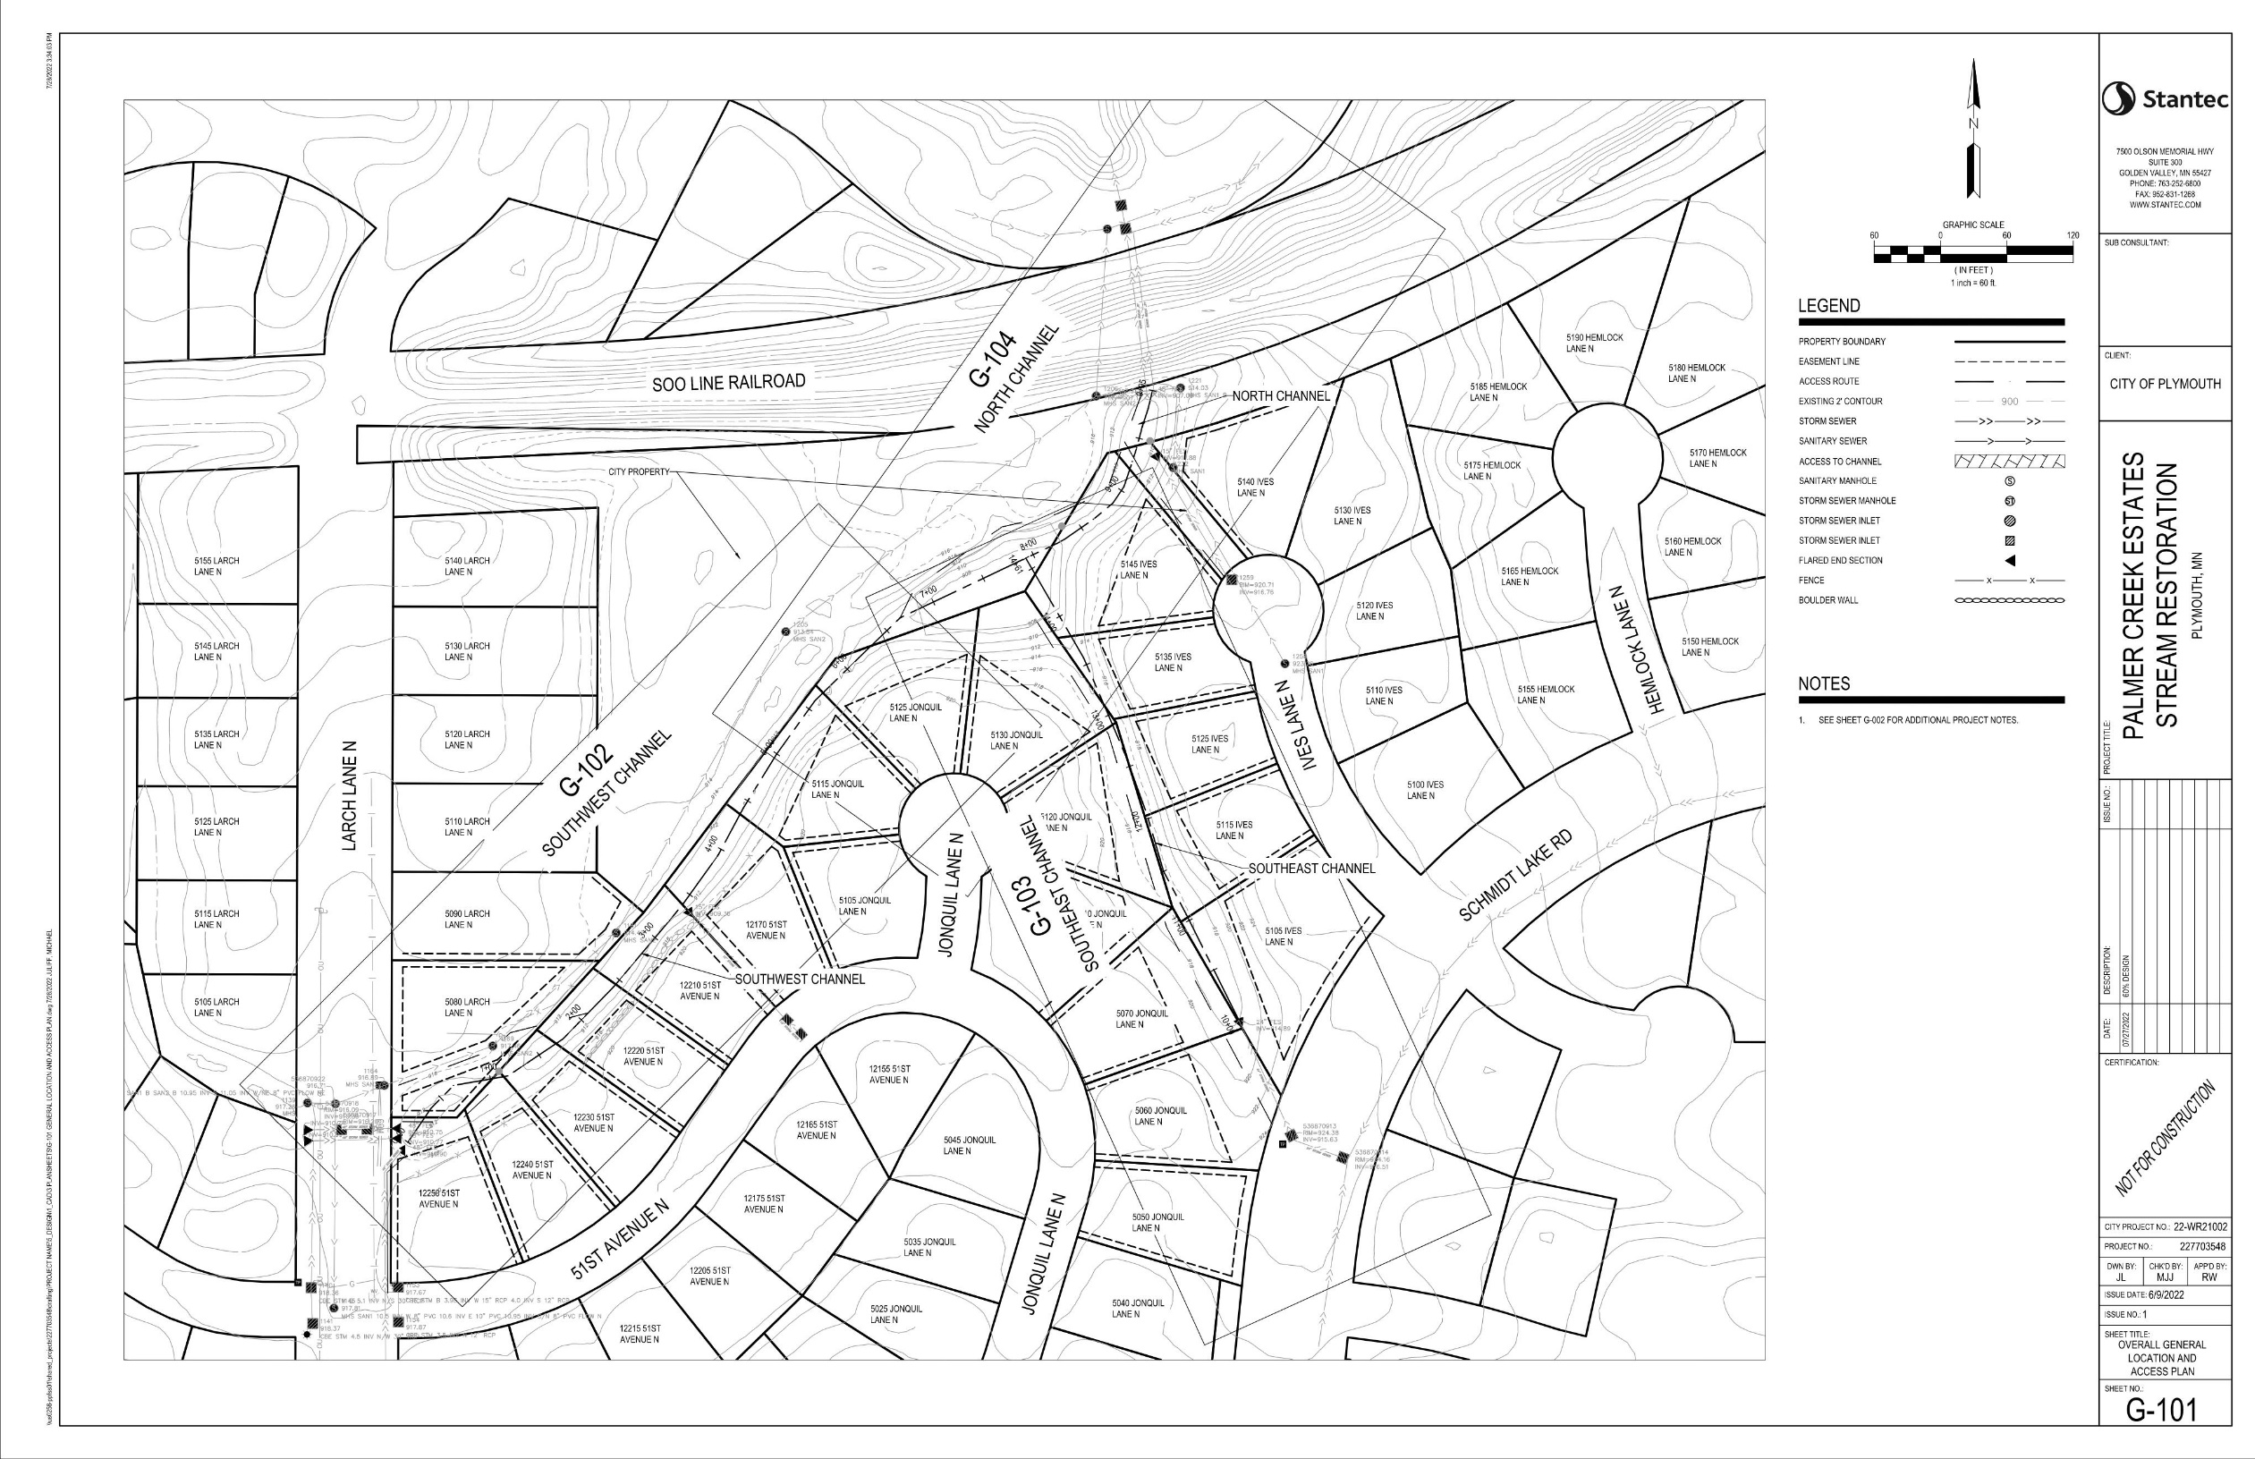

Slide 13
3
N Channel
1
SW Channel
2
SE Channel

Slide 14
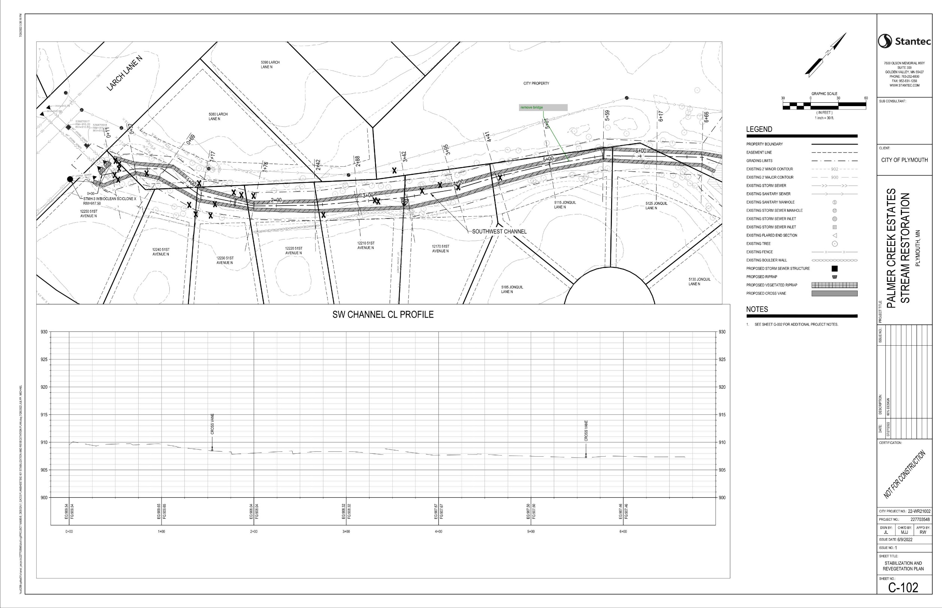
Sciclone Chamber
1
SW Channel

Slide 15
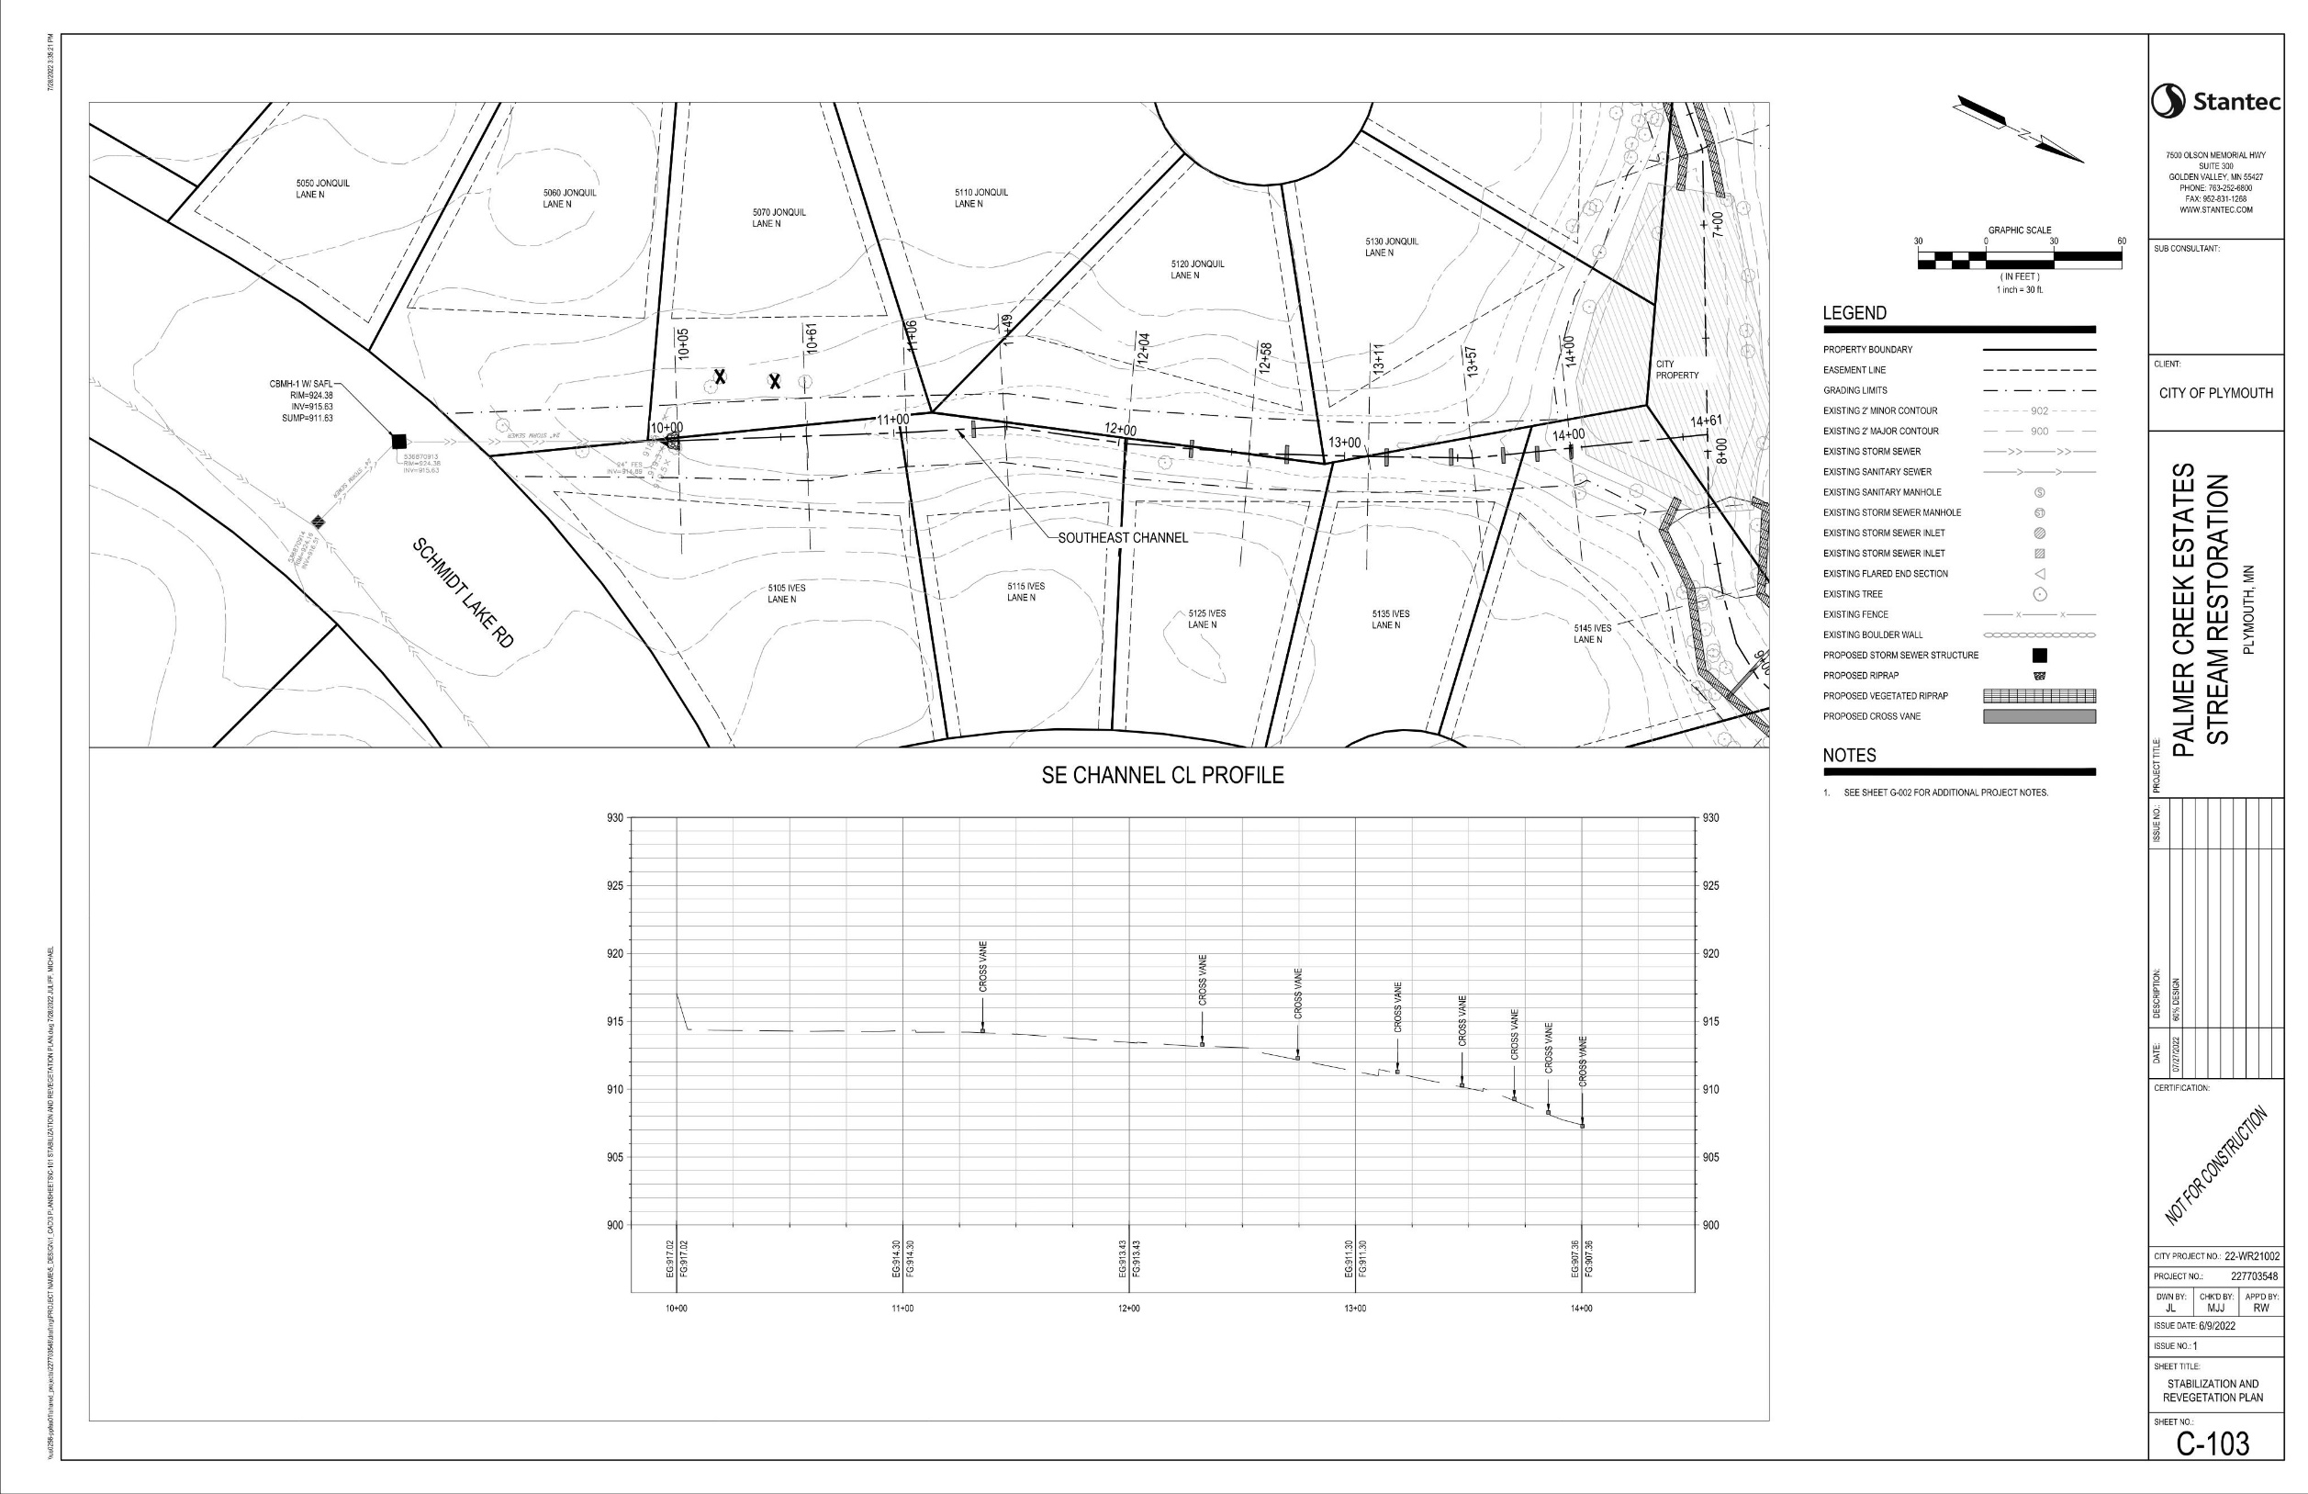
2
SE Channel

Slide 16
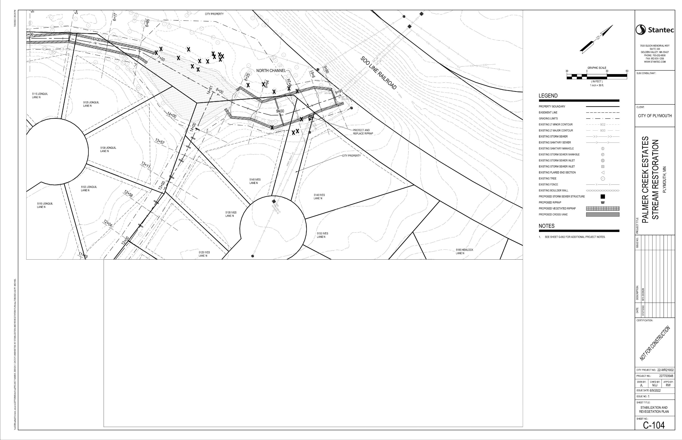
3
N Channel

Slide 17
Funding Participants
No Assessments to Property Owners
Shingle Creek Watershed
City of Plymouth
Notes:
$500K Construction budget. Look for ways to partner with the HOA for work above the City’s budget to increase the economies of scale

Slide 18
Questions or Comments?
  Ben Scharenbroich, City of Plymouth - Water Resources Supervisor
    bscharenbroich@plymouthmn.gov
    (763) 509-5527
Notes:
Take questions.
Staff will stick around if you want to ask questions in person or point out areas of concern.

Slide 19
3
N Channel
1
SW Channel
2
SE Channel

