Slide 1



Pike Creek Drainage
Improvement Project
WR-220001

Slide 2
Project Team
City of Plymouth
  Ben Scharenbroich, Water Resources Supervisor
    bscharenbroich@plymouthmn.gov
City of Maple Grove
  Derek Asche, Water Resources Engineer
    dasche@maplegrovemn.gov
Design Consultant, WSB
  Kendra Fallon, PE
  Jake Newhall, PE

Slide 3
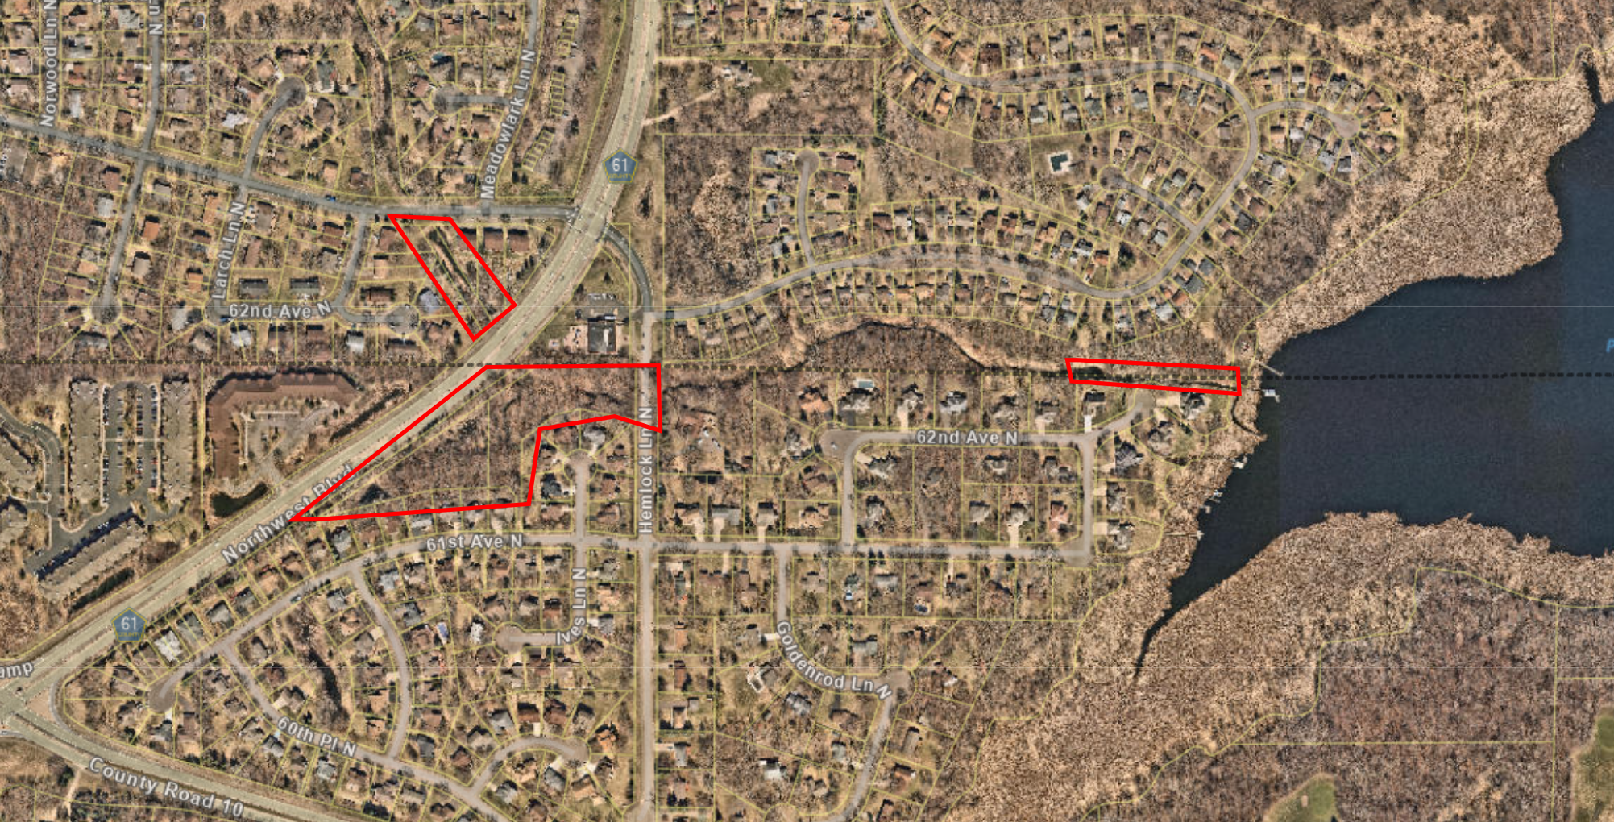
Pike Creek Drainage Improvement Project
Past SCWMC CIP Project
Maple Grove
Plymouth

Slide 4
Project Timeline
Phase | Time
Initial Watershed Presentation | August 2022
Resident Meeting | August 24, 2022
Engineering Final Design | Fall 2022
Contractor Bidding | Fall 2022
Construction | Winter 2022/2023

Slide 5
Identified Potential Improvements
  Address Bank Erosion
  Remove blockages
  Sediment Dredging
    Address Water quality
    Address Bank Erosion
    Removal of sediment and debris
  Tree Removals
    Evaluated Diseased & Hazardous Trees
    Identify those Impacting flow
    Identify those potentially impacted by bank erosion improvements areas
  Resident Input
Notes:
This development was constructed before many of the current storm water management best practices were utilized. Recent stormwater modeling has identified the potential that some properties have higher flood risk than others, but tangible flood risk reduction cannot be had without significantly impacting the nature of the neighborhood.
With the entirty of the design, Barr will model the improvements to ensure no adverse impacts are pushed to properties.

Slide 6
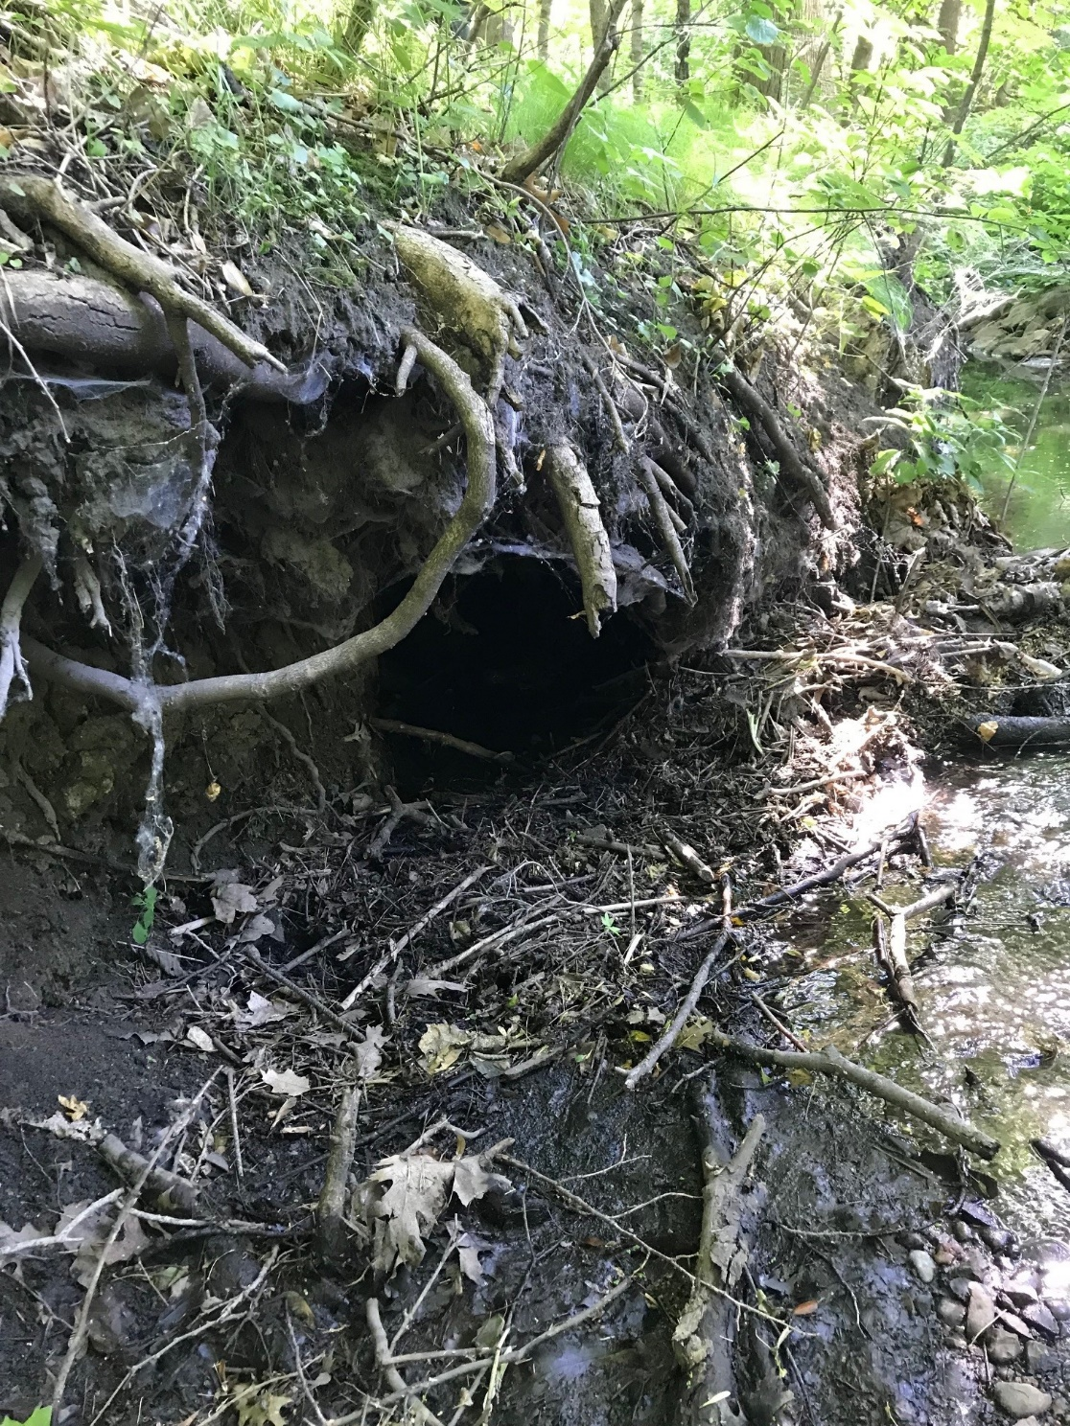
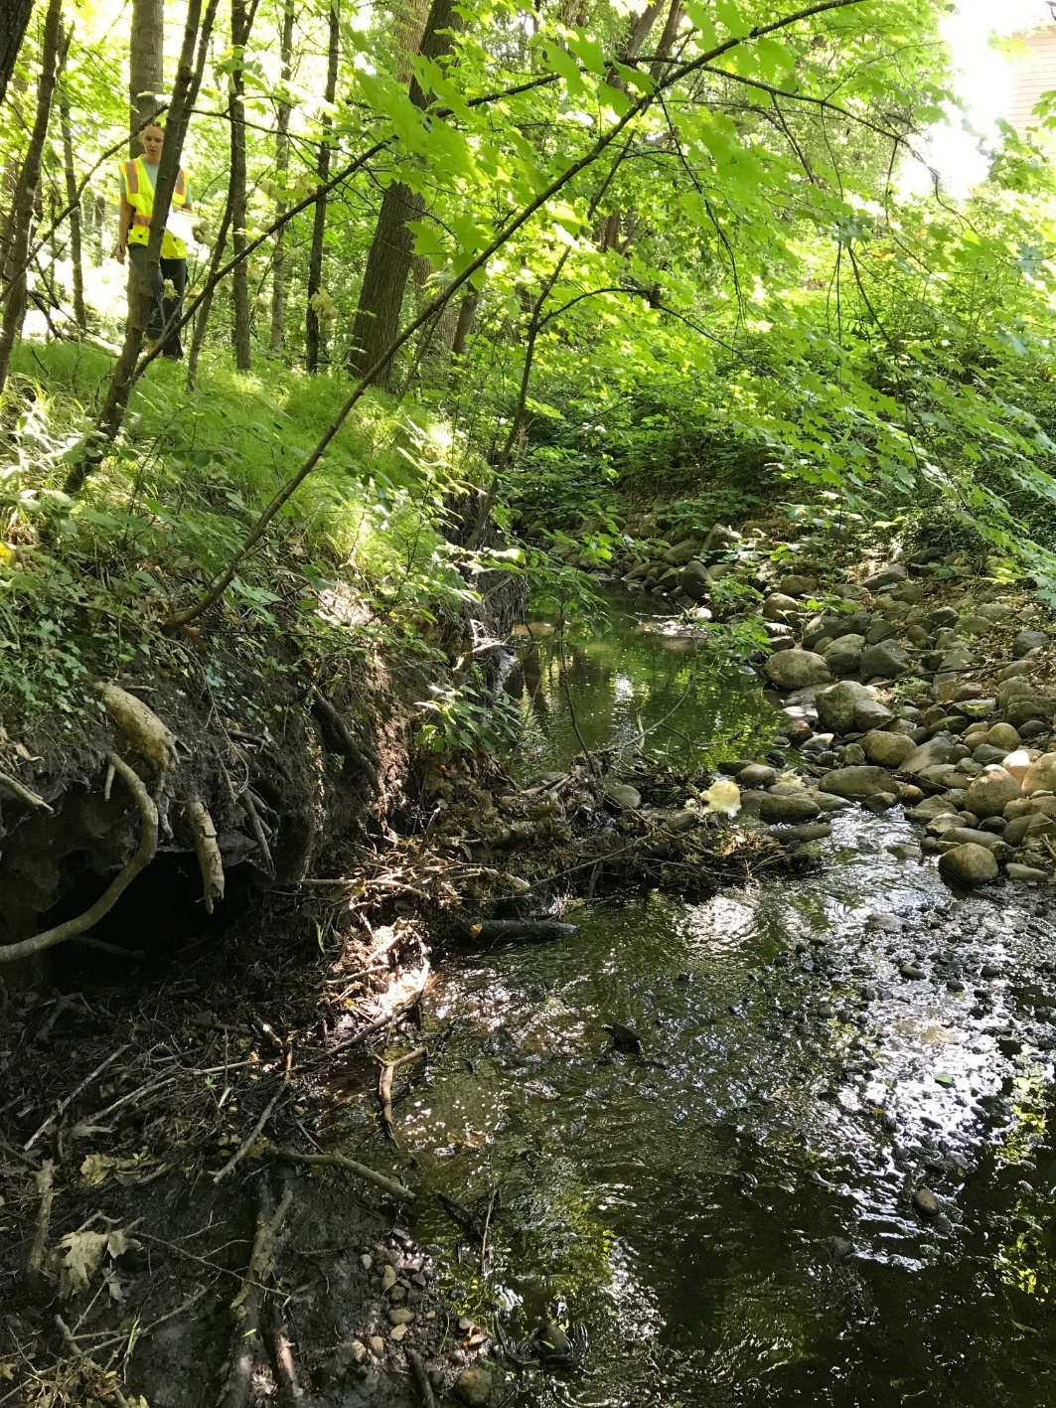
Eroding Banks

Slide 7
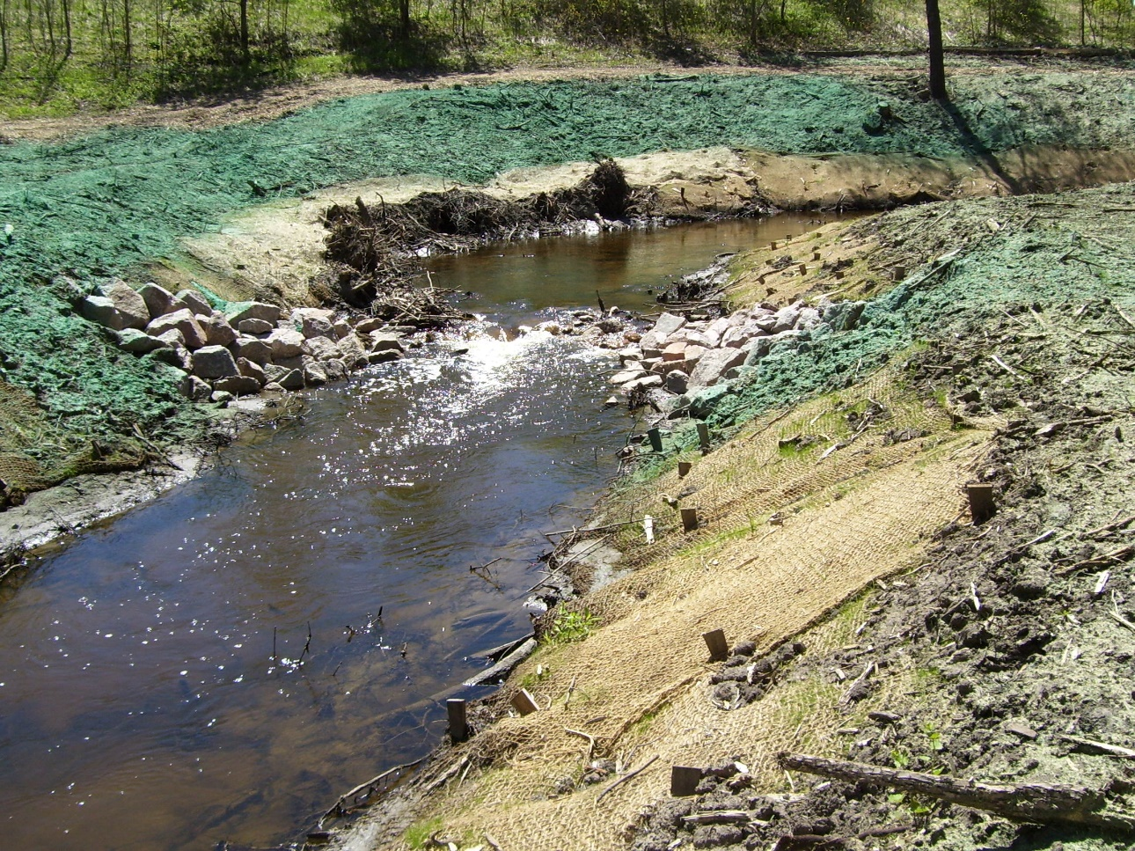
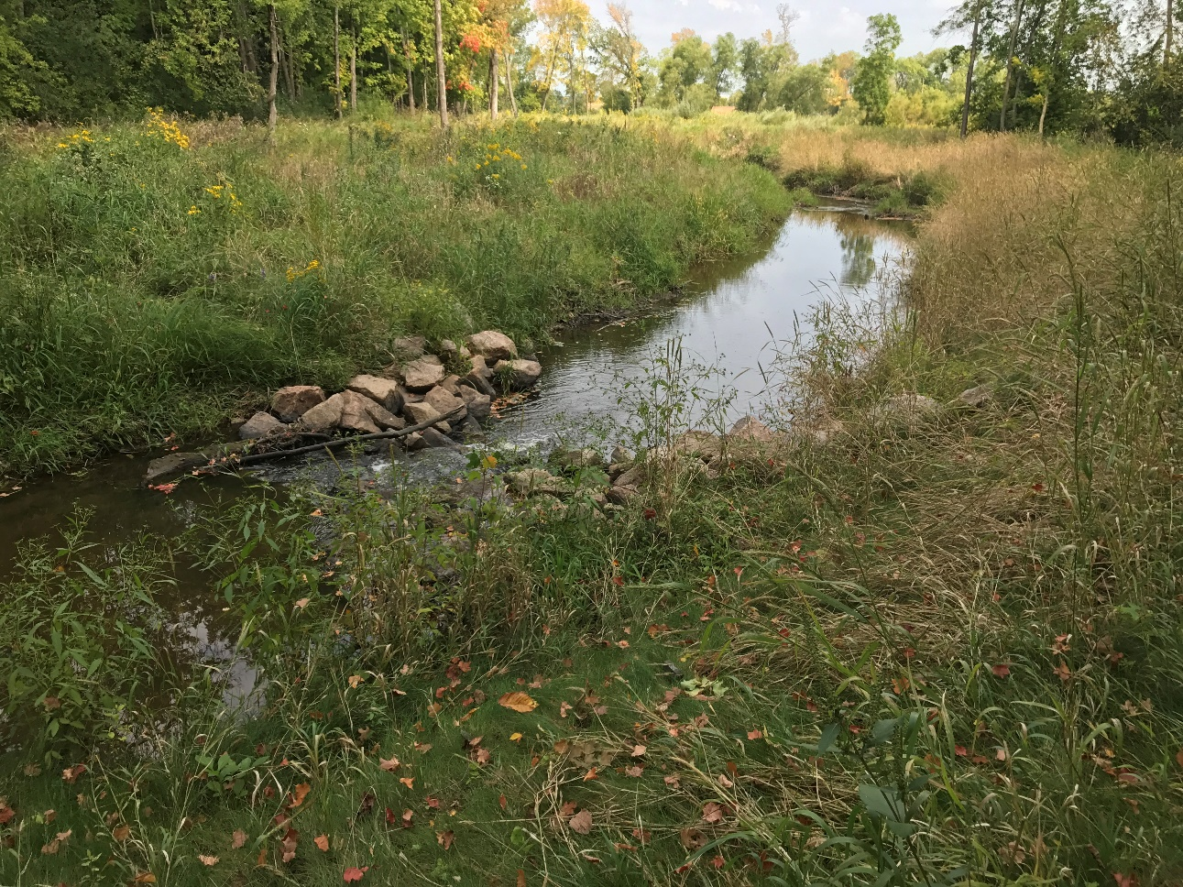
Channel Erosion Repair

Slide 8
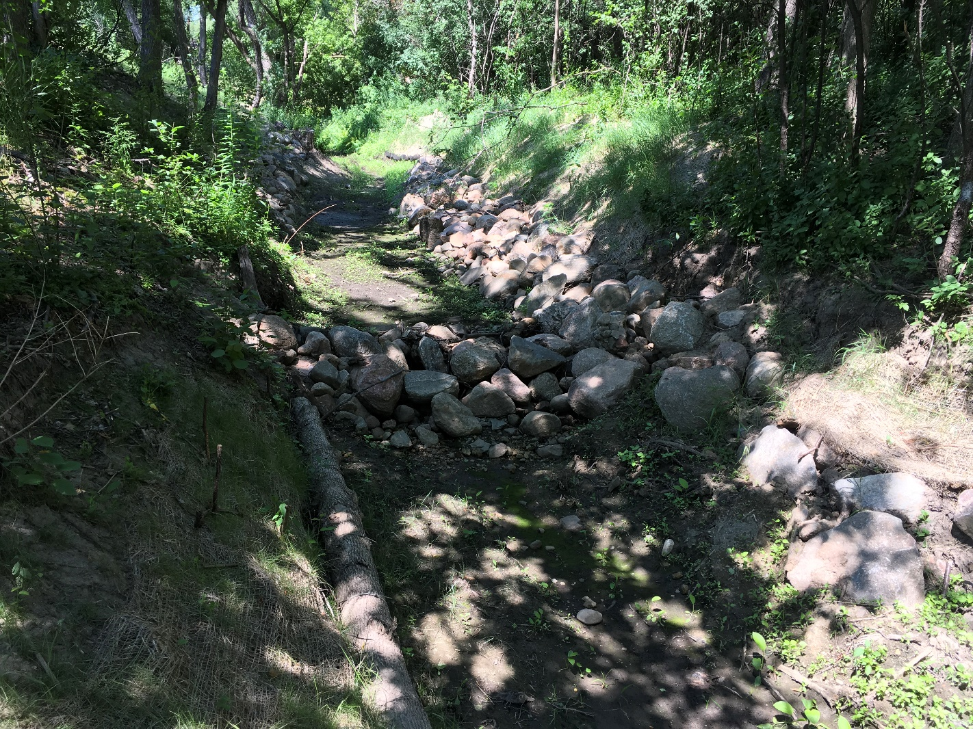
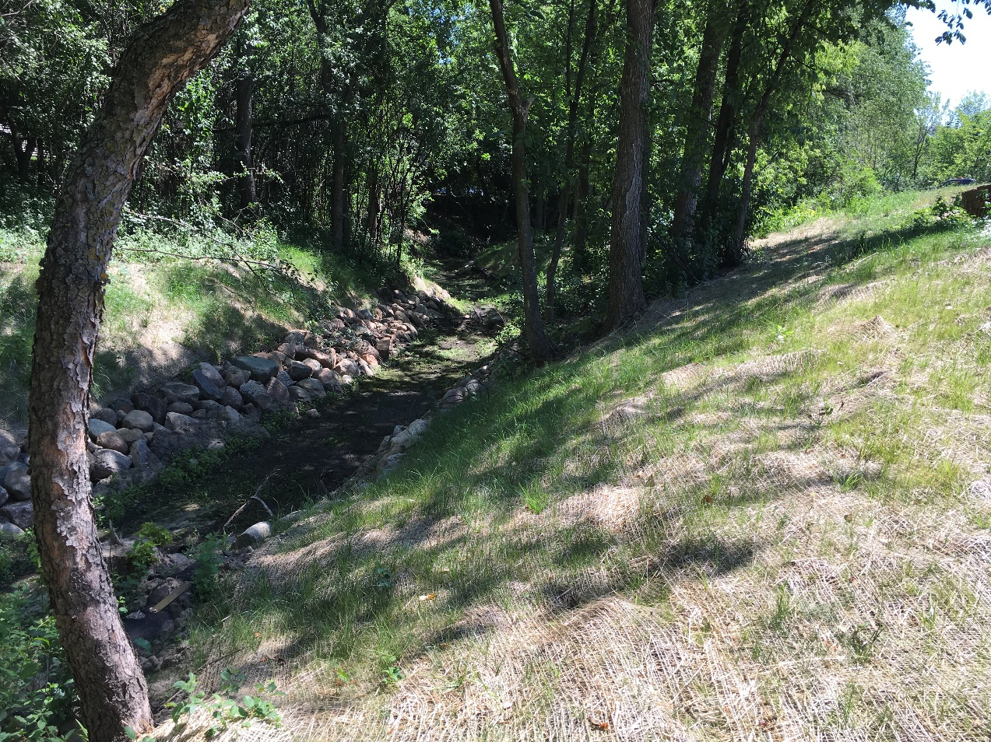
Channel Erosion Repair

Slide 9
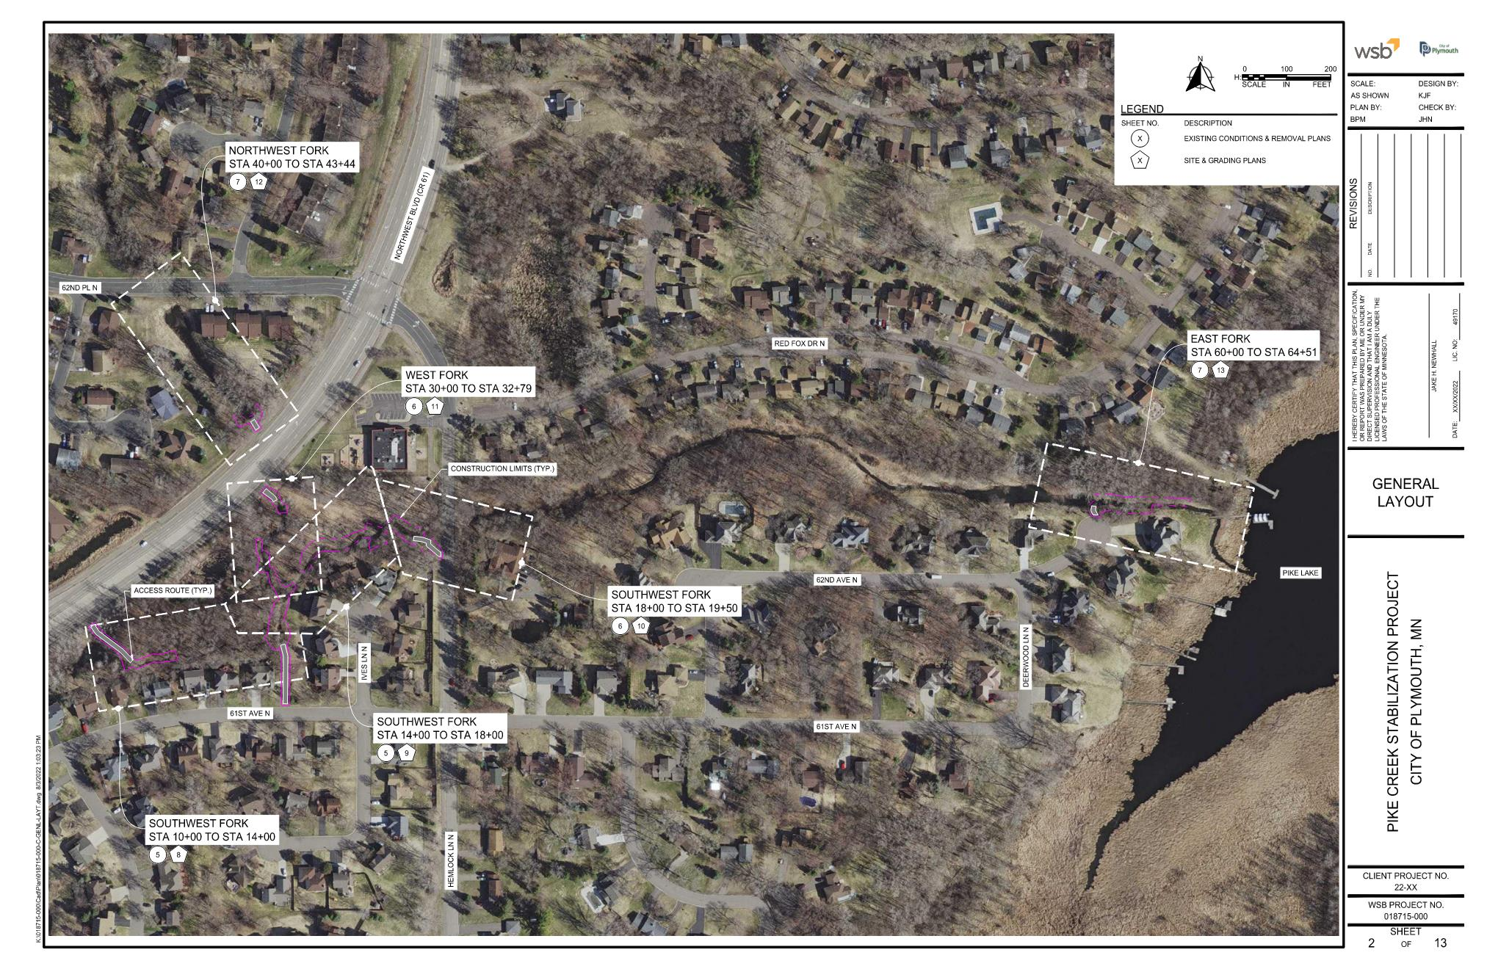

Slide 10
5
6
3
4
2
1

Slide 11
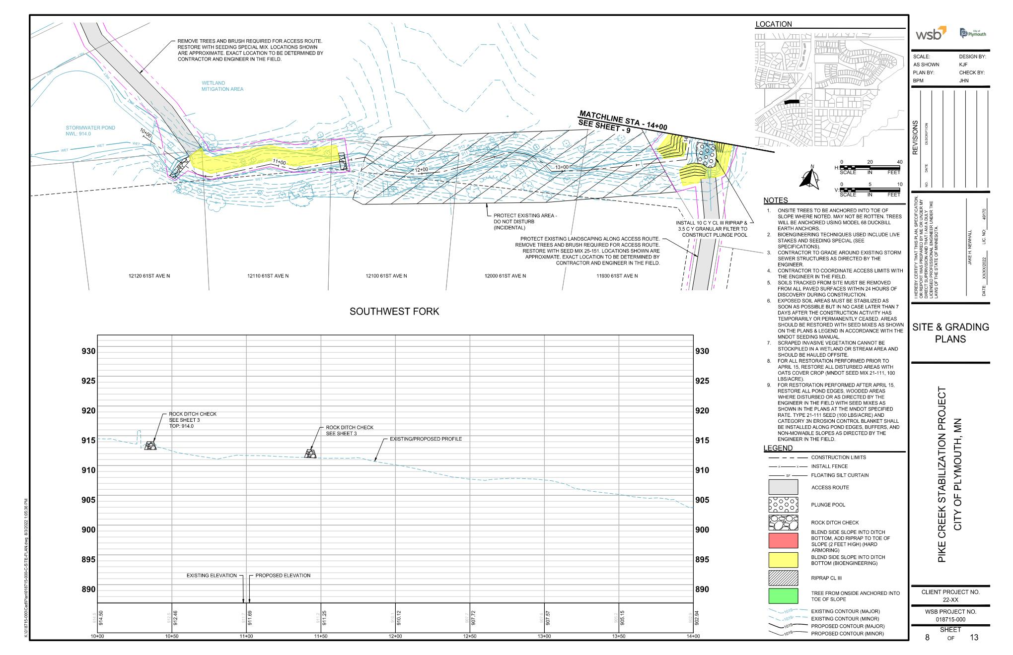

Slide 12
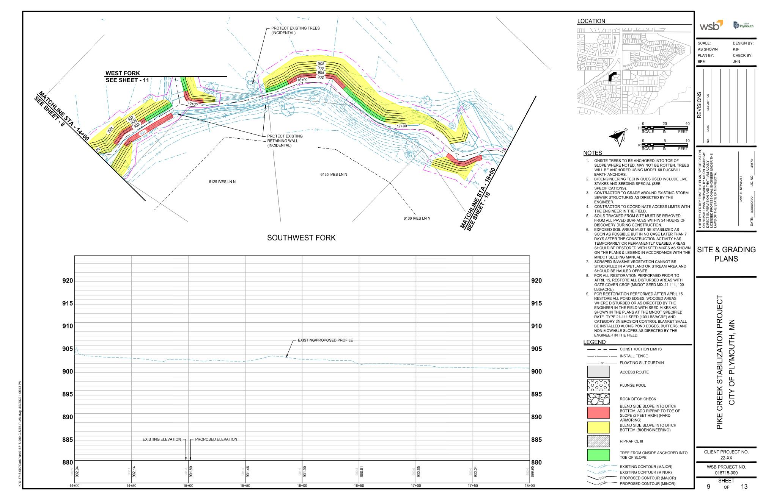

Slide 13
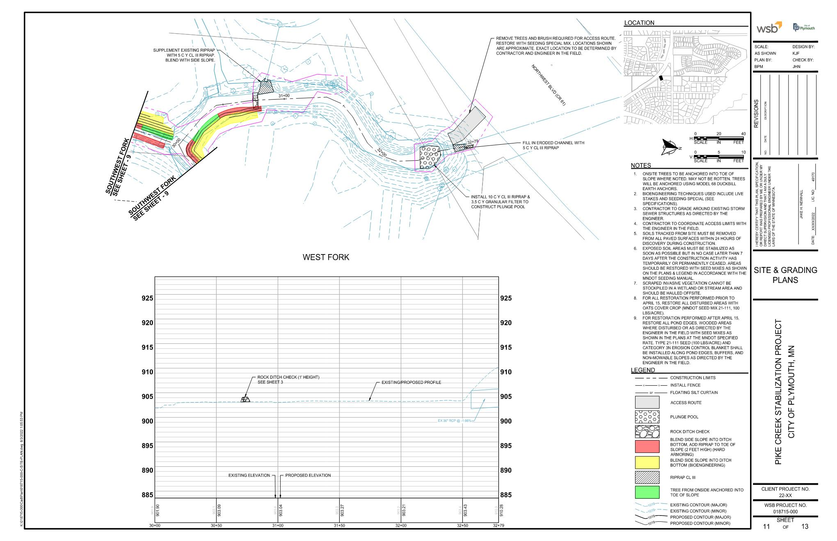

Slide 14
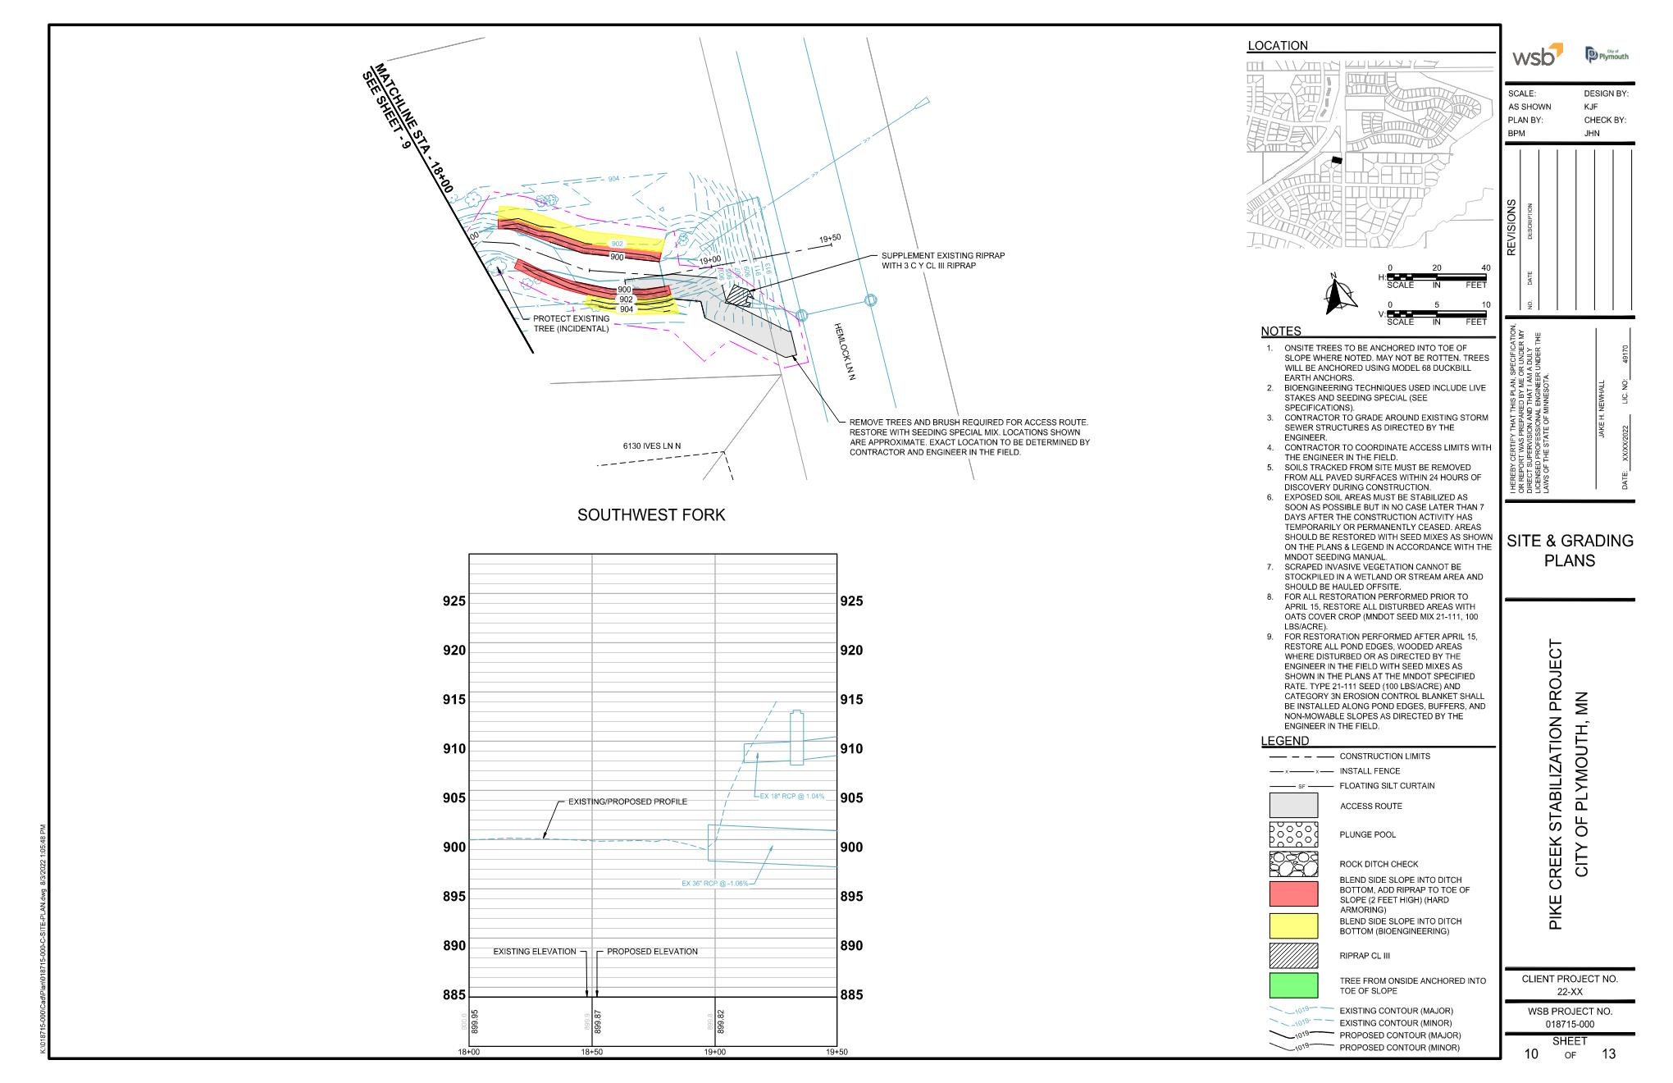

Slide 15
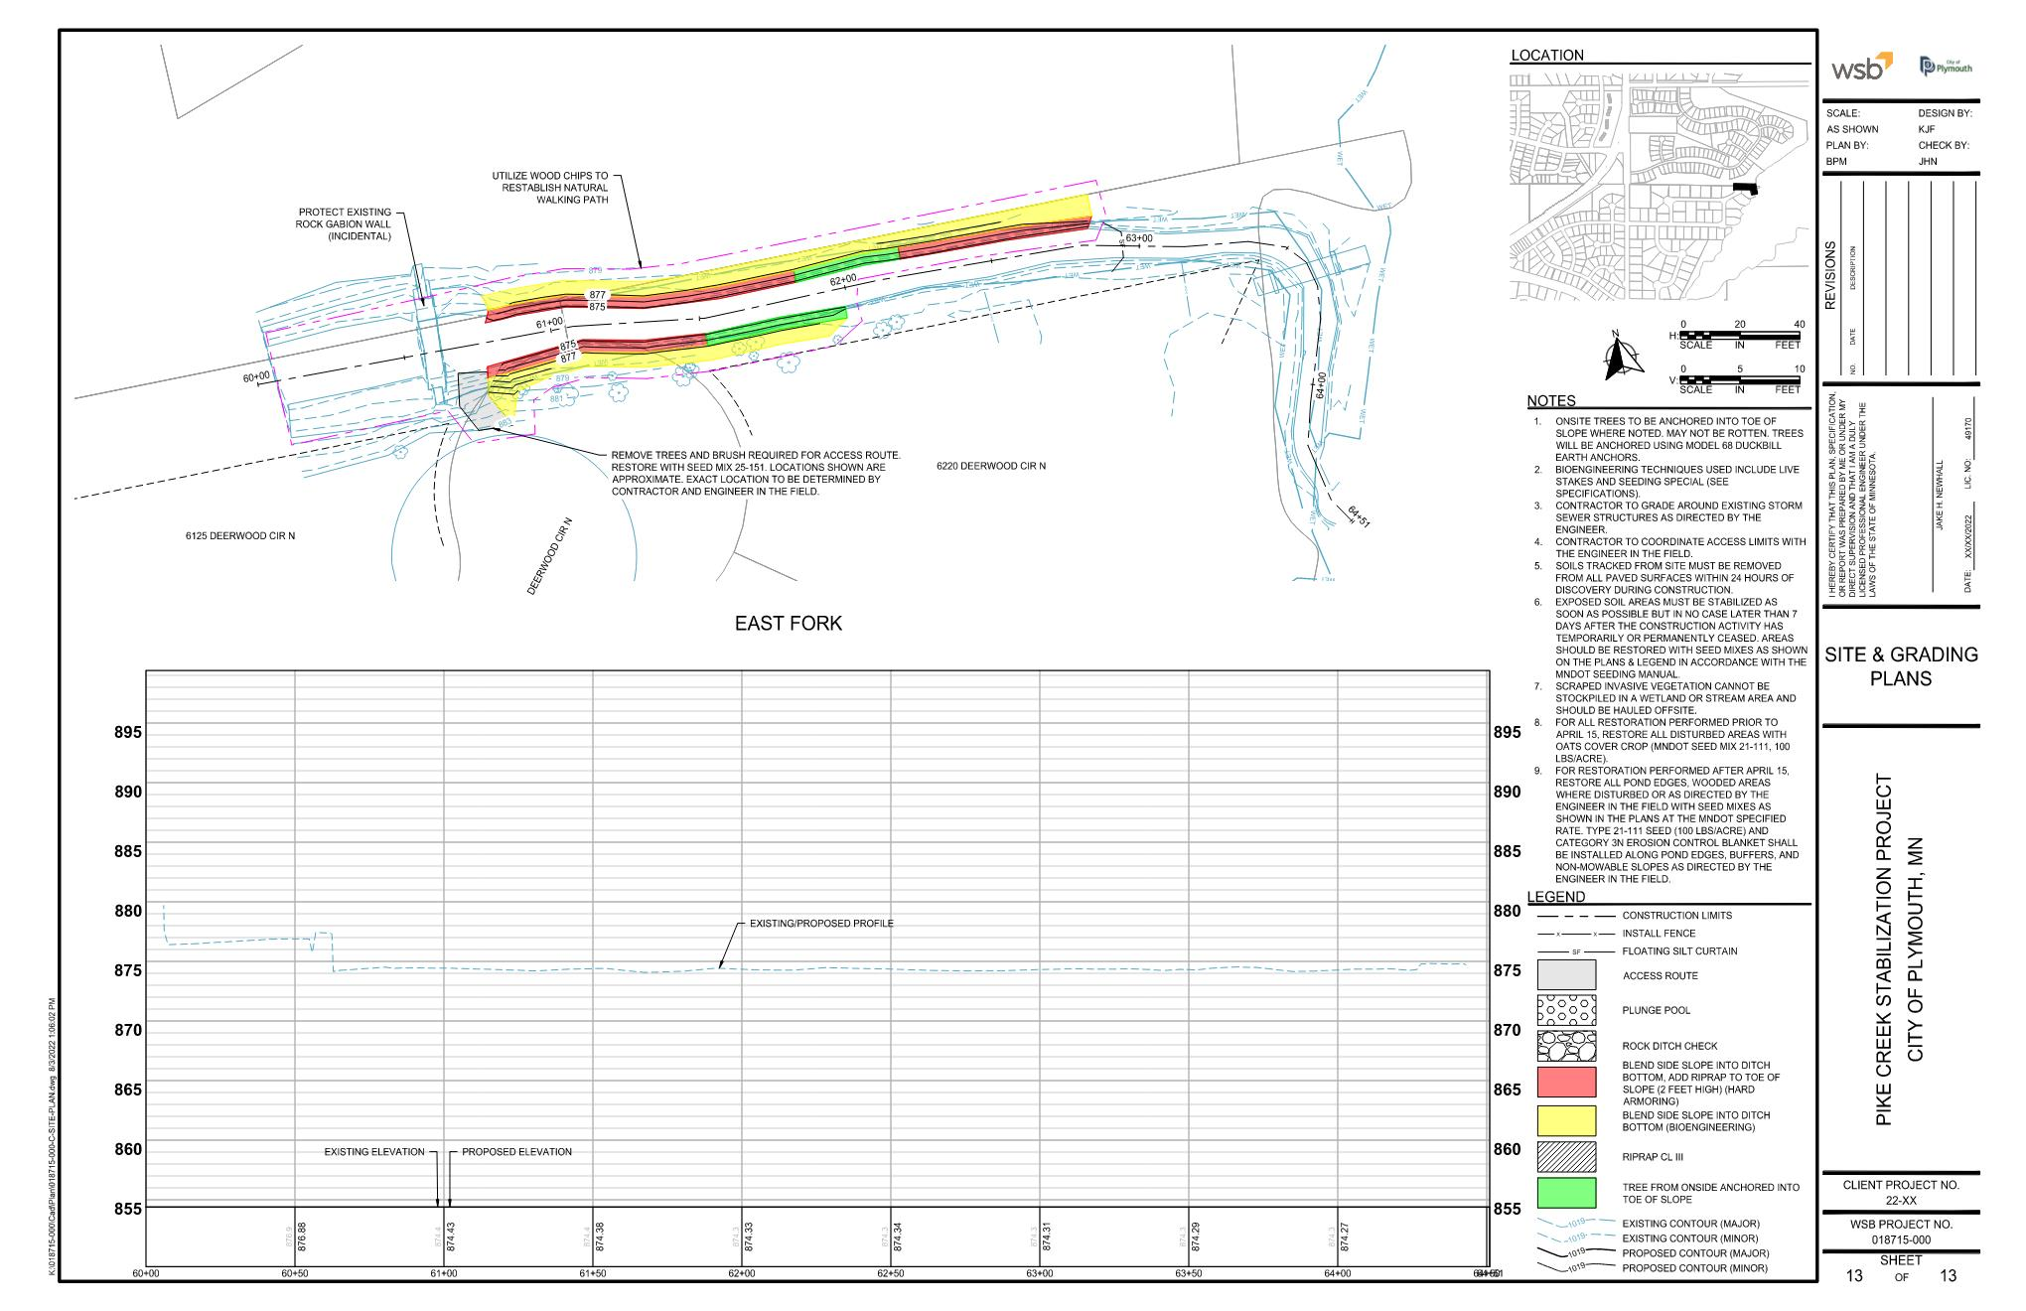
Potential Pond Maintenance

Slide 16
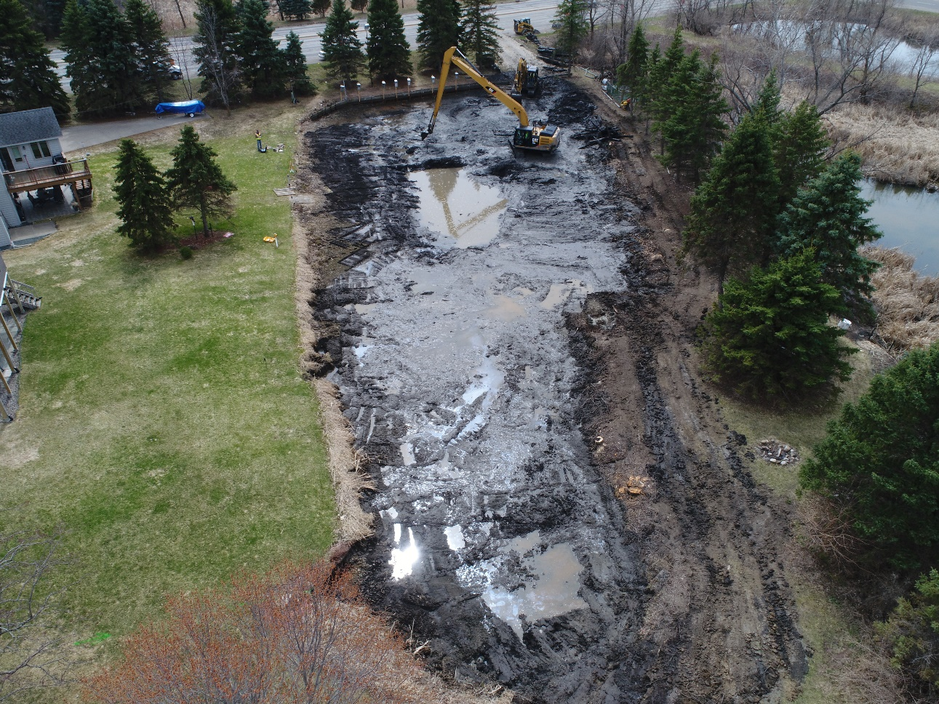
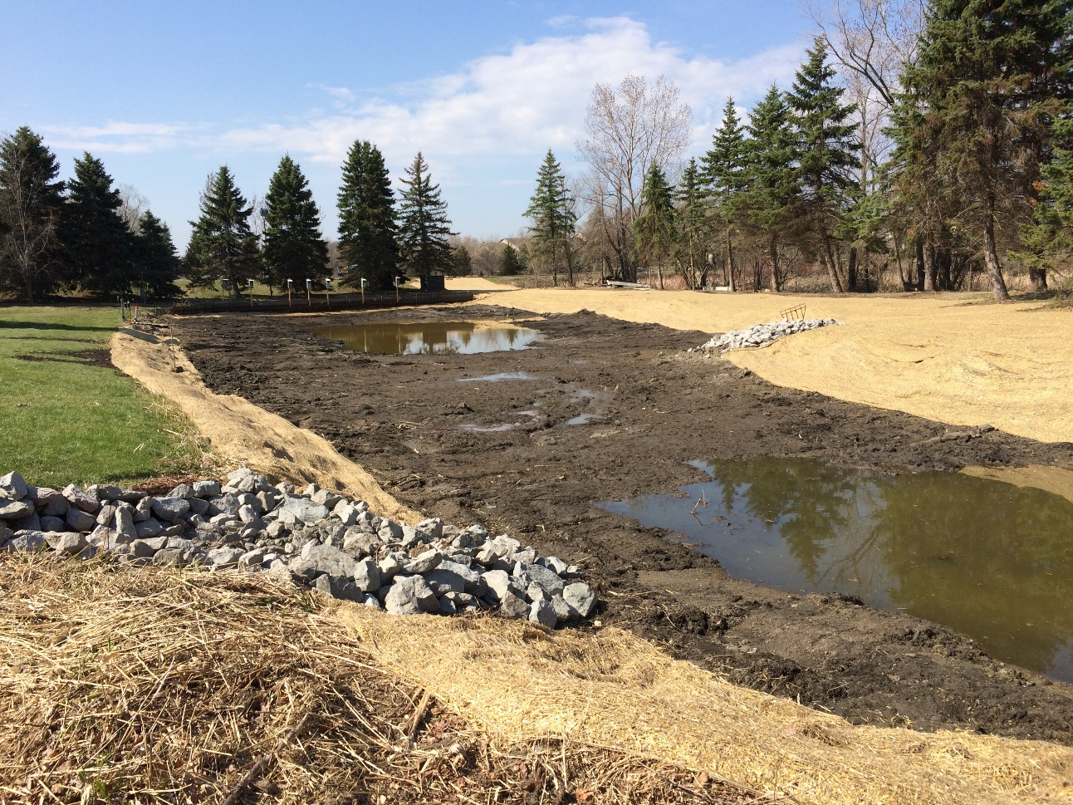
Pond Maintenance

Slide 17
Funding Participants
No Assessments to Property Owners
Shingle Creek Watershed
  $95,000
Board of Water and Soil Resources Clean Water Fund
  $150,000
City of Maple Grove & Plymouth
  $150,500
Notes:
$500K Construction budget. Look for ways to partner with the HOA for work above the City’s budget to increase the economies of scale

Slide 18
Questions or Comments?
  Ben Scharenbroich, City of Plymouth - Water Resources Supervisor
    bscharenbroich@plymouthmn.gov
    (763) 509-5527
  Derek Asche, City of Maple Grove - Water Resources Engineer
    dasche@maplegrovemn.gov
Notes:
Take questions.
Staff will stick around if you want to ask questions in person or point out areas of concern.

Slide 19
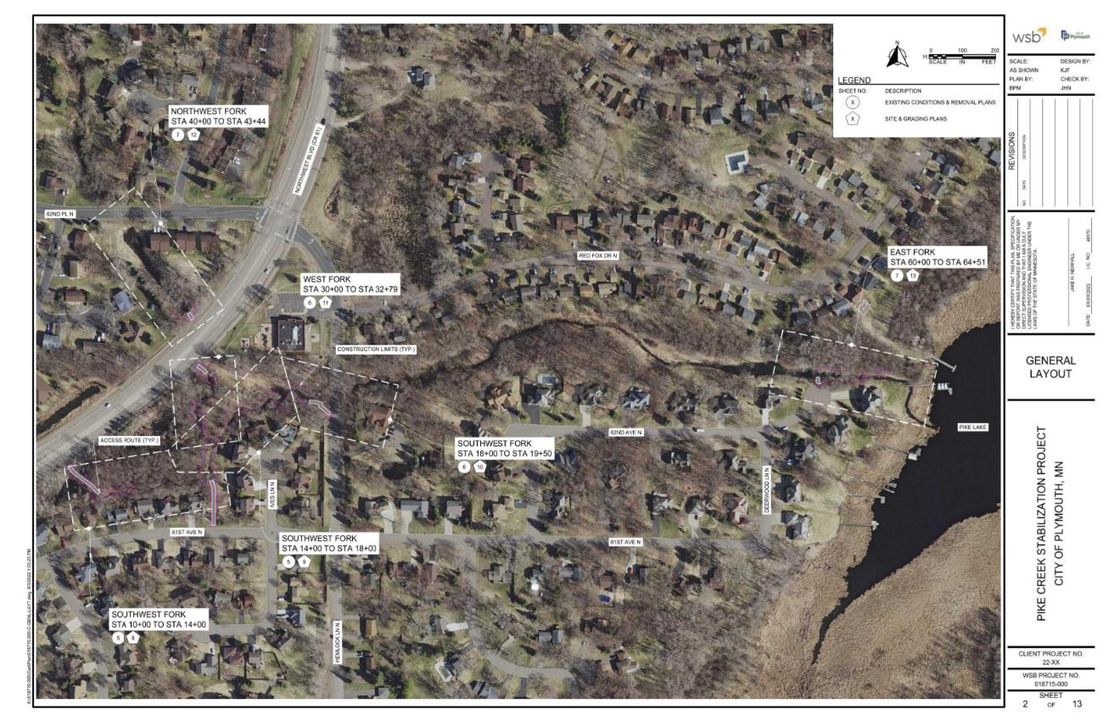
Notes:
This map shows the project limits for the reconstruction project. The highlighted streets are those proposed for reconstruction.

