Slide 1
Maple Creek Stream Restoration Project
WR-20-0001
Neighborhood Information Meeting – October 25, 2021

Slide 2
Project Team
City of Plymouth
  Ben Scharenbroich, Water Resources Supervisor
    bscharenbroich@plymouthmn.gov
  Chris McKenzie, PE, Engineering Services Manager
    cmckenzie@plymouthmn.gov
Design Consultant, WSB
  Jake Newhall, PE
    jnewhall@wsbeng.com
  Laura Rescorla, PE
    lrescorla@wsbeng.com

Slide 3
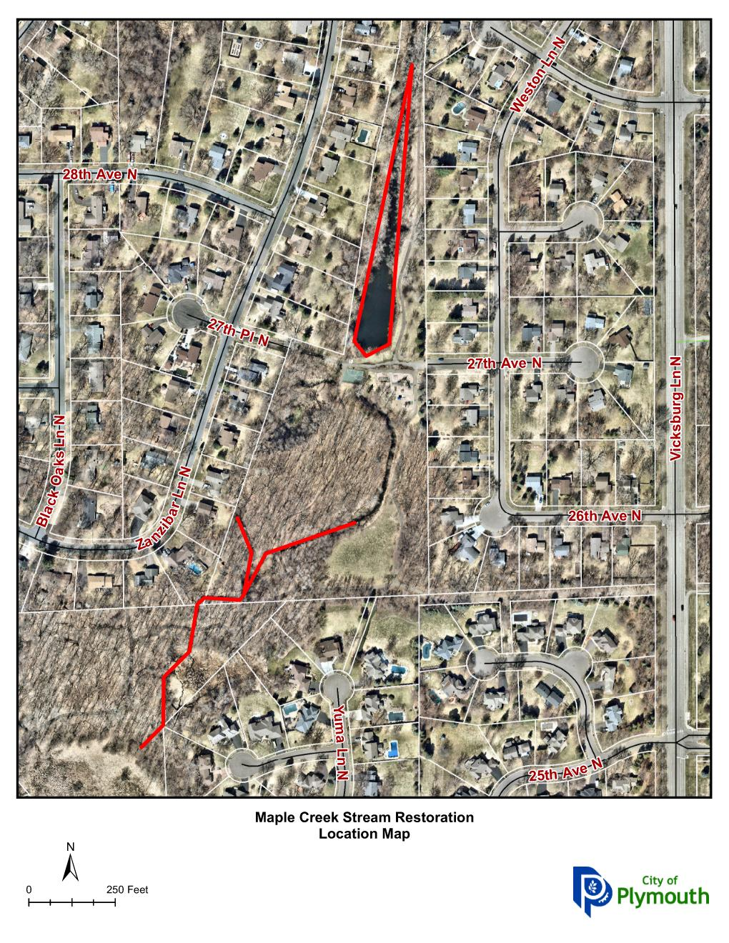
Maple Creek Stream Restoration
Location Map
Notes:
This map shows the project limits for the reconstruction project. The highlighted streets are those proposed for reconstruction.

Slide 4
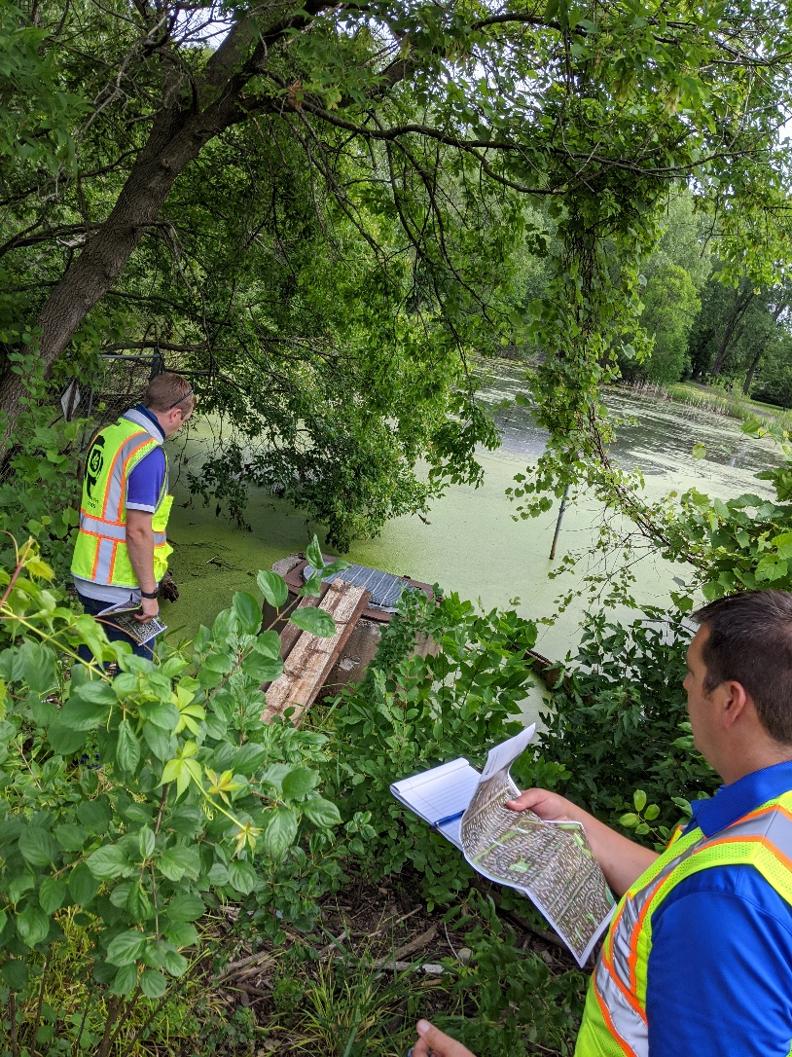
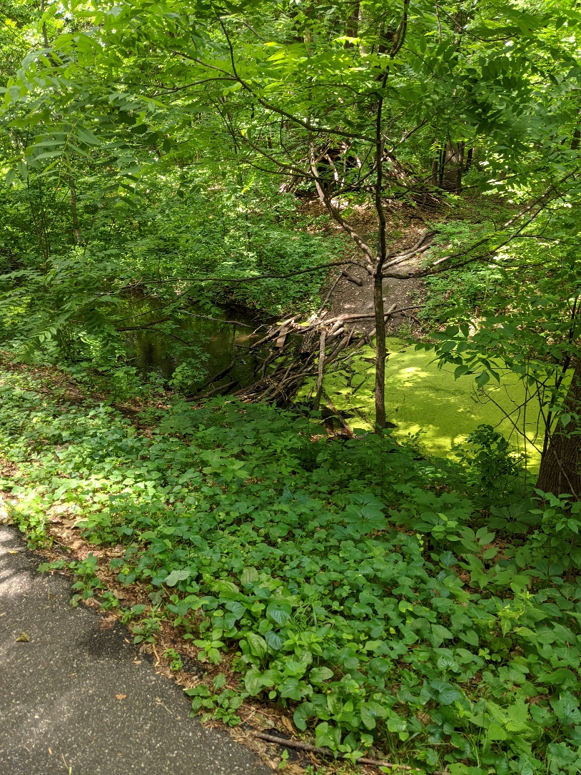
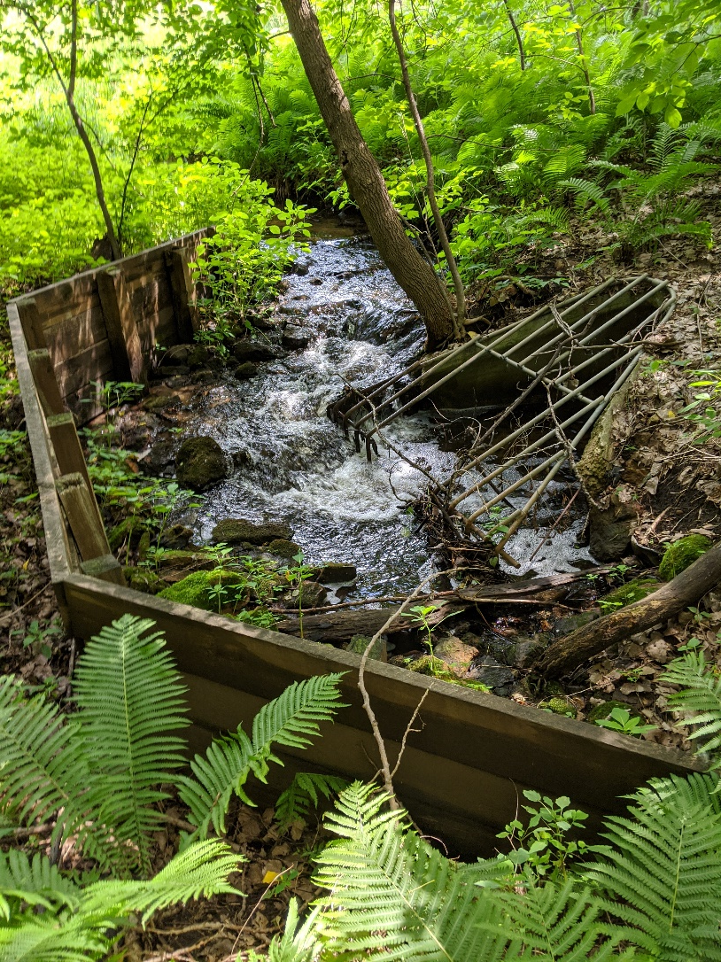
Maple Creek Current Conditions

Slide 5
Project Improvements
The proposed improvements of the project are:
  Pond Dredging
  Iron Enhanced Sand Filter Installation
  Trail Realignment
  Stream Channel Erosion Repair
  Wetland Restoration
  Storm Sewer Outlet Maintenance
  Revegetation with native grasses and flowers
Pond Expansion, Iron Enhanced Sand Filter & Trail Realignment
Channel Restoration
Wetland Restoration & Storm sewer outlet maintenance
Notes:
This map shows the project limits for the reconstruction project. The highlighted streets are those proposed for reconstruction.

Slide 6
Project Improvements
The proposed improvements of the project are:
  Pond Dredging
  Iron Enhanced Sand Filter Installation
  Trail Realignment
  Stream Channel Erosion Repair
  Wetland Restoration
  Storm Sewer Outlet Maintenance
  Revegetation with native grasses and flowers
Pond Expansion, Iron Enhanced Sand Filter & Trail Realignment
Channel Restoration
Wetland Restoration & Storm sewer outlet maintenance
Notes:
This map shows the project limits for the reconstruction project. The highlighted streets are those proposed for reconstruction.

Slide 7
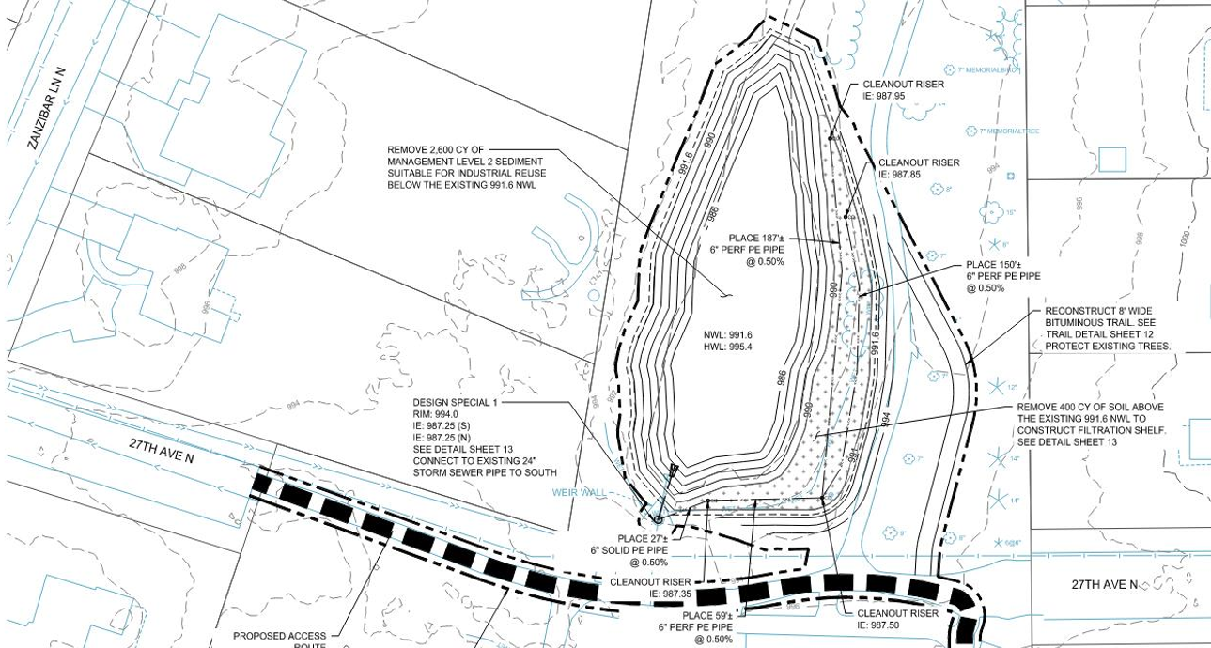
Pond Expansion &
Additional Sand Filter

Slide 8
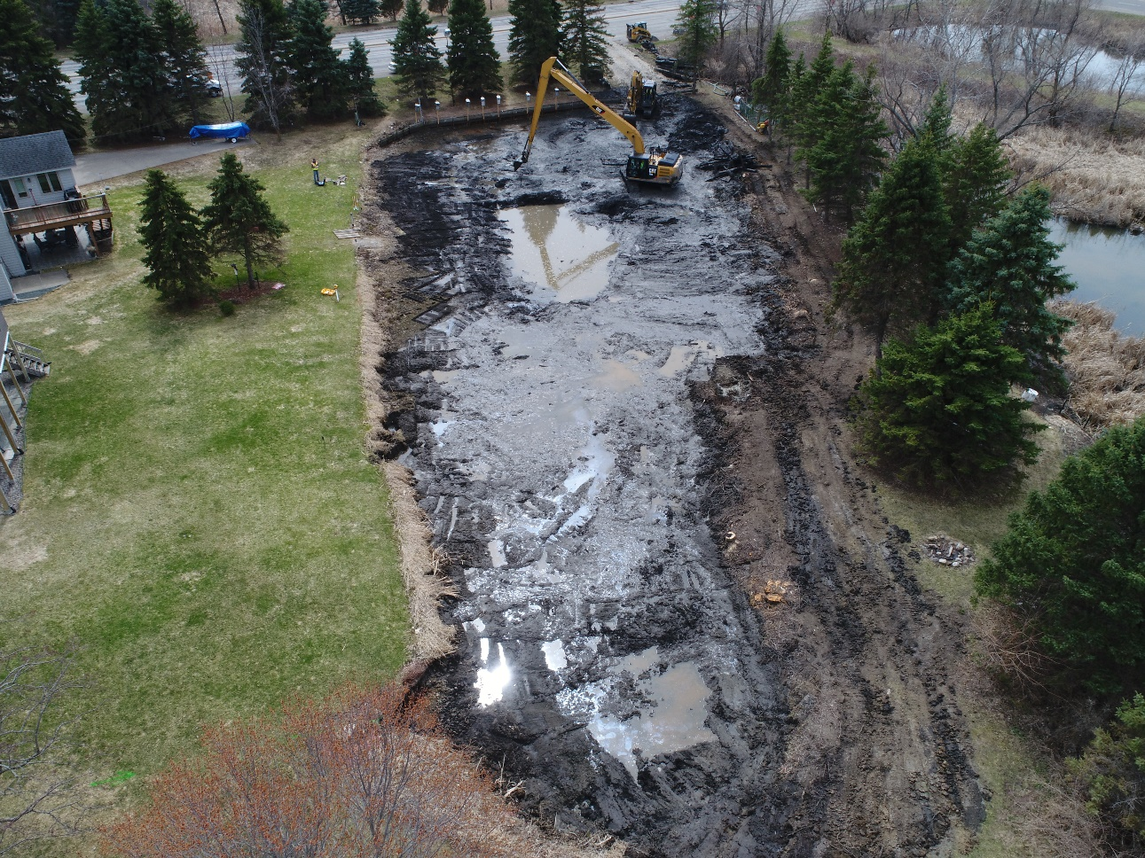
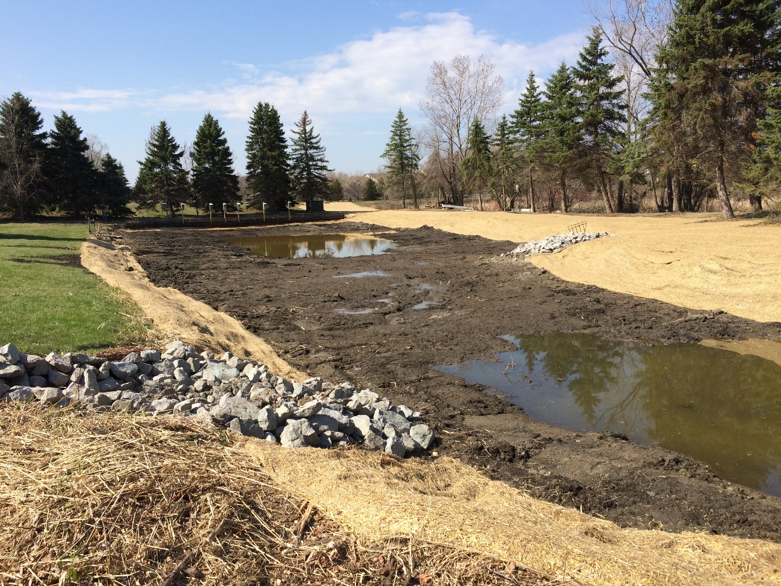
Pond Expansion

Slide 9
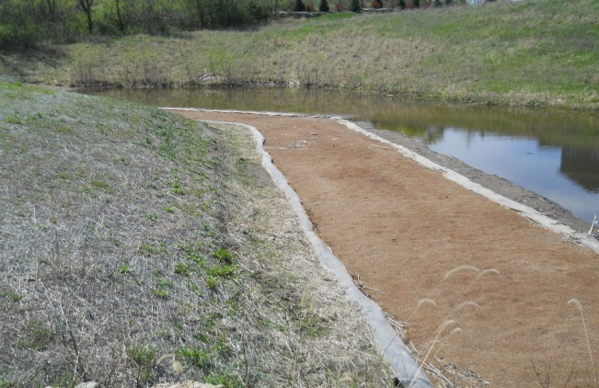
Iron Enhanced Sand Filter
Source: Minnesota Pollution Control Agency – MN Stormwater Manual

Slide 10
Project Improvements
The proposed improvements of the project are:
  Pond Dredging
  Iron Enhanced Sand Filter Installation
  Trail Realignment
  Stream Channel Erosion Repair
  Wetland Restoration
  Storm Sewer Outlet Maintenance
  Revegetation with native grasses and flowers
Pond Expansion, Iron Enhanced Sand Filter & Trail Realignment
Channel Restoration
Wetland Restoration & Storm sewer outlet maintenance
Notes:
This map shows the project limits for the reconstruction project. The highlighted streets are those proposed for reconstruction.

Slide 11
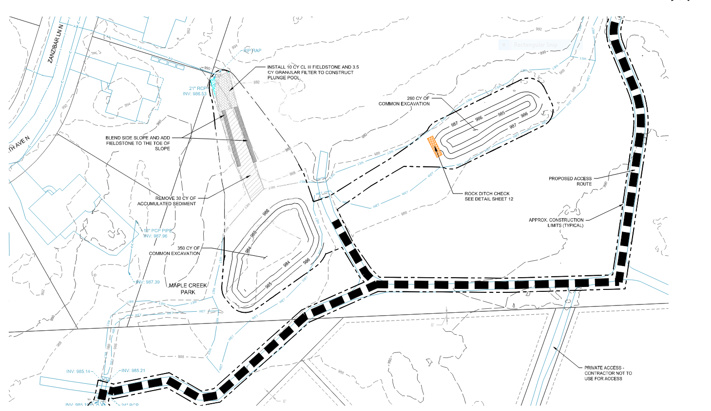
Creek Excavation & Erosion Repairs

Slide 12
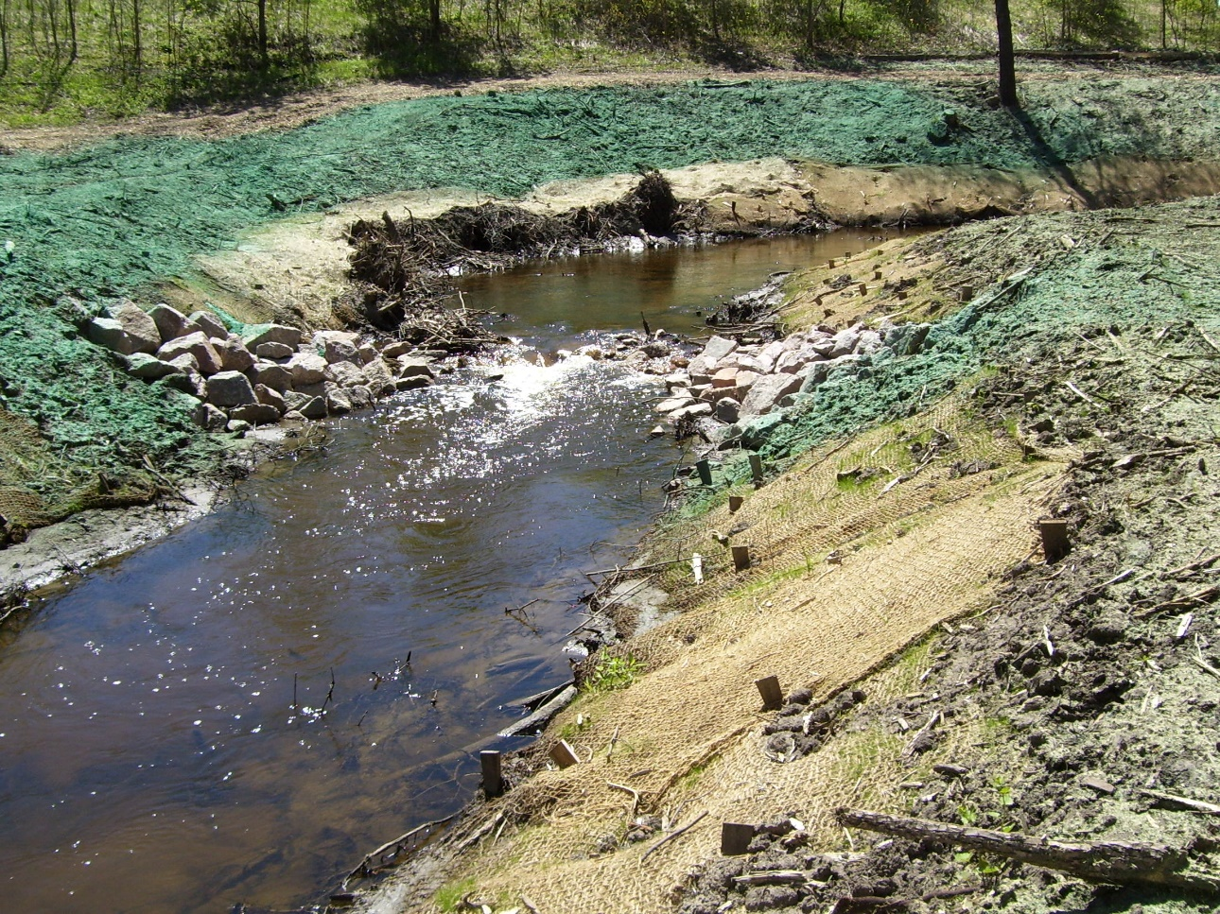
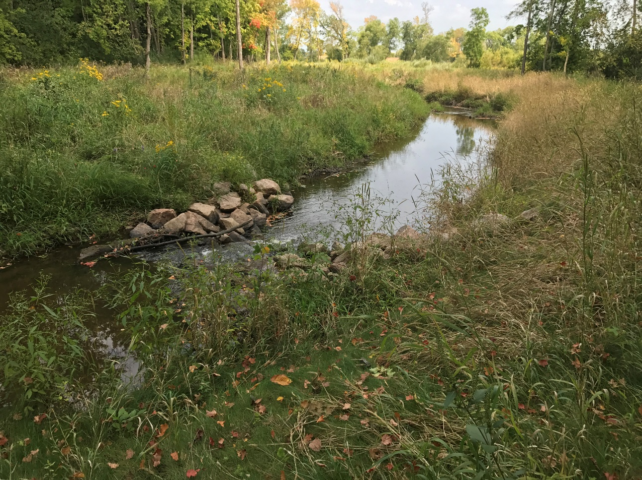
Channel Erosion Repair

Slide 13
Project Improvements
The proposed improvements of the project are:
  Pond Dredging
  Iron Enhanced Sand Filter Installation
  Trail Realignment
  Stream Channel Erosion Repair
  Wetland Restoration
  Storm Sewer Outlet Maintenance
  Revegetation with native grasses and flowers
Pond Expansion, Iron Enhanced Sand Filter & Trail Realignment
Channel Restoration
Wetland Restoration & Storm sewer outlet maintenance
Notes:
This map shows the project limits for the reconstruction project. The highlighted streets are those proposed for reconstruction.

Slide 14
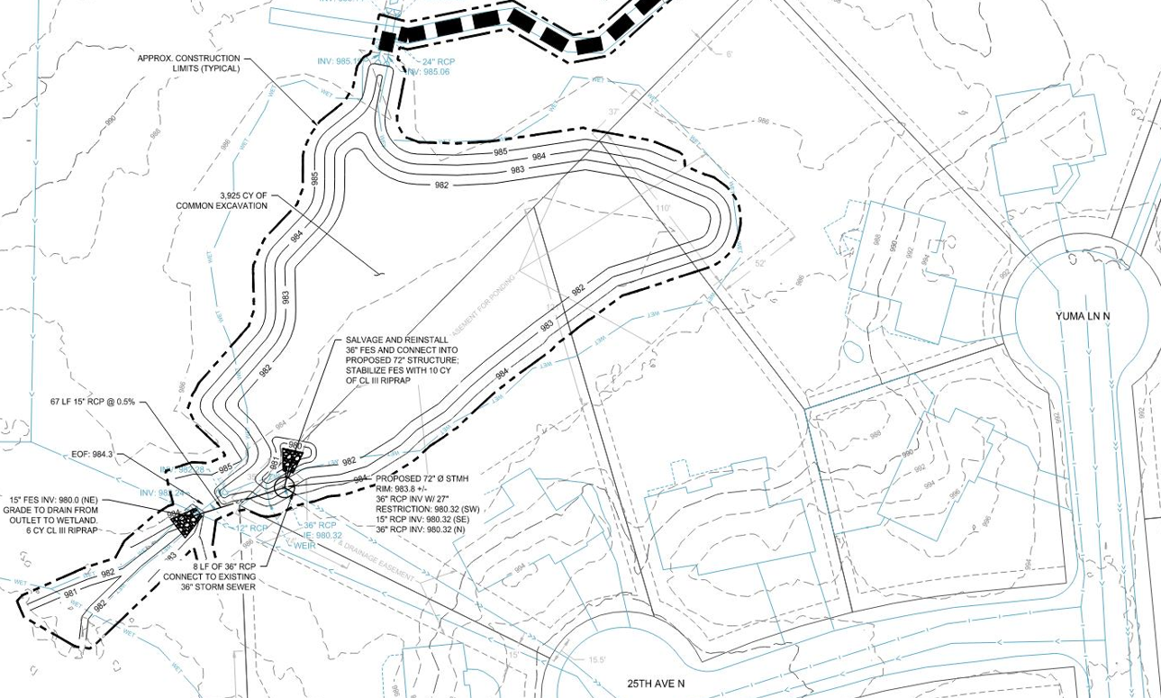
Wetland Restoration & Weir Repair

Slide 15
Project Improvements
The proposed improvements of the project are:
  Pond Dredging
  Iron Enhanced Sand Filter Installation
  Trail Realignment
  Stream Channel Erosion Repair
  Wetland Restoration
  Storm Sewer Outlet Maintenance
  Revegetation with native grasses and flowers
Pond Expansion, Iron Enhanced Sand Filter & Trail Realignment
Channel Restoration
Wetland Restoration & Storm sewer outlet maintenance
Notes:
This map shows the project limits for the reconstruction project. The highlighted streets are those proposed for reconstruction.

Slide 16
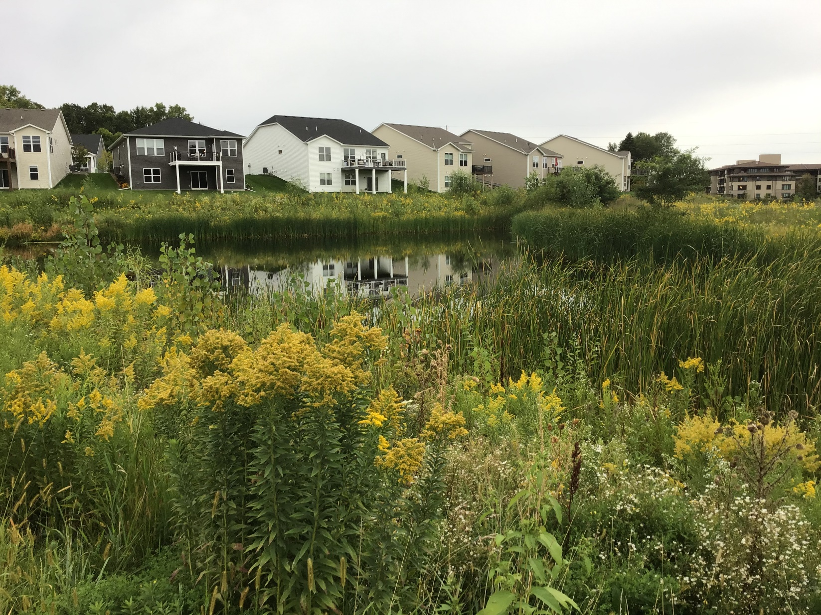
Wetland Restoration

Slide 17
Estimated Project Schedule
Informational Meeting……………. October 25, 2021
Plans Completed…………………….. November 2021
Bidding of Project…………………….November 2021
Award Contract………………………. December 2021
Construction
  Begin Construction December 2021 / January 2022
  Substantial Completion March 2022
  Final Completion Early Summer 2022
Notes:
Working on design now
Incorporate feedback from meeting into 90% draft plans
90% draft plans will give a good idea of impacts
Meet with residents
Incorporate feedback

Slide 18
Questions or Comments?
  Ben Scharenbroich, Water Resources Supervisor
    bscharenbroich@plymouthmn.gov
    (763) 509-5527
  Chris McKenzie, PE, Engineering Services Manager
    cmckenzie@plymouthmn.gov
    (763) 509-5513
Notes:
Take questions.
Staff will stick around if you want to ask questions in person or point out areas of concern.

