Slide 1
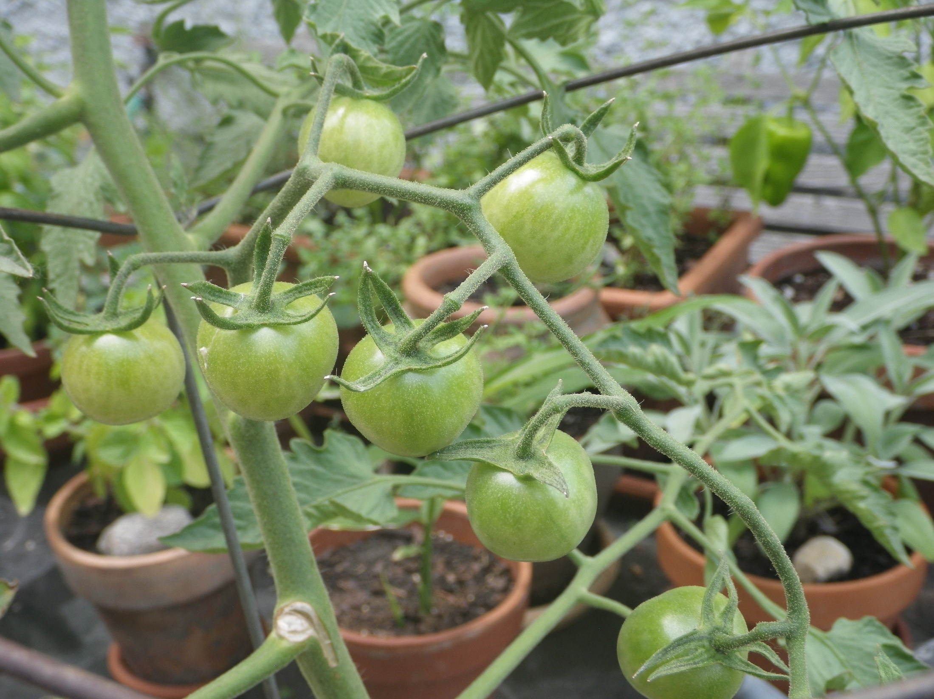
Anyone Can Grow Food
An Herb and Vegetable Primer
Tuesday August 3rd 7:00 pm
Sarah Lindblom, Solar Fresh Produce CSA

Slide 2
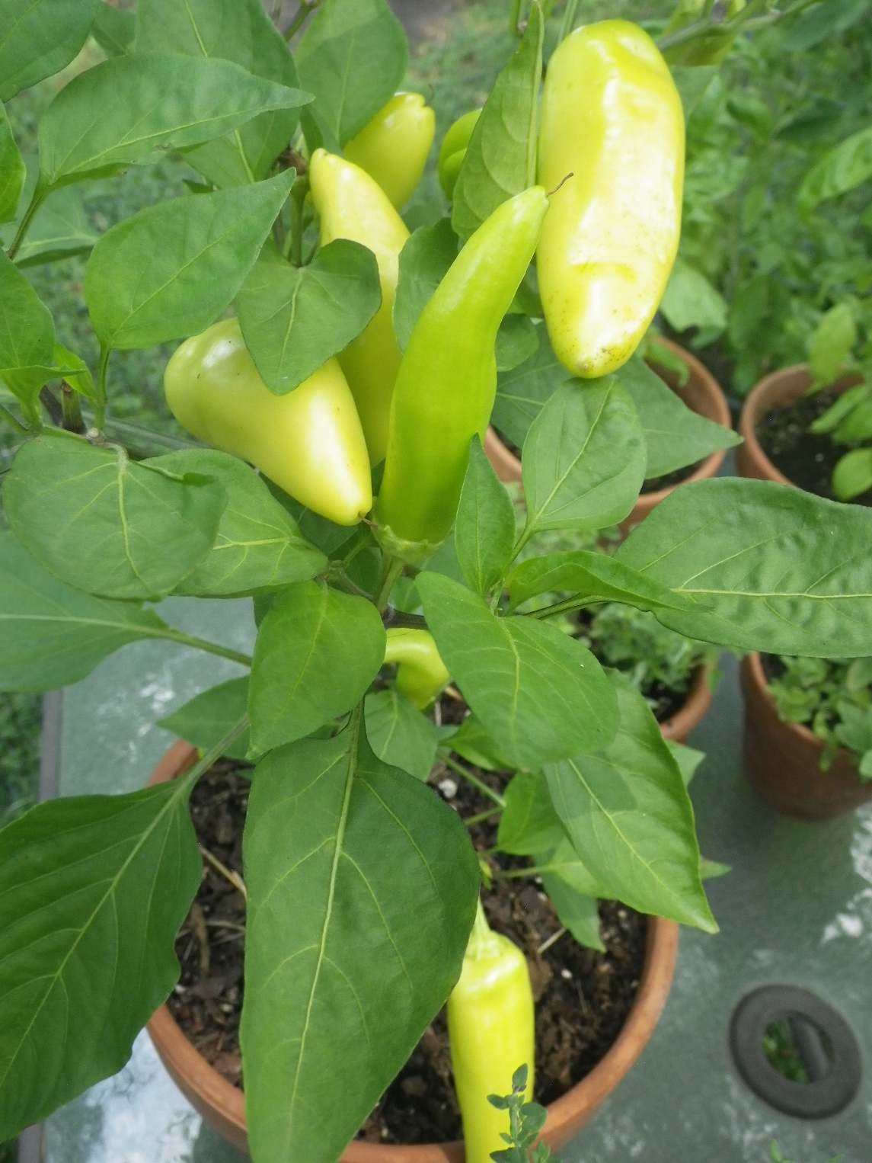
Agenda
Getting Started
  Materials
  Location
  Plant Varieties
Maintenance
  Patio Garden Ecosystem
  Watering

Slide 3
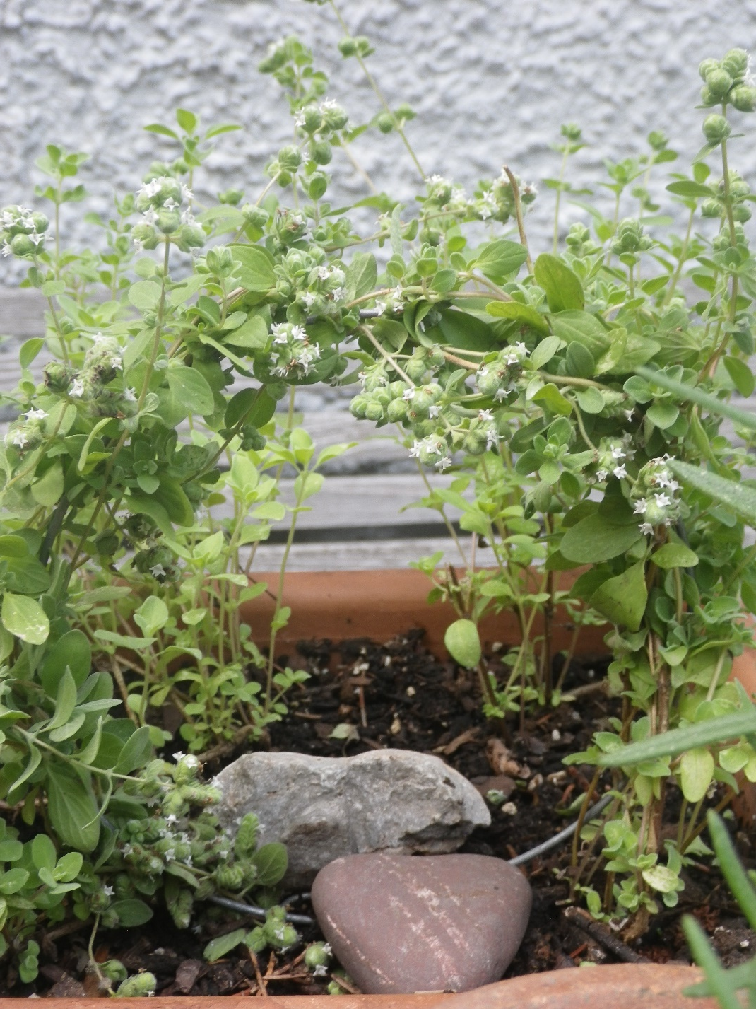
Getting Started
Materials:
Potting Mix
Pots and saucers
Watering Can
Seeds and plants
Fertilizer (compost)
Trellis material
Plant labels
Decorations
Location:
5-8 hours sun
Near a kitchen or patio or balcony
Near a water source
Grouped together
Somewhere you walk past each day

Slide 4
Getting Started
Choose varieties you enjoy eating
Start small and add more as you go
Planter pot size (or garden square footage) depends on size of plant
Use containers or buckets with drainage holes mixed with decorative pots
Smaller pots dry out faster
Small | Medium | Large
Annual Herbs- Basil, thyme, marjoram, parsley | Peppers or eggplant | Tomatoes
Lettuce | Annual flowers | Potatoes
Peas or beans | Perennial herbs (rosemary, sage, thyme) | Broccoli or cabbage
Annual flowers | Cucumbers
Spinach | Kale or Swiss chard
 | Strawberries

Slide 5
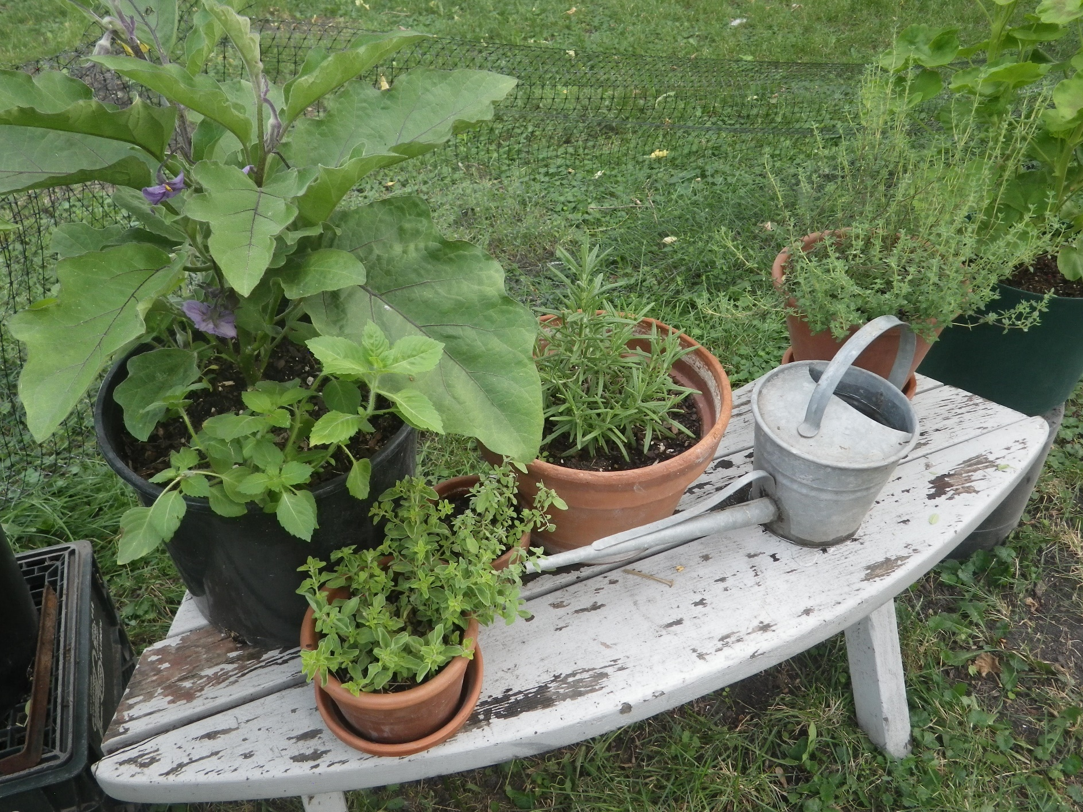
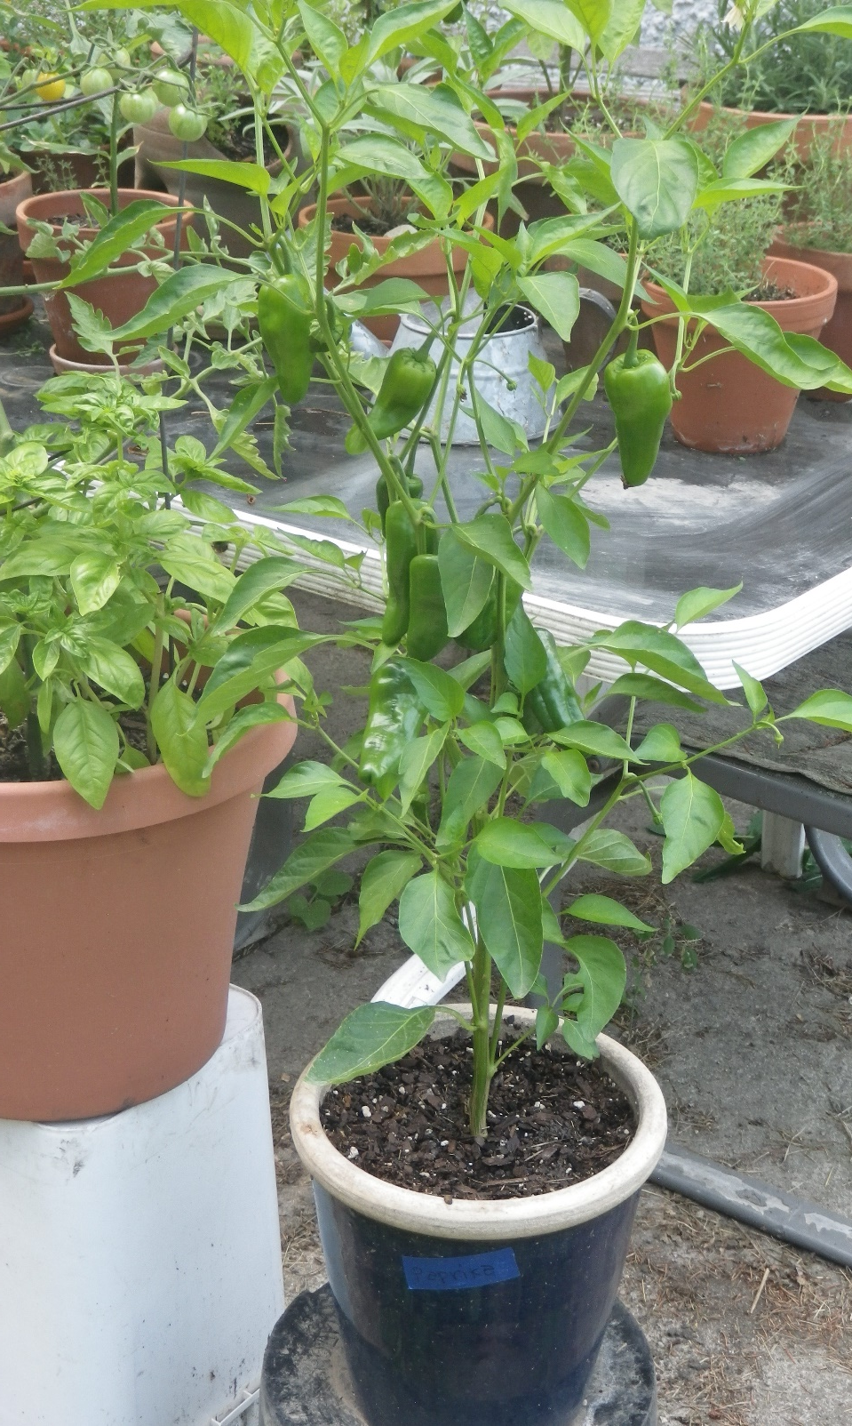

Slide 6
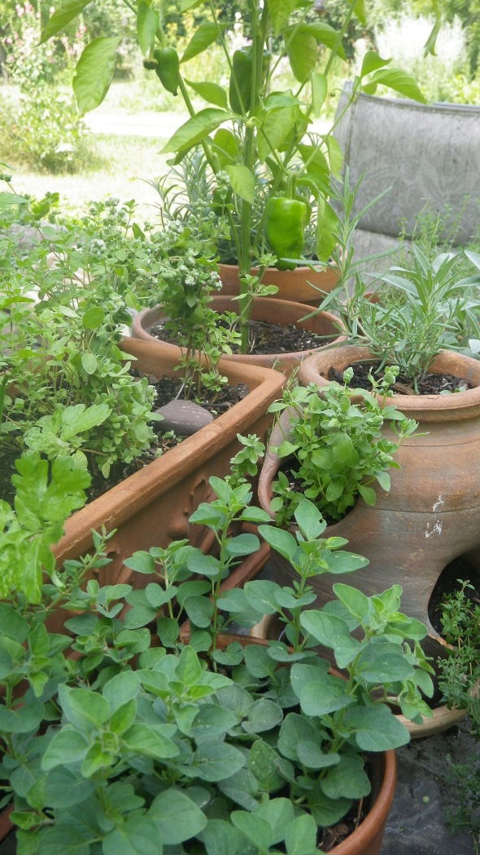
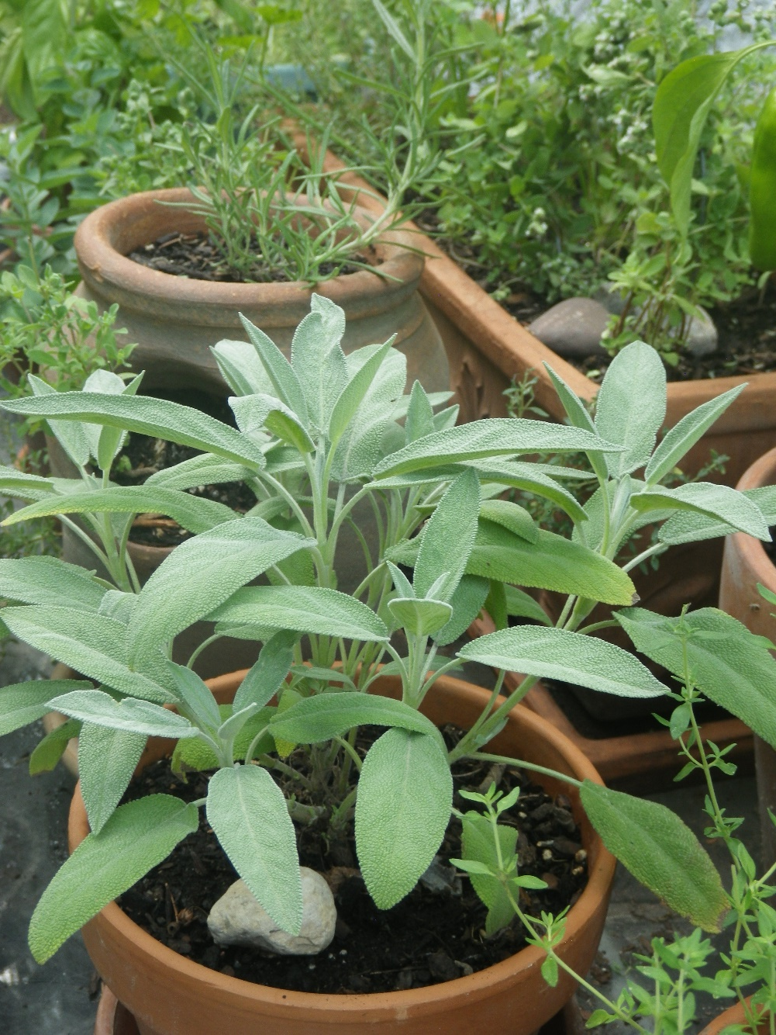
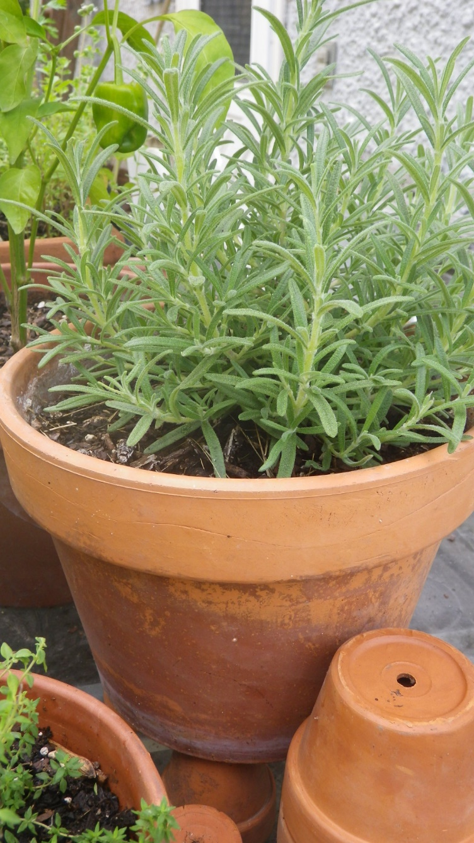
Herbs: A Good Place to Start

Slide 7
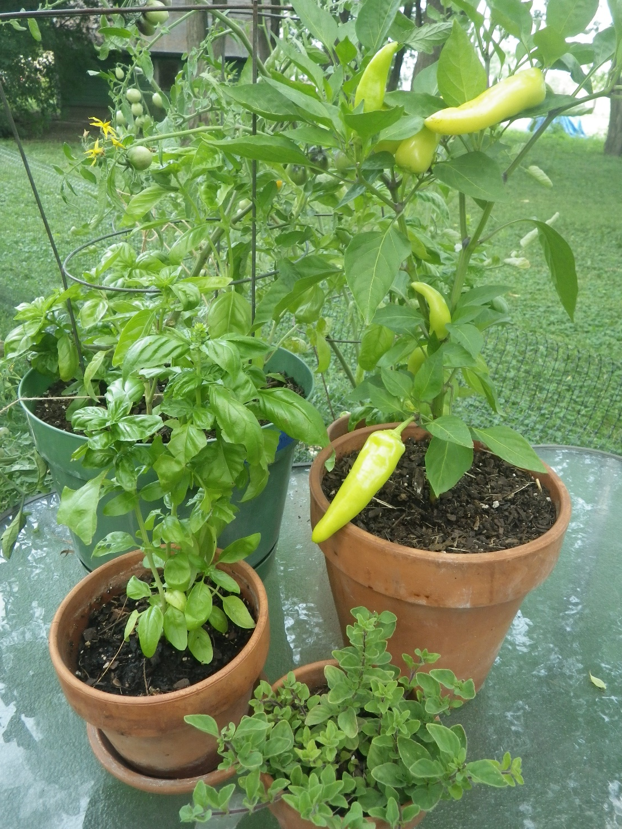
Patio Garden Ecosystem
Combine different types of herbs, vegetables and flowers
Think of the patio garden as a pet– it needs food, water, fertility, and attention daily
Rotate pots around as plants change and grow to get more sun
Leave a pollinator water source (Shallow dish with water and pebbles) to attract beneficial insects
Use Observations to make changes and updates
Frequent picking of herbs and fruits encourages more growth
Pick herbs before they flower

Slide 8
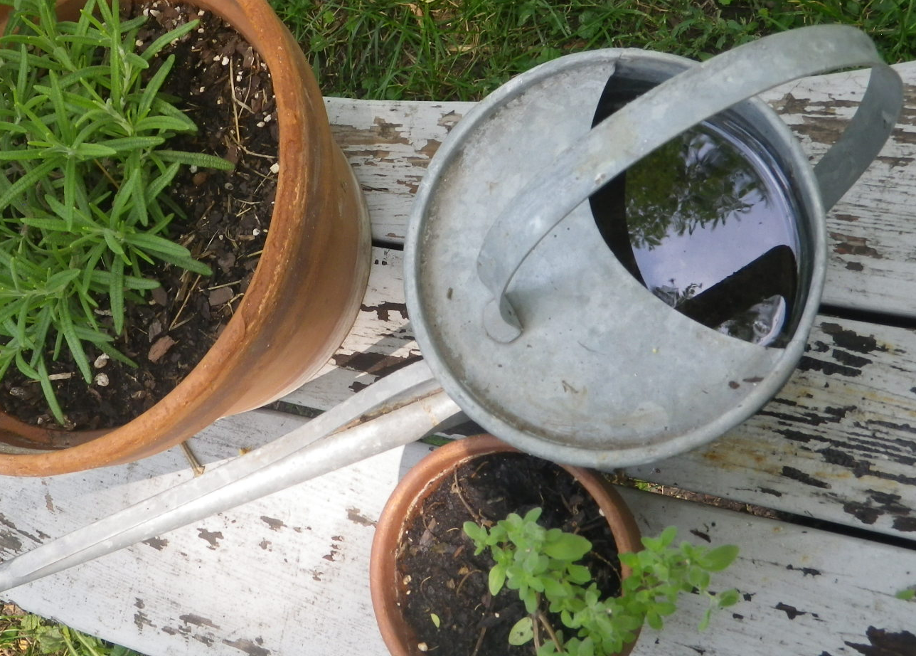
A Note on Watering
Watering depends on temperature and humidity
Check moisture levels daily
Dark containers dry out faster
Keep watering can full for quick watering
Water in the morning or evening

Slide 9
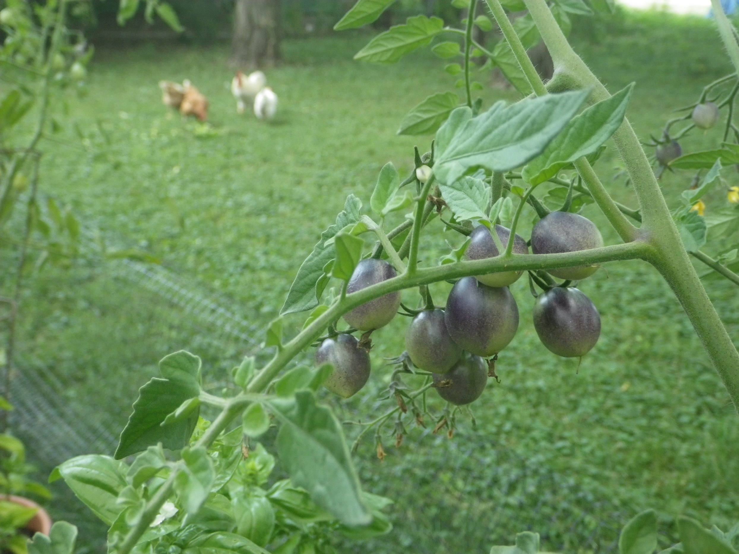
Questions?

